Slide 1
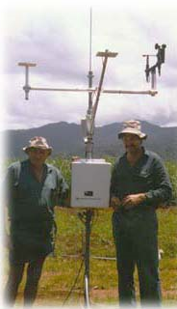
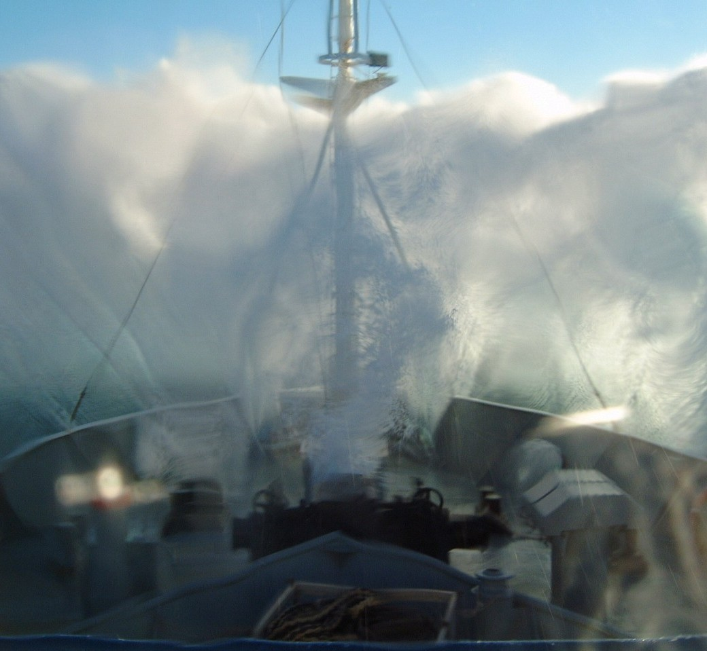
Lesson 2:
Common Sensors and Measurements Systems
If only it were this simple!
Notes:
Facilitator Notes:
Main Point:
We will be discussing how the various measurements are made and showing examples of the types of sensors currently in use.
Mention of a specific manufacturer or design is not an endorsement.
Feel free to ask questions at any time.

Slide 2
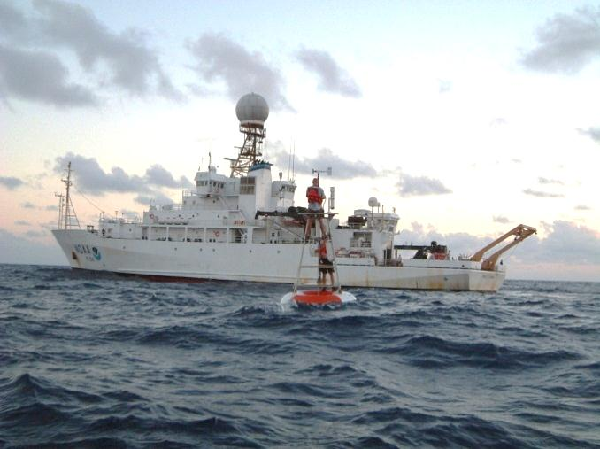
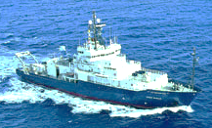
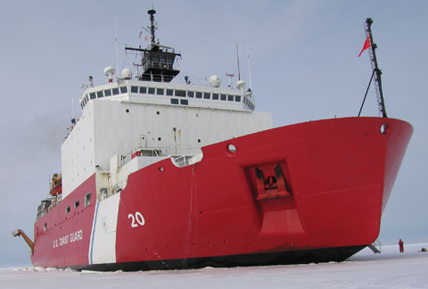
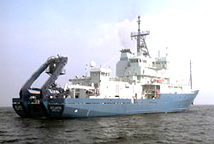
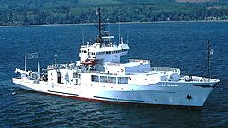
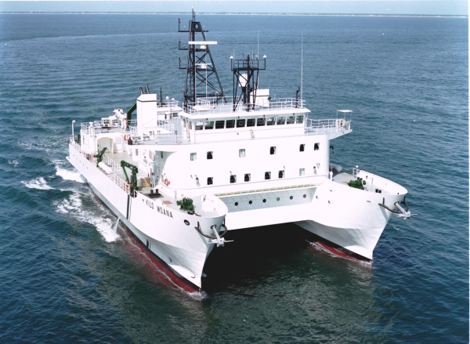
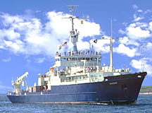
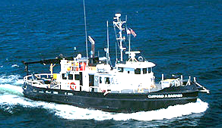
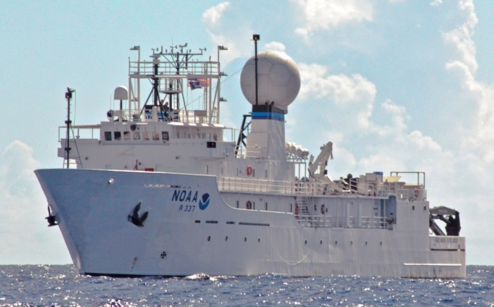
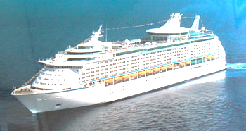
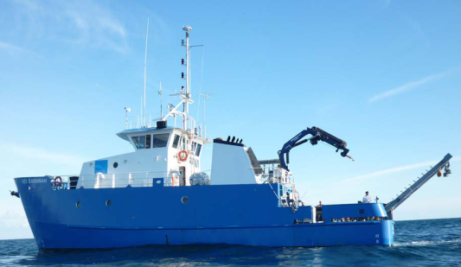
Brown
Revelle
Healy
Atlantis
Thompson
Kilo Moana
Knorr
Clifford A Barnes
Okeanos Explorer
Explorer of the Seas
Savannah
Notes:
Facilitator Notes:
Just as there are many different shapes and sizes of ships, there are many different types and styles of meteorological sensors you can mount on these ships to take measurements.
Direct vs indirect measurements
Most measurements require a conversion from engineering units (volts, resistance, capacitance) to SI units. This is direct measurement.
Other times, you may measure another parameter, such as a radiance, and apply an empirical relationship to obtain a rain rate, as you will see later. This is indirect measurement.

Slide 3
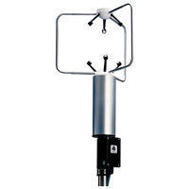
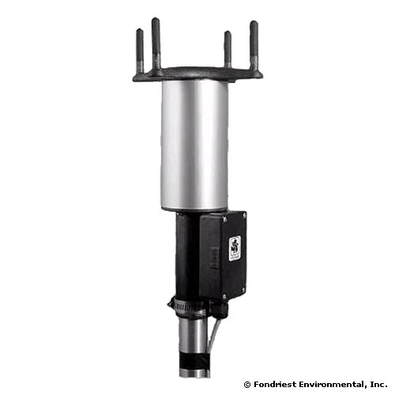
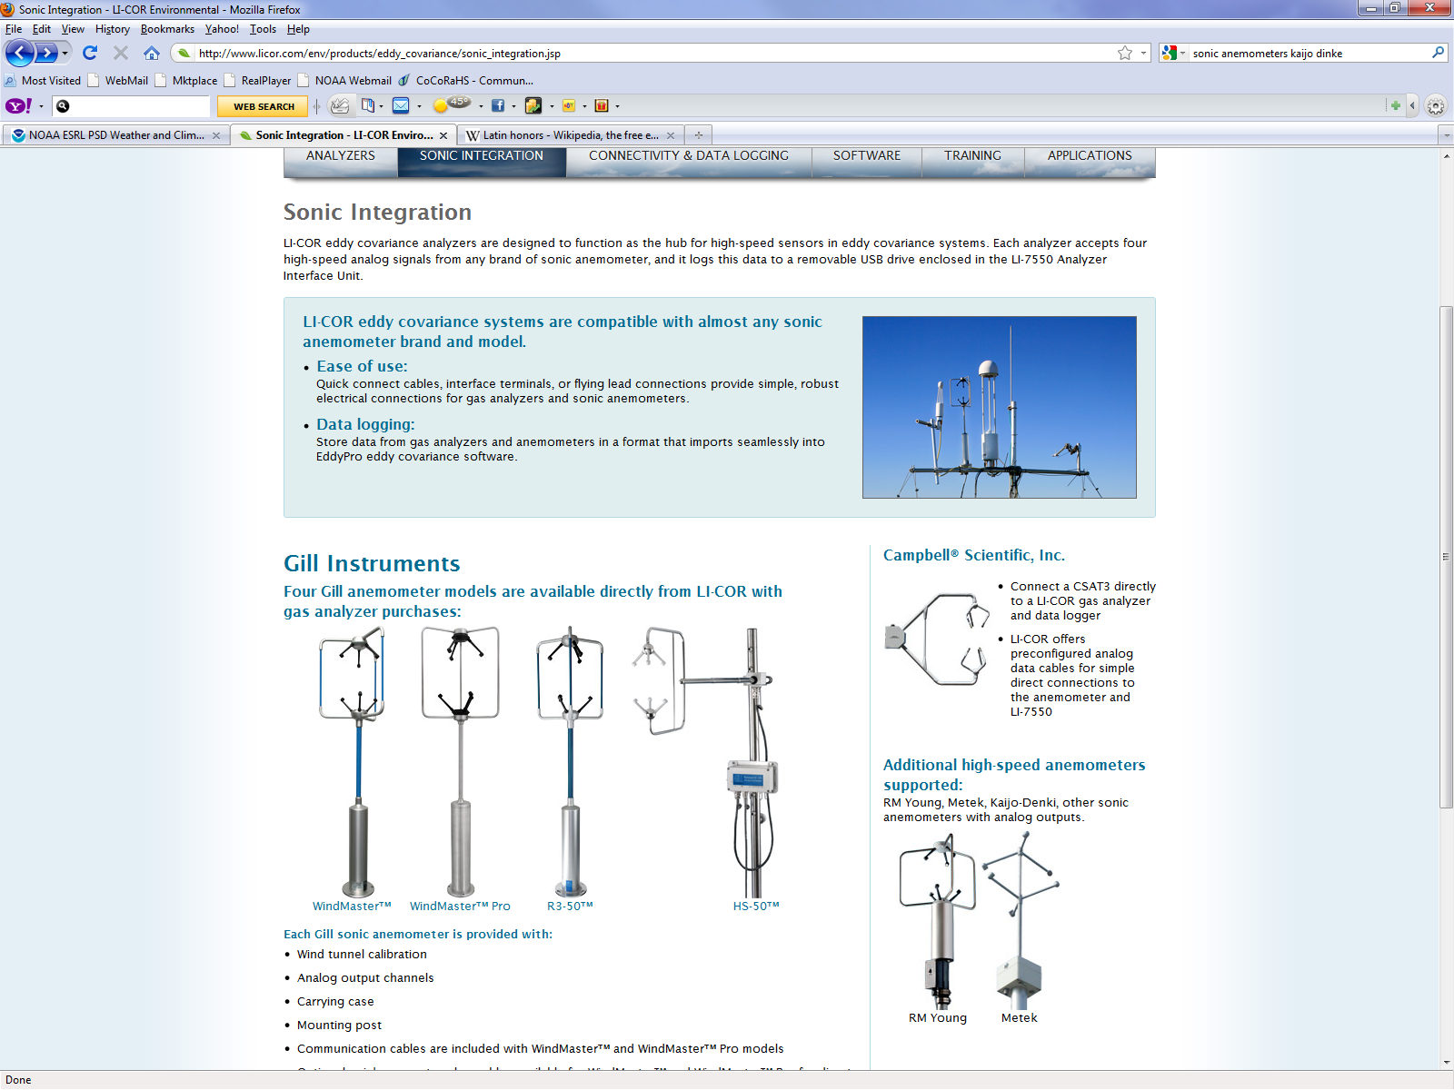
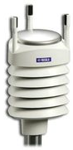
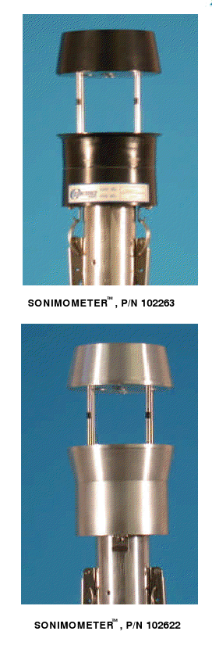
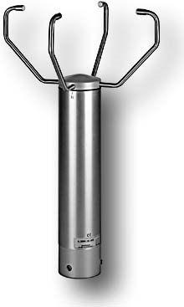
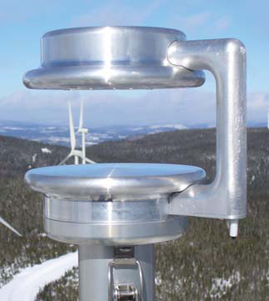



Sonic Anemometers
Notes:
Facilitator Notes:
Only a few of the different types of sonic anemometers

Slide 4
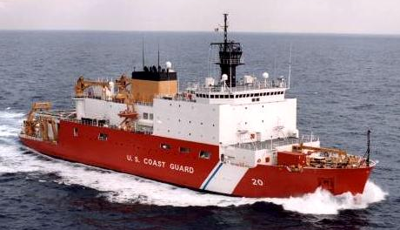
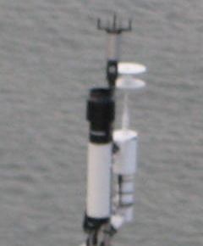
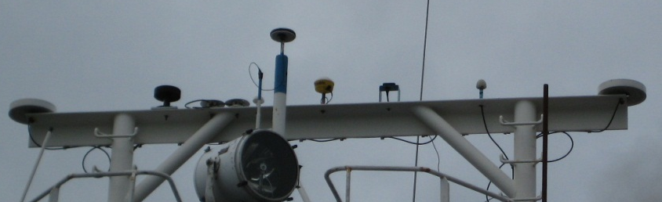
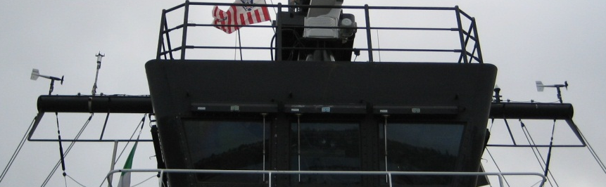
HEALY 2008
Main Mast
Forward Mast
PSP and PIR radiometers
Ultra Sonic & Prop-Vane (stbd)
Prop-Vane (port)
Ultra Sonic, T/RH/P
Notes:
Facilitator Notes:
Healy has two different types of wind sensors; some are used and maintained by the science side and others are used and maintained by the ship (navigation/bridge.)

Slide 5
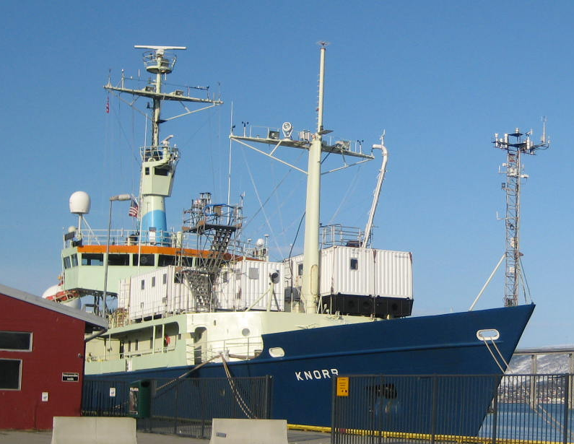
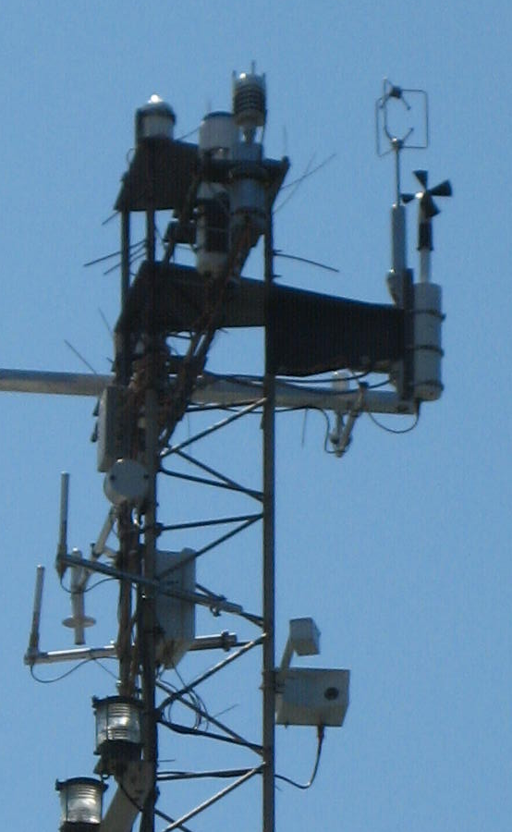
WXT, Prop-Vane,
IMET
ICEALOT 2008
Notes:
Facilitator Notes:
2 sonics and 1 prop-vane. The prop-vane and WXT sonic belonged to the ship.

Slide 6
Wind speed and direction
Air temperature and humidity
Atmospheric pressure
Incoming short- and long-wave radiation
Rainfall
Sea surface temperature
Ship’s heading
Ship’s course over ground (COG)
Ship’s speed over ground (SOG)
Time (UTC)
Notes:
Facilitator Notes:
Again, just a reminder of the measurements we are focusing on.

Slide 7
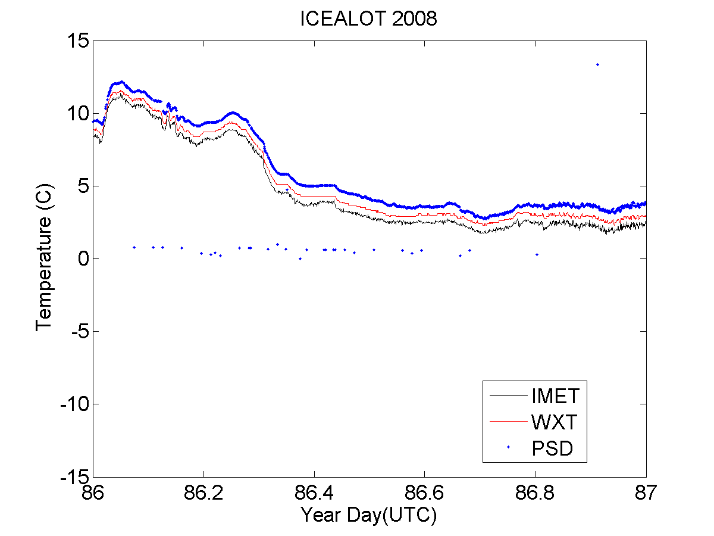
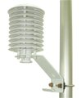
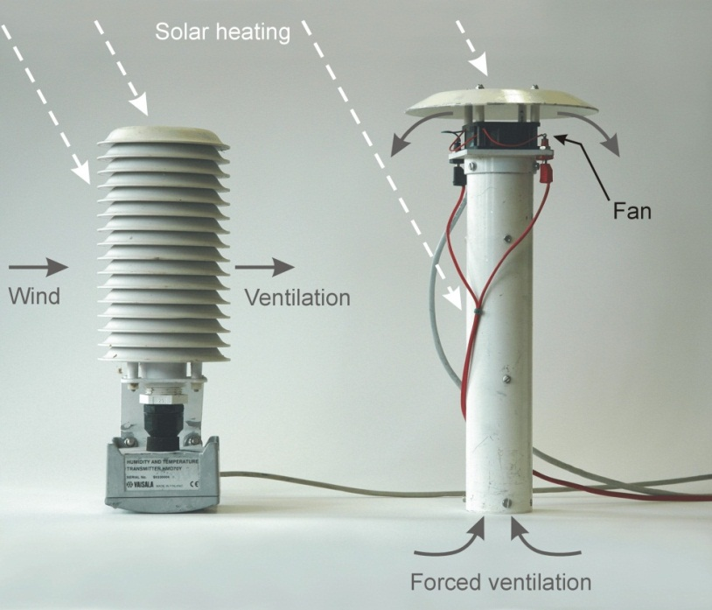
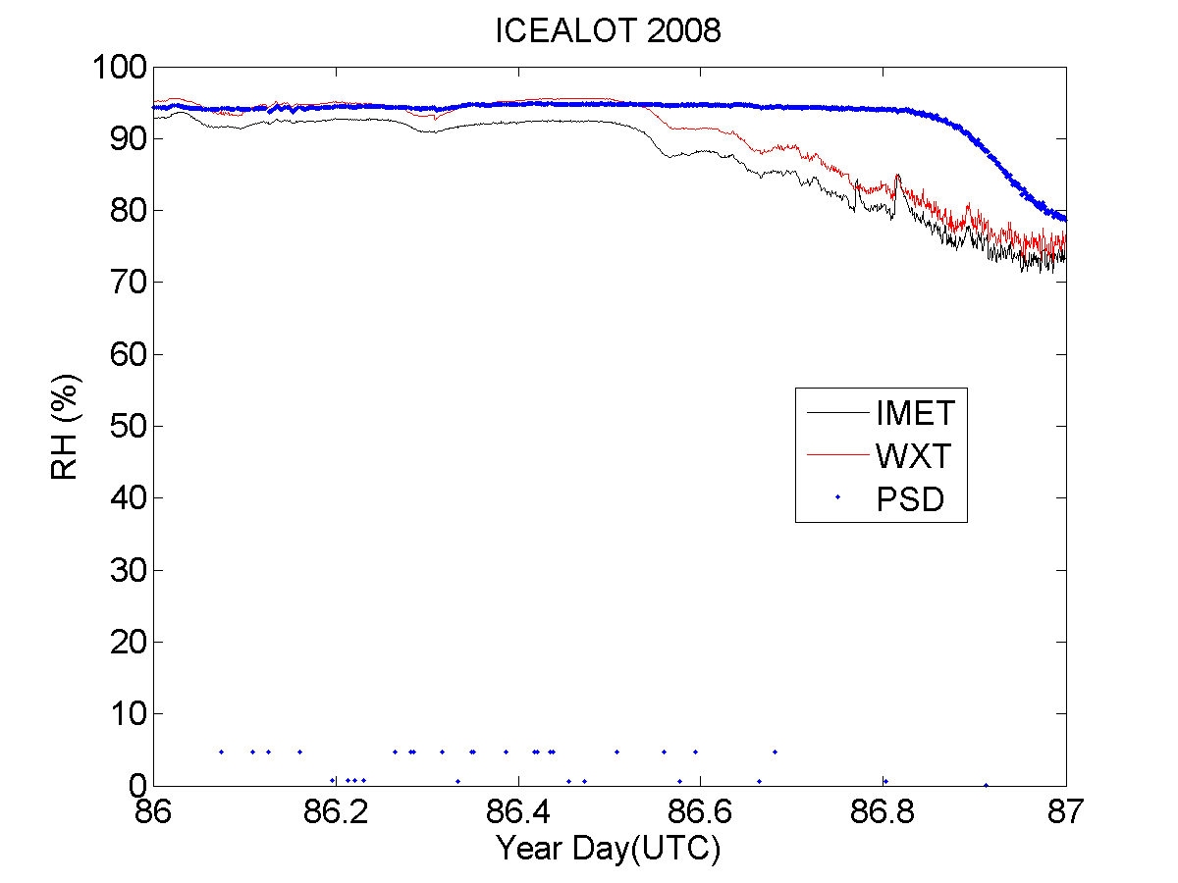
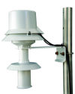
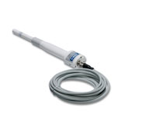
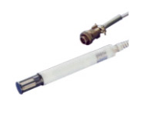
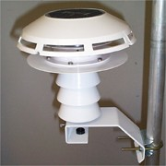
Air Temperature and Humidity
Notes:
Facilitator Notes:
Type of sensors:
Temp: thermistors (RTD), thermocouples del(R) = k* del(T)
RH: capacitance or resistance
The most usual causes of error in air temperature measurement are sources of anomalous heating: the sun and the ship.
Ventilation, whether natural (wind) or using a fan (aspirated), can limit anomalous heating.
The ship itself is a massive source of heat, and almost any location aft of the bow will measure air that has passed over some area of warm steel.
Thus, ship-relative wind direction is a critical part of the data record.
Most systems combine air temperature and humidity sensors in the same package, so they are subject to the same conditions of ventilation and screening from solar heating.
Indirect measurement (next slide)

Slide 8
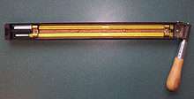
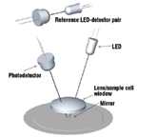
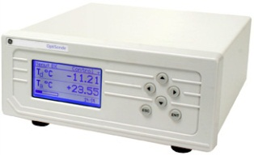
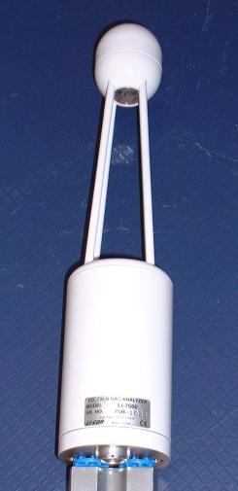
Indirect Measurement of Humidity
Psychrometer
(Wet/Dry Bulb)
Chilled Mirror
(Dew point)
LICOR 7500 gas analyzer
(Water vapor)
Notes:
Facilitator Notes:
Here are ways to indirectly measure RH.
All require formulas or tables to compute RH.
A psychrometer is often used as a reference when careful measurements are taken (well ventilated and at night).
A cool mirror is often used for very low humidity and is very accurate.
A gas analyzer uses changes in IR intensity across a given path.

Slide 9
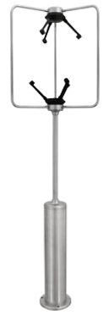
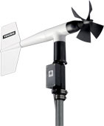
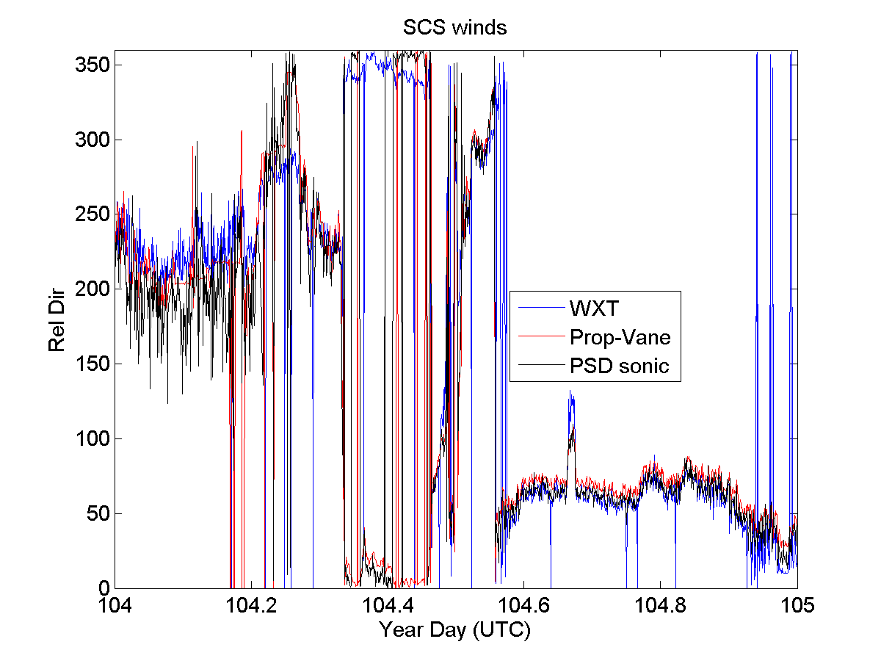
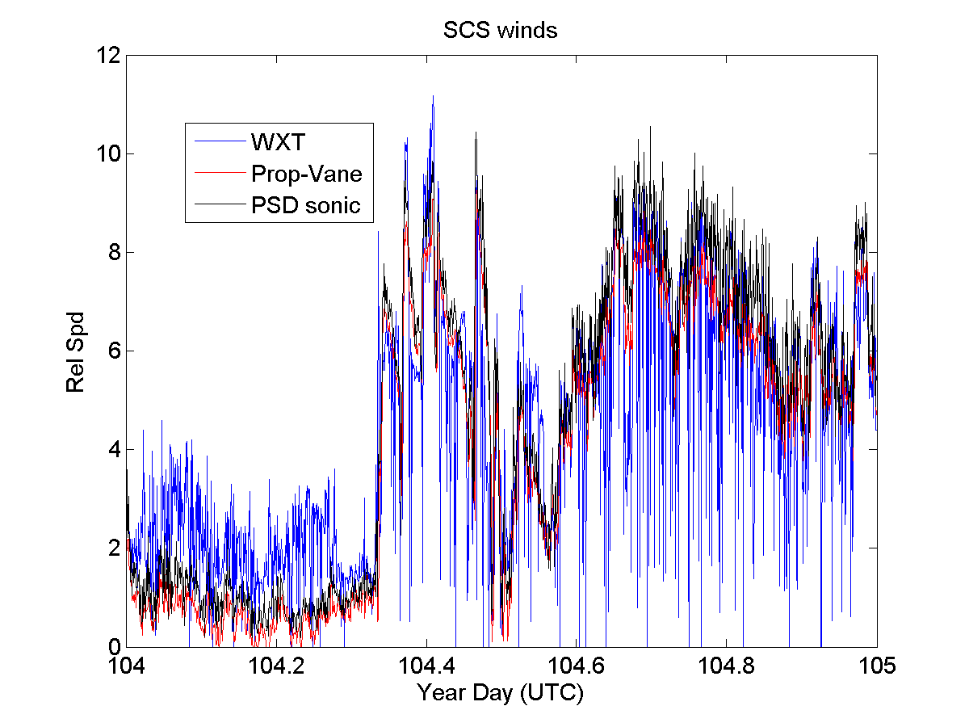
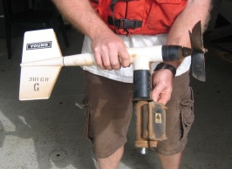
Wind Speed and Direction
Cup/Vane
Notes:
Facilitator Notes:
Bulk fluxes are directly proportional to the wind speed.
Wind speed and direction are taken together, partly because they are often both obtained from a single instrument, but also because they are measured relative to the ship and must be combined with the ship’s heading, course, and speed to arrive at the true wind vector, which will be covered in Lesson 4.
The demands on accuracy of the ship’s velocity are therefore equivalent to those of the anemometer measurement, a fact not always appreciated.
It is thus necessary to record the ship’s navigational data stream together with the meteorological data, and to document whatever information is available on the accuracy of the various components.
The appropriate wind speed to use in bulk flux algorithms is that relative to the ocean surface (i.e., taking account of the surface current).
This introduces another source of uncertainty because the water velocity at the interface itself is very seldom measured. There are two ways in which conversion from relative to true wind can take some account of the surface velocity: by combining the ship motion in Earth coordinates (e.g., from GPS) with currents from the ship’s ADCP, or by using the Döppler-log/gyro, which measures the ship’s motion through the water. Data reports should indicate which method has been used; both incur additional sources of instrumental error, and furthermore the measured currents are at considerable depth (of order 10 m). Fortunately, in many cases current is a small fraction of the wind speed, so its contribution to the error is also small, but in light winds it can be significant.

Slide 10
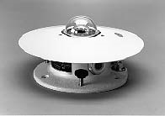
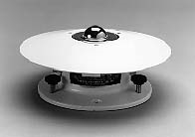
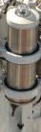
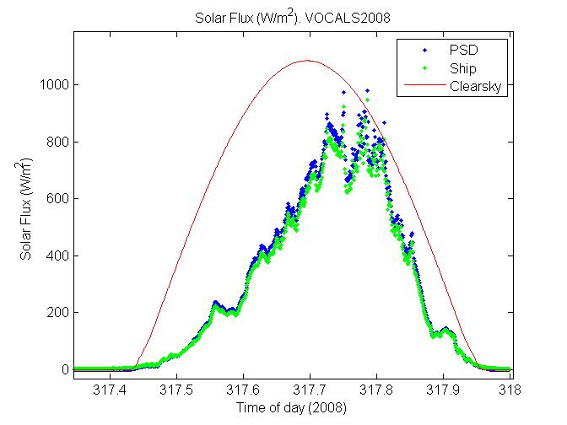
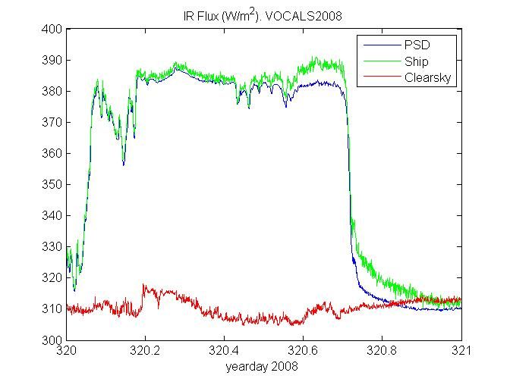
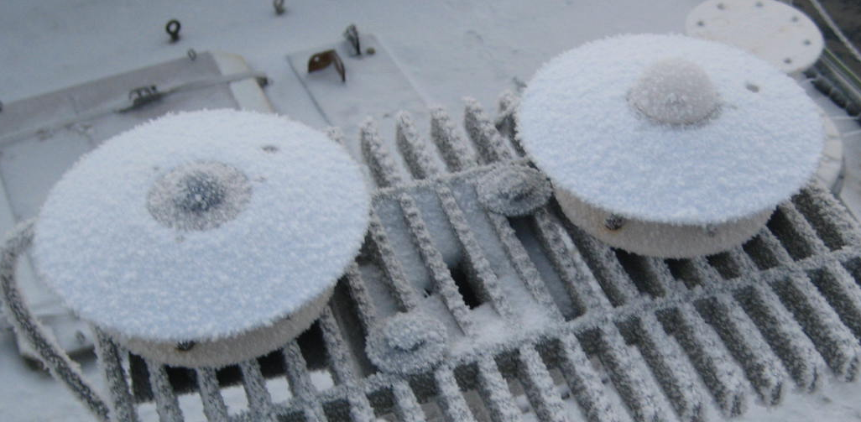
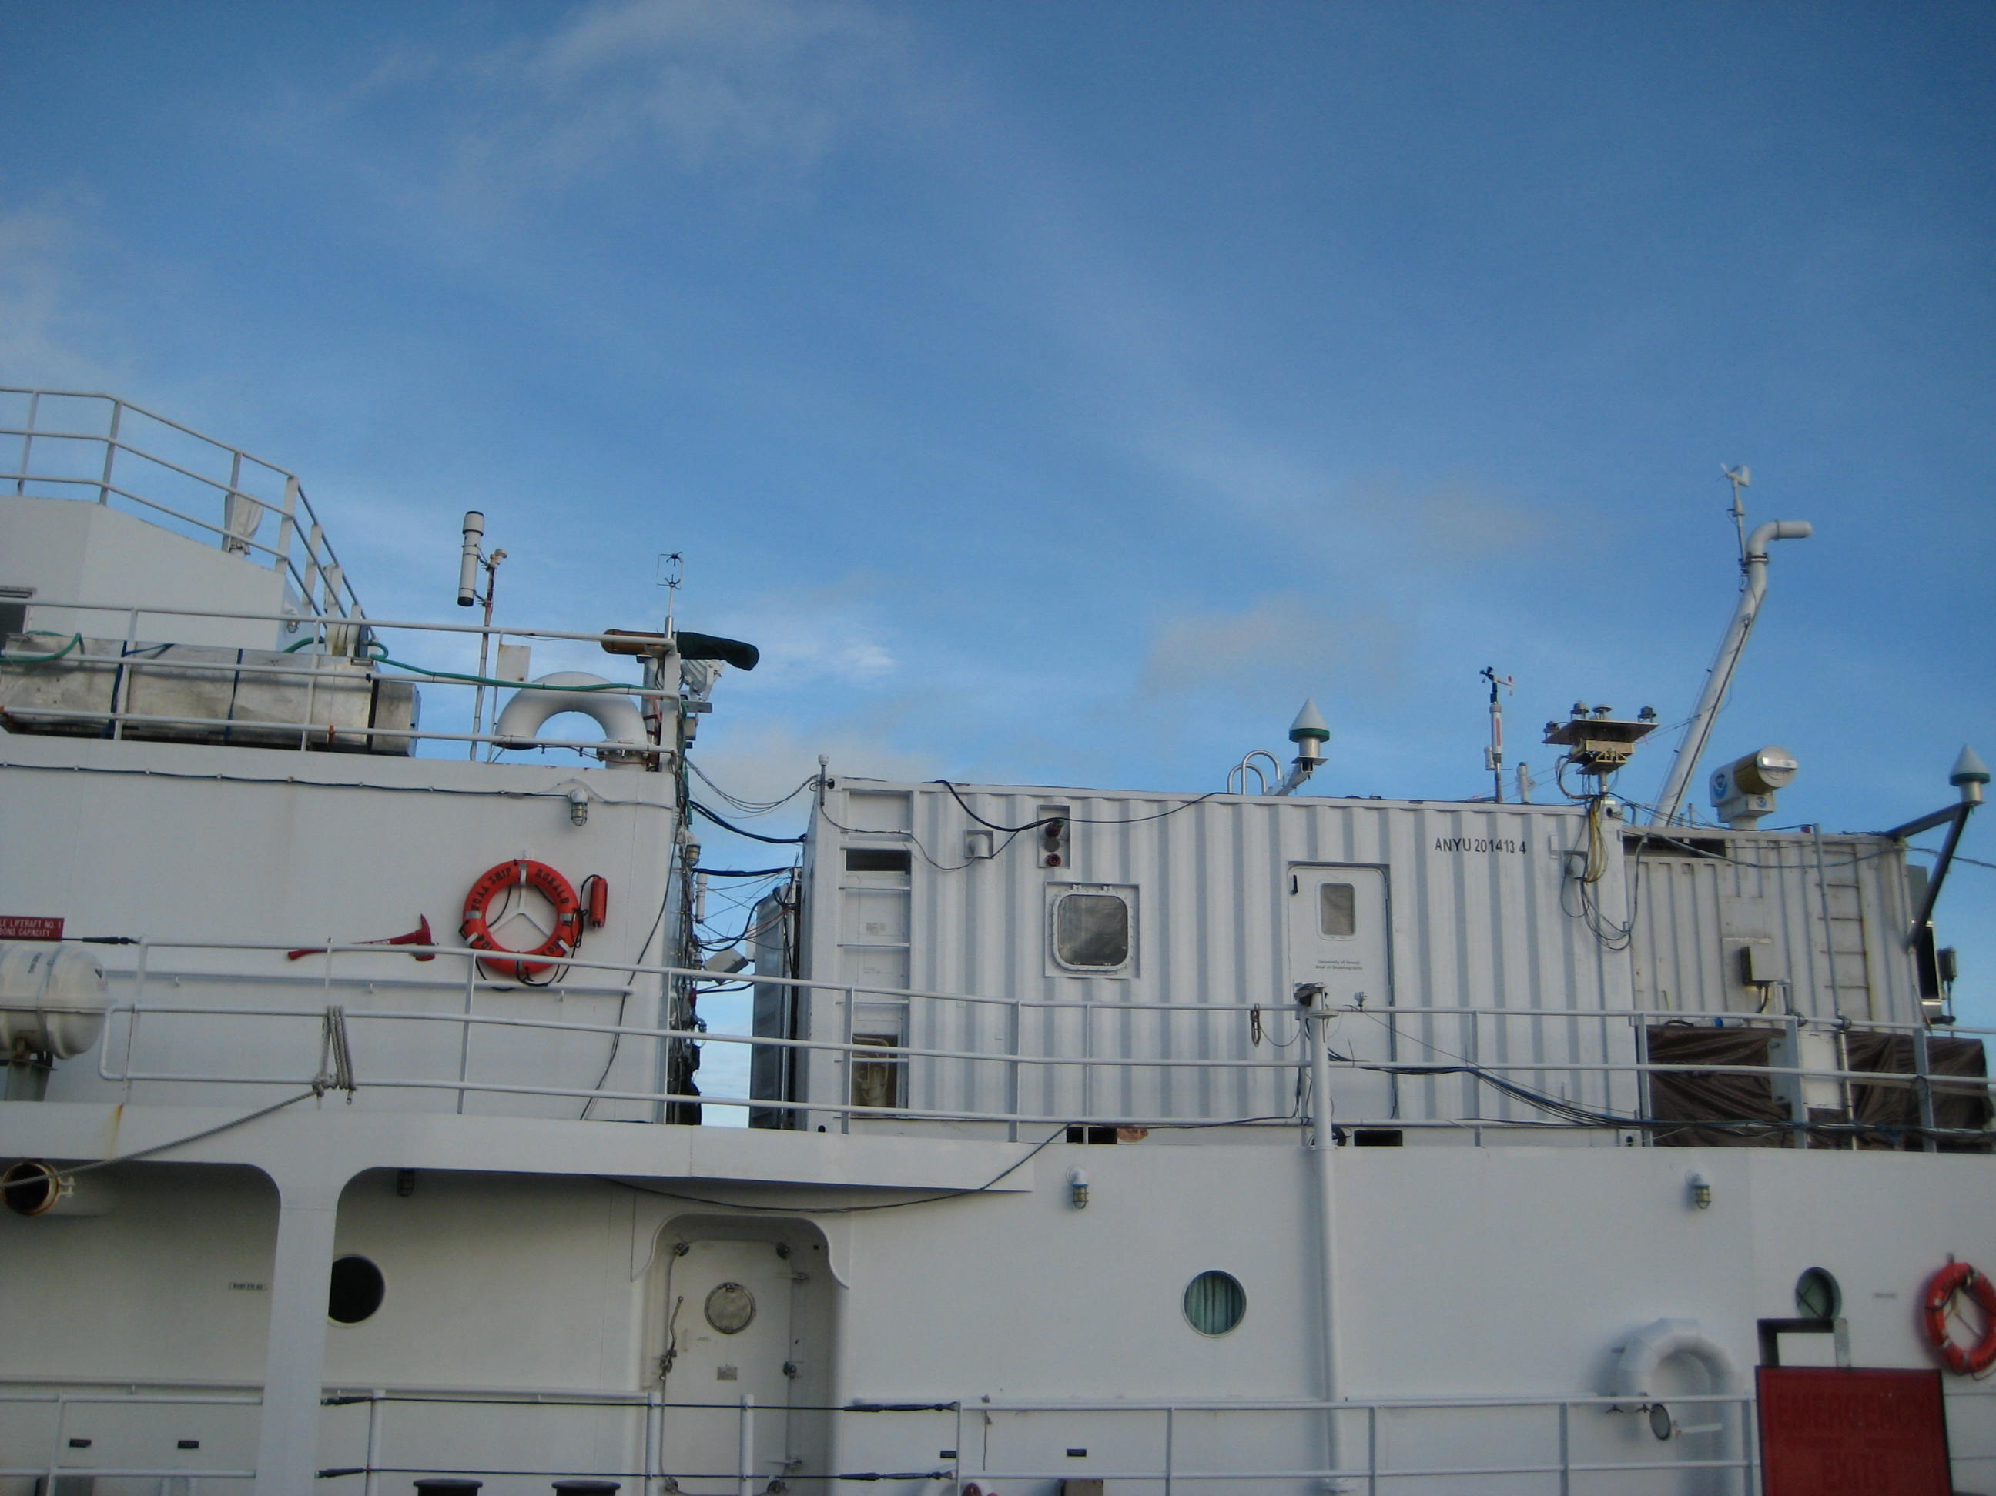
Incoming Shortwave and Longwave Radiation
SW
LW
Notes:
Facilitator Notes:
Left Pyranometer: broadband solar irradiance on a planar surface 300 to 2,800 nm; direct and diffuse;
radiation varies with the cosine of the angle of incidence.
Right Pyrgeometer: atmospheric infra-red radiation spectrum that extends from approximately 4.5 µm to 100 µm.
Bottom right The stabilized platform is designed to keep radiometers level, but if it is not working properly it can introduce its own errors.
Bulk calculations use the net radiative fluxes (R_{s↓}- R_{s↑}) and (R_{l↓}‑ R_{l↑}) as do models of the oceanic mixed layer temperature profile and estimations of SST. For these reasons radiation measurements are increasingly becoming routine aboard ships and moorings.

Slide 11



Direct Diffuse
Pyroheliometer
Rotating Shadowband
PHOTOSYNTHETICALLY ACTIVE RADIATION (PAR)
Notes:
Facilitator Notes:
Pyroheliometer: measures direct incoming SW radiation and requires tracking the sun.
Rotating Shadowband: measures diffuse (reflected) SW radiation. Normally tracks the sun, but “rotating band” allows for a pitching and rolling ship.
Photosynthetically Active Radiation (PAR) measurements cover the spectra band that photosynthetic organisms are sensitive to and are used to calculate the euphotic depth in the ocean.

Slide 12



Rainfall
(direct)
Siphon
Hasse et al., 1998
Notes:
Facilitator Notes:
Direct measure accumulation
Rainfall, particularly during convective storms, is perhaps the “patchiest” of all meteorological variables. Single point measurements from ships and buoys are generally less relevant for climate models than area-averaged values or spatial characteristics. Nevertheless, accurate point measurements over the ocean are invaluable for validating satellites and radar that do obtain spatial rainfall patterns, but must be calibrated against ground truth. Currently such validation is mostly obtained from rain gauges located on islands and atolls, which have been found to distort the rainfall field.
The main problem is error due to wind flow distortion that can lead to underestimation, depending on the location of the gauge.
The problem has been studied, using an array of gauges distributed around the ship, and correction schemes have been devised that can improve the accuracy of rain measurement, to within 10-15%, as shown in Figure 2.3 (in Bradley and Fairall, 2006). Operationally, it is important to ensure the rain gage is well exposed and near the location where relative wind speed and direction are recorded. A well-positioned gauge adjacent to a wind instrument is better than several gauges scattered around the ship. The range of rain rates observed, from drizzle registering less than 1 mmhr⁻¹ to tropical storms producing 200 mmh⁻¹ (often accompanied by strong winds) also presents challenges for rain gauge design.
The net air-sea heat flux includes a component of sensible heat from rainfall. Examples include warm rain in Hawaii and the cold drops felt from midwest storms even in the middle of summer.
Over extended periods, the contribution is small, but during heavy storms it can be several hundred Wm⁻².

Slide 13


Rainfall
(Indirect)
Disdrometer
Optical
Rain rate
Rain accumulation
Notes:
Facilitator Notes:
Indirect measure
Disdrometer: used to measure the drop size distribution and velocity of falling hydrometeors. Some disdrometers can distinguish between rain, graupel, and hail.
Optical sensors: falling rain causes beam intensity variations in the infrared light as the rain passes through the beam. These irregularities, known as scintillation, have characteristic patterns, which are detected by the sensor and converted to rain rate.
WXT: uses intensity of impact to compute volume and then rain rate.

Slide 14
Rainfall Measuring Instruments Used Aboard Ships and Moorings
Siphon rain gauge
+ Volumetric – direct calibration
- Distorts wind flow
- Funnel can clog with debris or guano
- Misses catch when siphoning
- Evaporation loss at low rain rates
- Affected by ship motion
Optical rain gauge (ORG)
+ Open path, less wind distortion
+ Sensitive to low rain rates
- Requires calibration
- Uncertain directional response
Notes:
Facilitator Notes:
Pros (+) and Cons (-)

Slide 15






Atmospheric Pressure
Quad-Disk Pressure Port
minimizes dynamic pressure errors due to wind
Static Pressure Head
Notes:
Facilitator Notes:
Pressure is one of the state variables that define the thermodynamic properties of the atmosphere.
In boundary layer and climate studies, pressure most commonly appears in the calculation of dry and moist air density (needed for air-sea flux calculation) and in humidity conversions; it also appears in the psychrometer equation.
Most weather stations house their barometric pressure sensor within the weather station display console. Therefore, placement of the weather station console receiver is an important consideration since the physical environment of the console will influence air pressure measurement readings. If possible, install the console at an indoor location where the temperature is as constant as practical (i.e., not affected by vessel heating, drafts, or the sun). Because the pressure is the weight of the atmosphere above the sensor, the pressure port is the true height of the pressure sensor.
Rule of thumb is that 1 mb = 10 m change in altitude
Bernouli Effect: Increased velocity = decreased pressure
Given two objects hanging side by side, increasing the flow between them will result in their coming together.

Slide 16






Sea Surface Temperature
Sea Chest
Hull
Notes:
Facilitator Notes:
Historically, sea surface temperature was understood to be the temperature measured from a ship by whatever means available and reported as SST irrespective of the depth of measurement. We now know that temperature in the ocean surface layer can vary with depth by an amount that is significant in the context of accurate bulk flux determination. It is the temperature of the sea-air interface itself that physically determines the magnitude of the turbulent heat fluxes and also the outward flux of longwave radiation. At the same time, these fluxes produce a cooling at the interface, the so-called “cool skin” of order 1 mm thick and typically a few tenths of °C.
In moderate to strong winds the water below the skin will be well mixed, and its “bulk” temperature will vary little in the vertical. During the day, however, penetration and absorption of solar radiation can produce a diurnal warm layer below the cool skin. Under clear skies and with light winds, as found in tropical oceans, this layer may be a few °C higher than in the bulk below. “Sea surface temperature” may thus vary with depth and for the purposes of flux calculation, the temperature value should always be accompanied by the depth at which it was measured (e.g., SST_{(d)} = 18.3º_{(4.5 m)}). The characteristics of the ocean surface mixed layer are discussed in Price et al. (1986), and the physics of the cool skin and diurnal warm layer is given in Fairall et al. (1996a).
Traditional bulk transfer coefficients have usually been determined using a bulk sea temperature. However, newer algorithms use transfer coefficients determined with respect to the interface value. The true interface temperature cannot be measured with present technology, but the measurement of an infrared radiometer (at a few μm depth) comes close, and is sometimes available from shipboard or satellite sensors. Also, models of both the cool skin and diurnal warm layer, which enable skin temperature to be estimated from a bulk measurement at known depth, are becoming more reliable.
The TOGA program specified an accuracy of ±0.3ºC for SST over a 2 x 2 degree region as a target for validation of space-borne radiometers (WCRP 1985). An error of 0.3ºC changes sensible and latent heat fluxes calculated with a bulk flux algorithm by 2 Wm⁻² and 10 Wm⁻² respectively, for typical climatic conditions in the tropics. The past decade has seen the development of several high-resolution infrared radiometers for shipboard deployment that achieve 0.1ºC accuracy.

Slide 17


Sea Surface Temperature
(IR)
Notes:
Facilitator Notes:
Renewed interest in remote IR and Microwave sensors
Indirect and Remote

Slide 18
TIME
Reference (UTC)
Synchronized (GPS)
between systems when necessary

Slide 19
Ship Motion
  Pitch, roll, yaw
  Accelerations
For mean quantities we believe that these motions are not critical, except during extreme conditions. Other factors that come into play are the flow distortion effects of the ship. There are also known effects caused by waves that are then dependent on the period and amplitude of the waves relative to the wind.
We use these for corrections to our higher frequency data used to calculate fluxes.
Notes:
Facilitator Notes:
Acceleration impacts on true wind calculation are addressed in Lesson 4.

Slide 20
For More Information
Hosom, D. S., R. A. Weller, R. E. Payne and K. E. Prada. The IMET (improved meteorology) ship and buoy systems. Journal of Atmospheric and Oceanic Technology 12:527-540. June 1995
Colbo, K., and R. A. Weller. The accuracy of the IMET sensor package. Journal of Atmospheric and Oceanic Technology, 26:1867-1890. September 2009
Bradley, E. F. and Fairall, C. W.: A guide to making climate quality meteorological and flux measurements at sea. NOAA Technical Memorandum OAR PSD-311. Earth System Research Laboratory, Physical Sciences Division, Boulder, Colorado. October 2006.

Slide 21
Hands-On Demonstration with Instruments and DAS
We have the following instruments available (in addition to a Campbell Scientific logger, PC, etc.)
  R.M. Young wind monitor
  Gill 2-D windsonic
  Vaisala T/RH (HMP45 and HMT335)
  Vaisala WXT (all in one weather station)
  Pressure sensor w/dynamic pressure port

Slide 22
End
Lesson 2

Slide 23

Incoming Shortwave and Longwave Radiation
Direct/Diffuse
Direct/Diffuse
Notes:
Facilitator Notes:
How many of you consider radiation measurements standard, like T/RH and winds?
Besides direct application, the net radiative fluxes (R_{s↓}- R_{s↑}) and (R_{l↓}‑ R_{l↑}) are also used in bulk algorithms for models of the oceanic mixed layer temperature profile and for estimations of SST. For these reasons radiation measurements are increasingly becoming routine aboard ships and moorings.
On a clear day at low and middle latitudes, R_{s↓} is the dominant component of surface heating, peaking in the vicinity of 1000 Wm⁻². Thus, any deterioration in performance of the measuring instrument can lead to significant error in determining the net flux and the thermal and density structure of the ocean mixed layer. Studies of cloud-radiation interaction, currently in their infancy, will need to distinguish between the direct and diffuse components of R_{s↓}.
Over tropical oceans R_{l↓} is determined largely by very high humidity in the boundary layer, with little diurnal variability or effect from clouds (typically R_{l↓} ~350-400 Wm⁻²); at higher latitudes and under clear skies, R_{l↓} is significantly lower. The warm water of the tropics can emit 450 Wm⁻² of thermal energy, cooler waters of higher latitudes emit correspondingly less. (R_{l↓}- R_{l↑}) is therefore the difference of two fairly large quantities, and typically of order 50 Wm⁻².

