Slide 1
Data Adjustments: Pressure and True Wind
Presented by Marc Castells

Slide 2
Introduction to True Wind
True Wind
Apparent Wind
The wind relative to the ground.
What a wind instrument measures if it is affixed to the ground.
What you would feel on deck if the ship is completely stationary (i.e., when true = apparent.)
The apparent wind minus the wind induced by the ship's movement.
The wind relative to the ship.
What a wind instrument measures when it is affixed to a moving platform.
The wind that you feel when standing on deck or putting your hand out of a car window.
Vector sum of the true wind and the wind induced by the ship's movement.

Slide 3
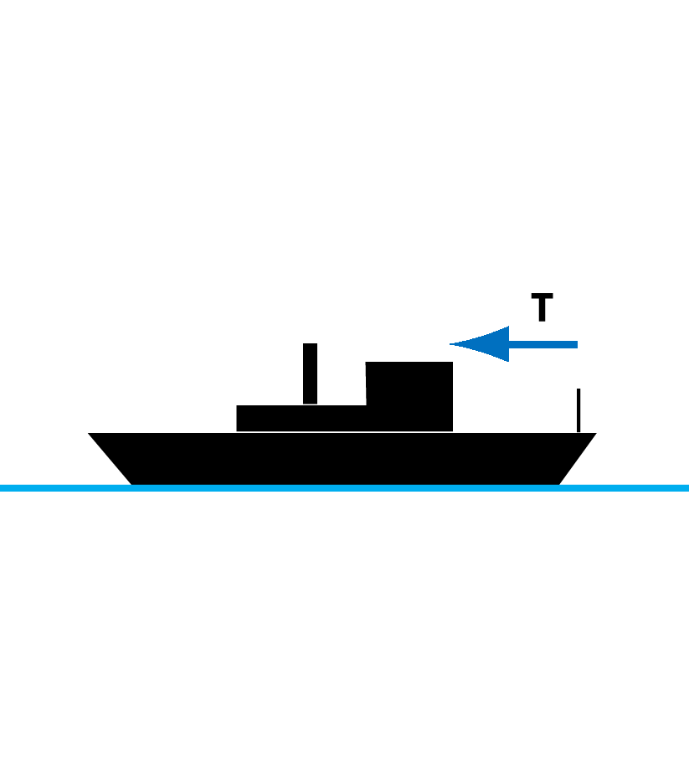
1D Example of True Wind Vector Math
Vessel is stationary on a day with true wind blowing directly over the bow.
Notes:
Facilitator Notes:
Start with a stationary ship with wind blowing directly over the bow.
Anemometer would measure wind of |T| with direction from 0˚.

Slide 4
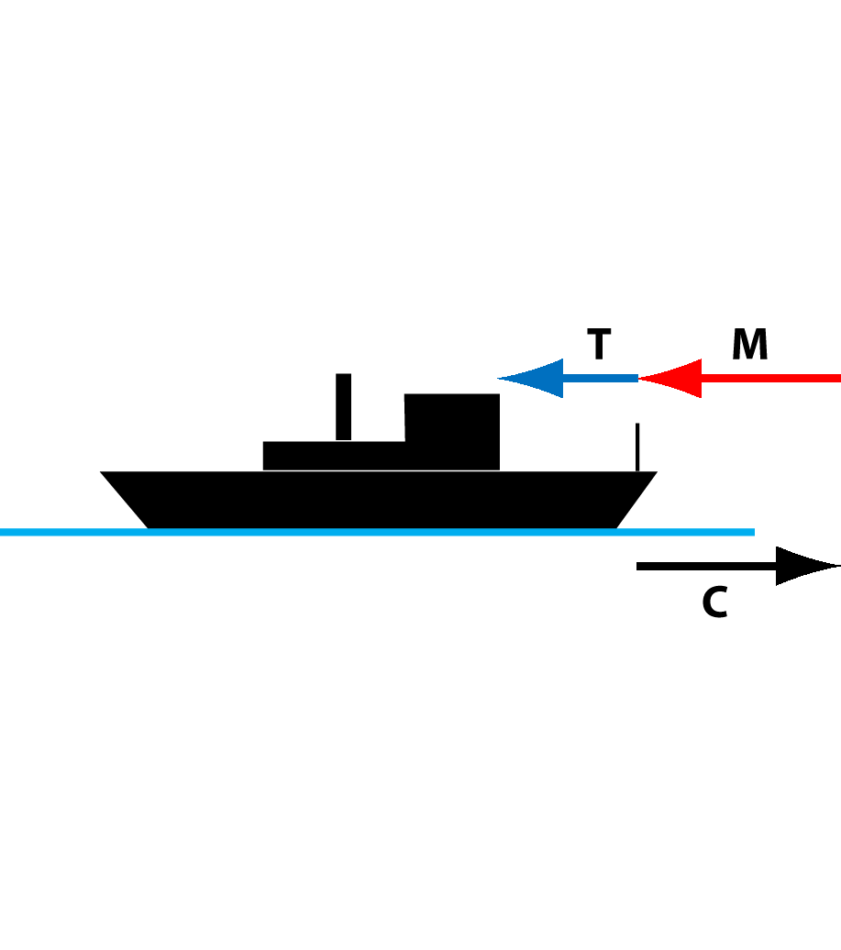
1D Example of True Wind Vector Math
Vessel moves forward inducing additional wind relative to the vessel.
Notes:
Facilitator Notes:
When vessel moves forward (Course = 0˚, speed |C|), an additional wind induced by the vessel motion (M) will be added to the true wind (T).
Note that M has the same magnitude as C, but with opposite sign (180˚ opposite direction).

Slide 5
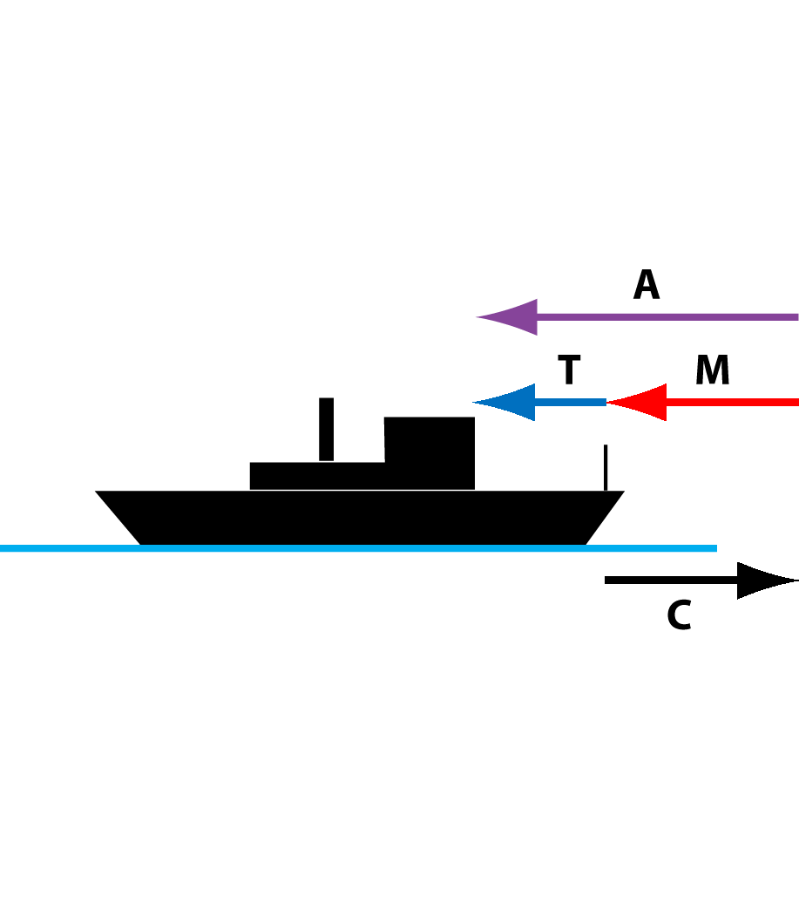
1D Example of True Wind Vector Math
A = T + M
T = A – M
M = –C
T = A – (–C) = A + C
Notes:
Facilitator Notes:
The apparent wind on the vessel, as measured by the anemometer, would be equal to T + M.
Therefore, calculating the true wind requires removing the wind induced by the motion of the vessel (M) from the apparent wind.
Continue discussion with the equations to get final form of T = A + C.
Prompt: As a reminder, what of these vectors do you actually measure?
Answer: Course and apparent wind vectors.

Slide 6
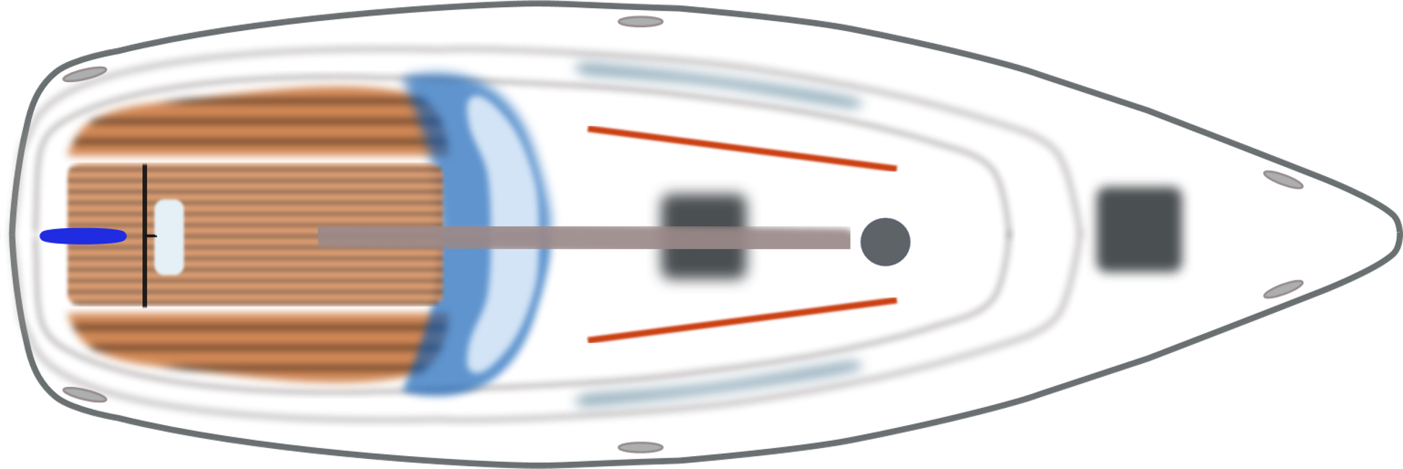
2D Example of True Wind Vector Math
SOG: 0 kts
HDG: 000
COG: 000
AWA: 090
AWS: 10 kts
TWA: 090 S
TWS: 10 kts
North
AWA/TWA

Slide 7
2D Example of True Wind Vector Math
SOG: 15 kts
HDG: 000
COG: 000
AWA: ?
AWS: ?
TWA: 090 S
TWS: 10 kts
North
TWA
Notes:
Prompt: Can anyone guess ballpark values for AWA and AWS?

Slide 8
2D Example of True Wind Vector Math
SOG: 15 kts
HDG: 000
COG: 000
AWA: ?
AWS: ?
TWA: 090 S
TWS: 10 kts
North
TWA
Notes:
Prompt: Can anyone guess ballpark values for AWA and AWS?

Slide 9
2D Example of True Wind Vector Math
SOG: 15 kts
HDG: 000
COG: 000
AWA: ?
AWS: ?
TWA: 090 S
TWS: 10 kts
North
TWA
Notes:
Prompt: Can anyone guess ballpark values for AWA and AWS?

Slide 10
2D Example of True Wind Vector Math
SOG: 15 kts
HDG: 000
COG: 000
AWA: ?
AWS: ?
TWA: 090 S
TWS: 10 kts
North
AWA
TWA
Notes:
Prompt: Can anyone guess ballpark values for AWA and AWS?

Slide 11
2D Example of True Wind Vector Math
SOG: 15 kts
HDG: 000
COG: 000
AWA: ?
AWS: ?
TWA: 090 S
TWS: 10 kts
North
AWA
AWA
15 knots
TWA
10 knots
Notes:
Prompt: Can anyone guess ballpark values for AWA and AWS?

Slide 12
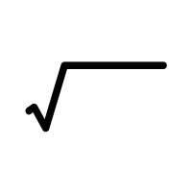
2D Example of True Wind Vector Math
SOG: 15 kts
HDG: 000
COG: 000
AWA: tan⁻¹(15kts/10kts) = 034 S
AWS: (10 kts)² + (15 kts)² = 18.03 kts
TWA: 090 S
TWS: 10 kts
18 knots
North
AWA
33.7°
AWA
15 knots
TWA
10 knots

Slide 13
2D Example of True Wind Vector Math
SOG: 12 kts
HDG: 020
COG: 020
AWA: 080 S
AWS: 6 kts
TWA: ?
TWS: ?
North
12 knots
AWA
6 knots

Slide 14
2D Example of True Wind Vector Math
SOG: 12 kts
HDG: 020
COG: 020
AWA: 080 S
AWS: 6 kts
TWA: ?
TWS: ?
North
12 knots
AWA
6 knots

Slide 15
2D Example of True Wind Vector Math
SOG: 12 kts
HDG: 020
COG: 020
AWA: 080 S
AWS: 6 kts
TWA: ?
TWS: ?
AWA
North
6 knots
12 knots

Slide 16
2D Example of True Wind Vector Math
SOG: 12 kts
HDG: 020
COG: 020
AWA: 080 S
AWS: 6 kts
TWA: ?
TWS: ?
AWA
North
6 knots
AWA
TWA
12 knots

Slide 17
2D Example of True Wind Vector Math
SOG: 12 kts
HDG: 020
COG: 020
AWA: 080 S
AWS: 6 kts
TWA: ?
TWS: 12.45 kts
AWA
North
6 knots
AWA
TWA
12.45 knots
12 knots
TWS = (6kts)² + (12kts)² – 2(6kts)(12kts)cos(80)

Slide 18
2D Example of True Wind Vector Math
SOG: 12 kts
HDG: 020
COG: 020
AWA: 080 S
AWS: 6 kts
TWA: 71.7° + 80° = 152 S
TWS: 12.45 kts
AWA
North
6 knots
AWA
TWA
12.45 knots
12 knots
(12.45kts)² + (6kts)² - (12kts)²
= cos⁻¹( ) = 71.7°
2 * (12.45kts) * (6kts)

Slide 19
2D Example of True Wind Vector Math
SOG: 12 kts
HDG: 020
COG: 020
AWA: 080 S
AWS: 6 kts
TWA: 71.7° + 80° = 152 S
TWS: 12.45 kts
AWA
North
6 knots
AWA
TWA
12.45 knots
12 knots
COG + TWA = TWD
020 + 152 = 172

Slide 20
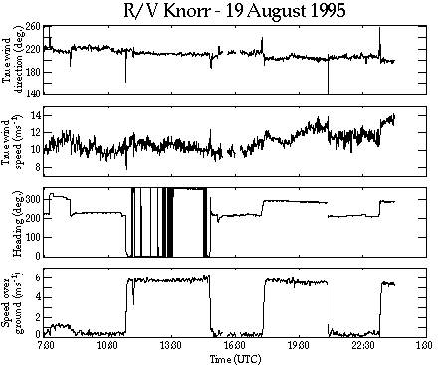
Averaging Errors
Notes:
Facilitator Notes:
Highlight spikes in true wind direction when vessel changes speed and heading.
These are acceleration spikes that result from calculating true winds after averaging input values.
Prompt: What types of motions would result in the acceleration of a an anemometer on a vessel?
Answer: vessel speed change, course change, heading change (turns), pitch, roll, heave.

Slide 21
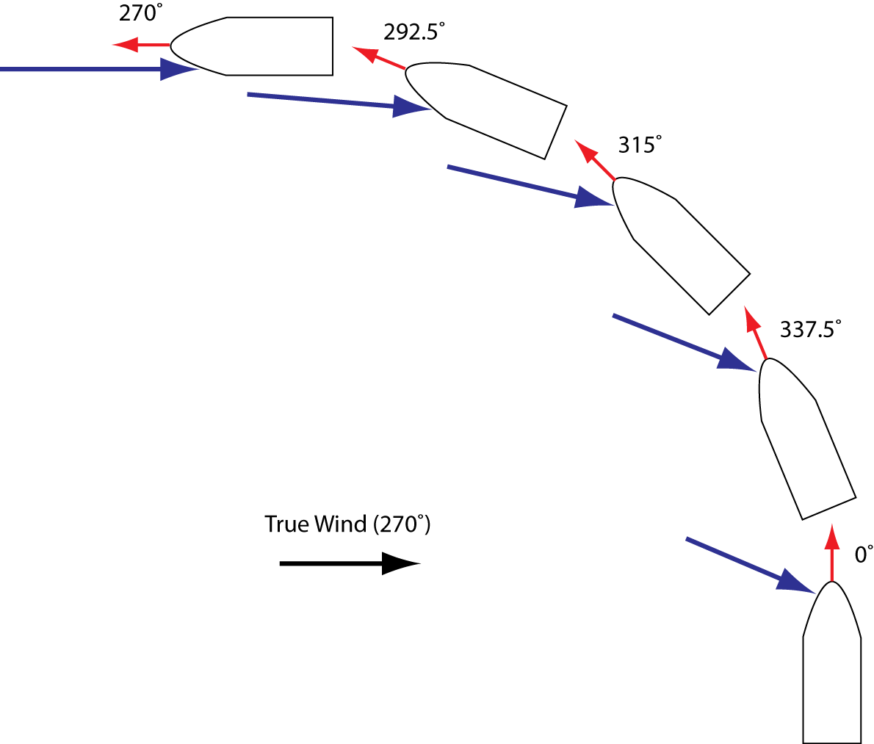
Turning Ship Alters Apparent Wind
Notes:
Facilitator Notes:
When a vessel turns (in this case while traveling at a steady forward speed over the ground; red), the apparent wind (blue) changes continuously during the turn.
Since the true wind equations are nonlinear (through the sine and cosine functions), they are accurate only when all the input parameters are approximately constant over the averaging period.
In the case above, the turning results in a lack of constancy over the time period of the turn.

Slide 22
Incorrect Averaging Method
Course​ | Speed​ | Heading​ | P. Wind Direction​ | P. Wind Speed​ | True Wind Direction​ | True Wind Speed​
0.0​ | 5.0​ | 0.0​ | 300.0​ | 10.0​ | ​ | ​
350.0​ | 5.0​ | 350.0​ | 305.0​ | 10.5​ | ​ | ​
340.0​ | 5.0​ | 340.0​ | 310.0​ | 11.0​ | ​ | ​
330.0​ | 5.0​ | 330.0​ | 315.0​ | 11.5​ | ​ | ​
320.0​ | 5.0​ | 320.0​ | 320.0​ | 12.0​ | ​ | ​
310.0​ | 5.0​ | 310.0​ | 330.0​ | 13.0​ | ​ | ​
300.0​ | 5.0​ | 300.0​ | 340.0​ | 13.5​ | ​ | ​
290.0​ | 5.0​ | 290.0​ | 350.0​ | 14.0​ | ​ | ​
280.0​ | 5.0​ | 280.0​ | 355.0​ | 14.5​ | ​ | ​
270.0​ | 5.0​ | 270.0​ | 0.0​ | 15.0​ | ​ | ​
315.0​ | 5.0​ | 315.0​ | 331.2​ | 11.7​ | 271.1​ | 8.1​
Notes:
Facilitator Notes:
As an example, say the turn in the previous diagram occurred over one minute and the acquisition system on the vessel records every five seconds.
We wish to calculate a one-minute averaged true wind value.
The data above would represent the conditions during the turn. We assume no ocean currents, so the heading equals the course over the ground.
If the ten input values are vector averaged first over the minute, the resulting true wind direction and speed are shown at the lower right.

Slide 23
Correct Averaging Method
Course​ | Speed​ | Heading​ | P. Wind Dir​ | P. Wind Speed​ | True Wind Dir​ | True Wind Speed​
0.0​ | 5.0​ | 0.0​ | 300.0​ | 10.0​ | 270.0​ | 8.7​
350.0​ | 5.0​ | 350.0​ | 305.0​ | 10.5​ | 266.8​ | 8.7​
340.0​ | 5.0​ | 340.0​ | 310.0​ | 11.0​ | 263.8​ | 8.7​
330.0​ | 5.0​ | 330.0​ | 315.0​ | 11.5​ | 261.1​ | 8.7​
320.0​ | 5.0​ | 320.0​ | 320.0​ | 12.0​ | 258.5​ | 8.8​
310.0​ | 5.0​ | 310.0​ | 330.0​ | 13.0​ | 263.9​ | 9.0​
300.0​ | 5.0​ | 300.0​ | 340.0​ | 13.5​ | 269.0​ | 9.0​
290.0​ | 5.0​ | 290.0​ | 350.0​ | 14.0​ | 274.5​ | 9.1​
280.0​ | 5.0​ | 280.0​ | 355.0​ | 14.5​ | 272.4​ | 9.5​
270.0​ | 5.0​ | 270.0​ | 0.0​ | 15.0​ | 270.0​ | 10.0​
​ | ​ | ​ | ​ | ​ | 267.1​ | 9.0​
Notes:
Facilitator Notes:
The proper way to create the one-minute average is to calculate the true winds for each five-second sample, and then vector average the five-second true winds.
The resultant one-minute average true wind is shown at the lower right.
Note that the difference is ~ 1.0 m/s in this case.

Slide 24
Height Matters
Notes:
Facilitator Notes:
Prompts:
What characteristic of the atmosphere makes knowing the height of individual MET sensors important?
How do winds, humidity, temperature, and pressure generally vary with increasing height above the ocean surface?
Answers:
Meteorological variables (winds, pressure, temperature, humidity) vary with height above the ocean surface.
Generally - winds increase; temperature, humidity, and pressure decrease with increasing height. (Exceptions – fog may result in uniform temperature/humidity with height.)

Slide 25
Wind, Temperature, and Humidity
Notes:
Facilitator Notes:
Data points include measurements from the ship’s instruments, a nearby buoy, a handheld Assman psychrometer, and a sea snake (for SST).
Profiles are calculated from version 3.0 of the COARE bulk flux algorithm.

Slide 26
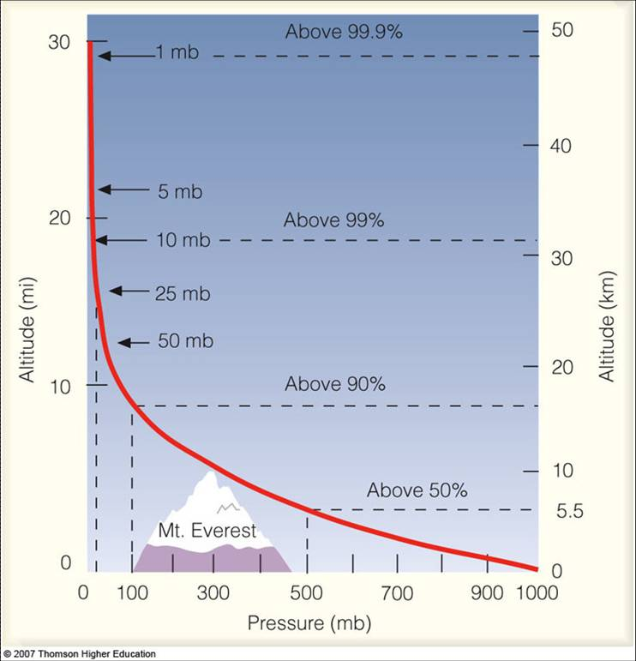
Pressure

Slide 27
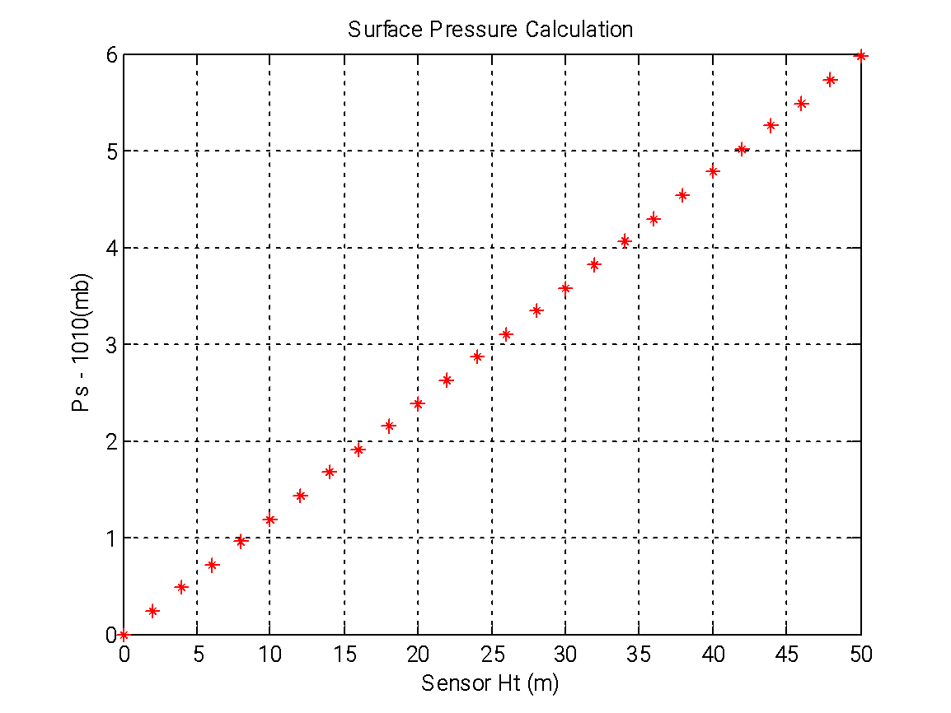
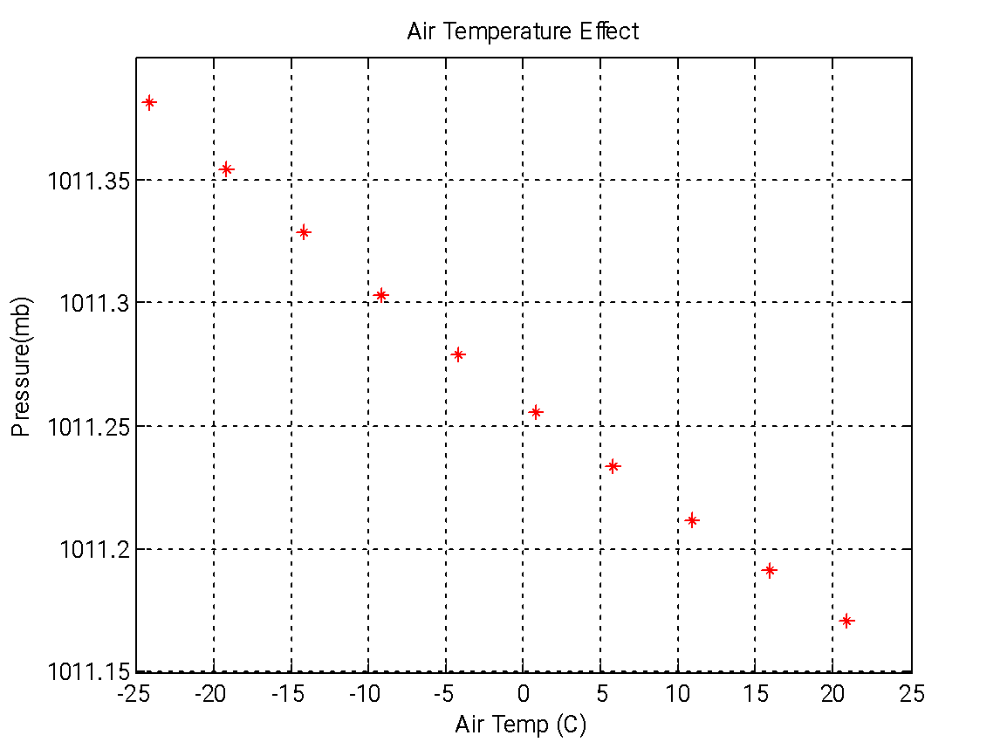
Station Pressure to Sea Level calculation
P_{s} = P_{z}e^{(gz/RaT)}
P_{z} = Station pressure (mb)
Ra = Universal Constant (J/kgK)… 287.05;
T = Temperature (K)
g = gravity (m/s)… 9.81;
z = height of pressure sensor (m)
P_{s} = sea level pressure (SLP mb)
Rough guesstimate 1mb = 10m
SLP >= Station Pressure
Notes:
Pressure is the most useful atmospheric variable measured by ships.
Sea level pressure cannot be measured by satellite, so ship measurements are often incorporated into forecast models to improve their accuracy.

Slide 28
Ship’s pressure sensor
Pilot House
2.946m
Deck3
2.883m
Deck2
Deck1
7.67m
7/11/2013 Measurements

Slide 29
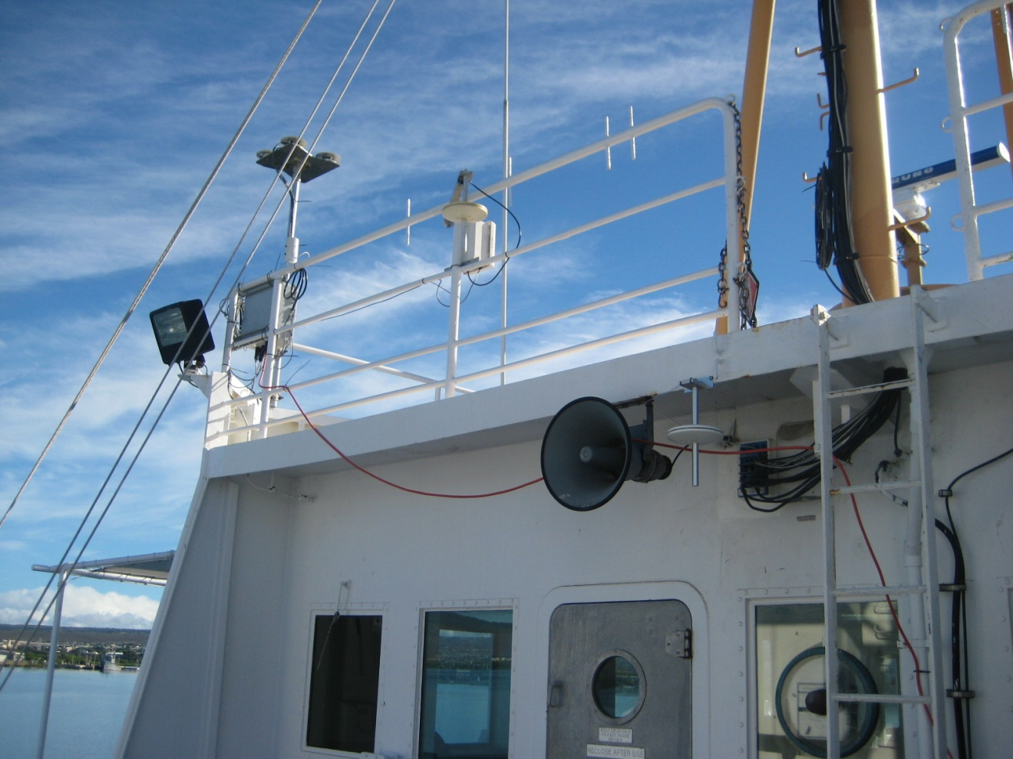
PSD dynamic pressure port and sensor
14.388m above water
Ship dynamic pressure port
12.02m above water
Ship ~1.38 mb @ 25ºC
PSD ~1.66 mb @ 25ºC

Slide 30
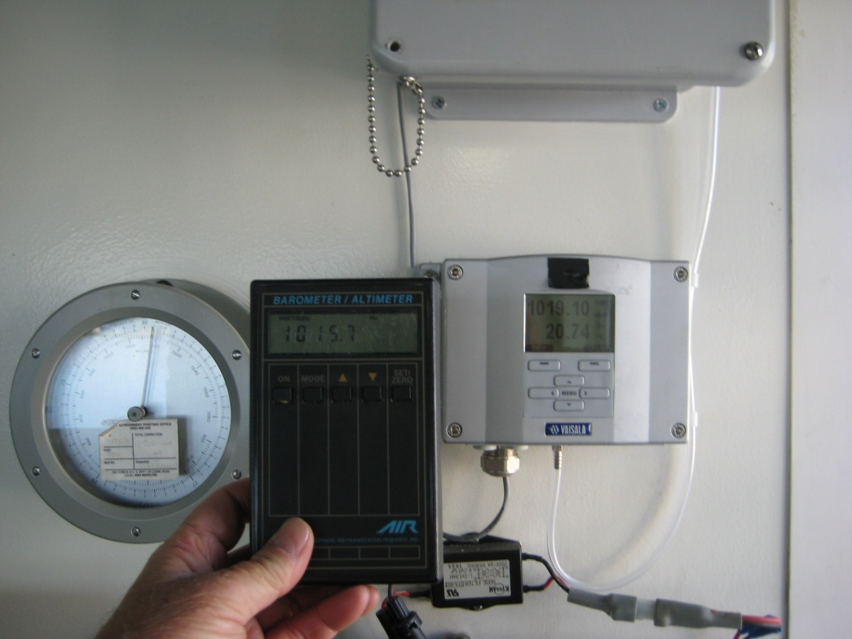
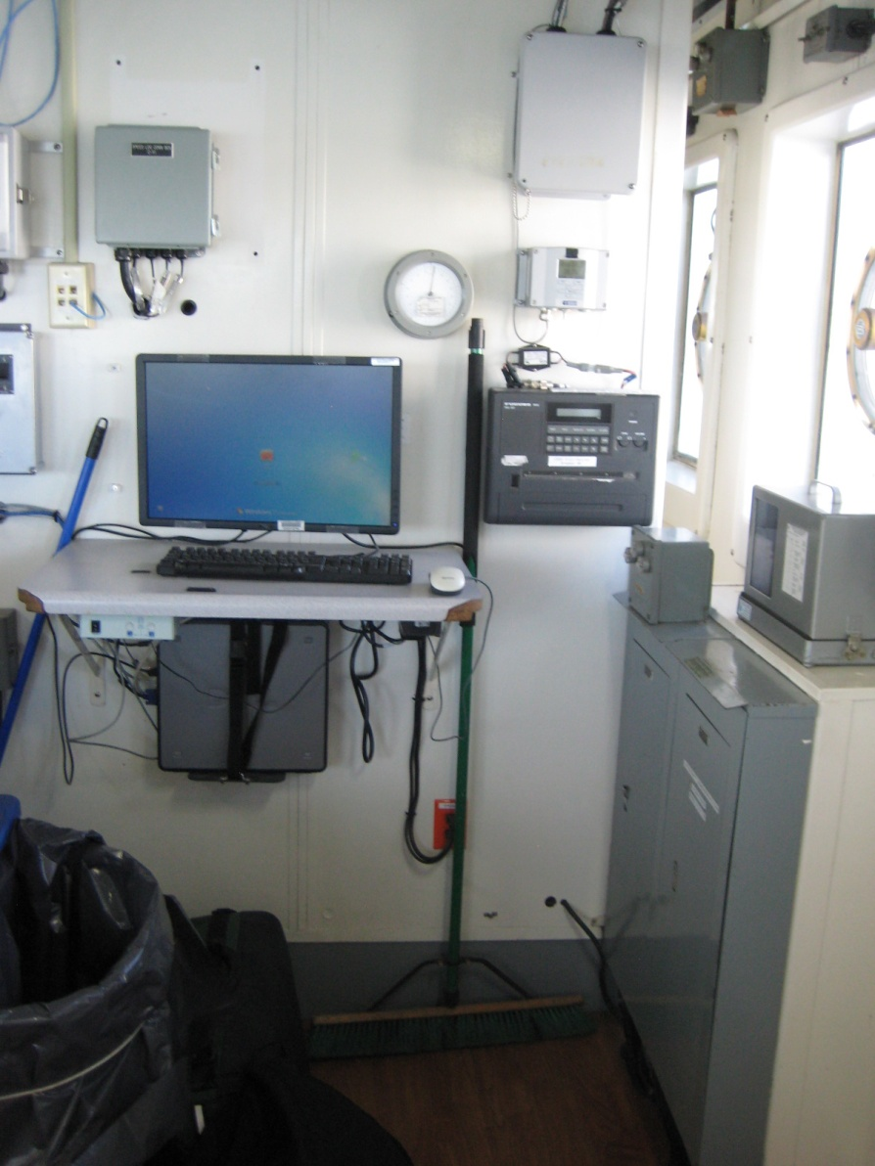
Tygon tubing to
dynamic pressure port
NWS barometer
Ship pressure
12.02m above water
65”

Slide 31
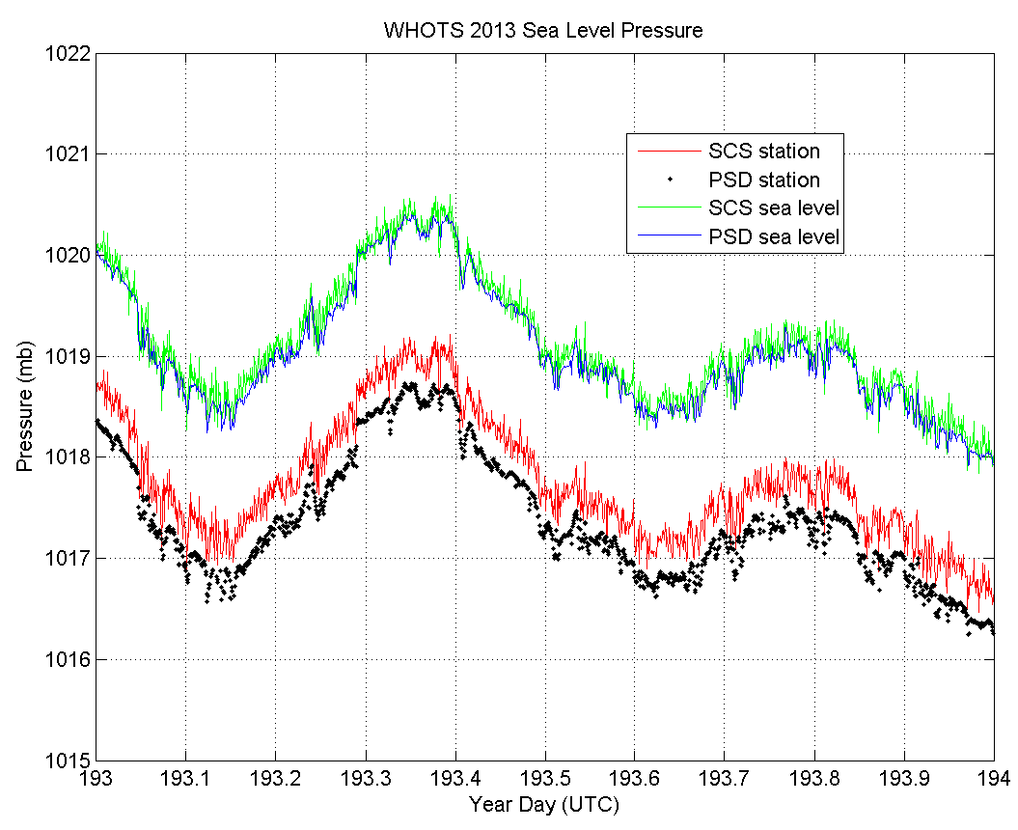
Sea Level
Station

Slide 32
Pressure
Notes:
Facilitator Notes:
Recall from Lesson 1:
Pressure at a given height and location is the result of the weight of the atmosphere above that location.
Pressure decreases with height (less atmosphere in column), which impacts near-surface observations.

Slide 33
Accuracy Targets
Notes:
Facilitator Notes:
Given the desired accuracy for pressure measurements, not providing the height of your barometer or whether the data are measured at the barometer height or sea level will contribute to errors in analyses conducted by a user of your pressure data.

Slide 34
Applying Heights in the Field
Image Courtesy NOAA OAR
Notes:
Facilitator Notes:
With known instrument heights, scientists can compare observations from platforms measuring at different heights.
Technicians can use this knowledge to conduct spot comparisons of their shipboard MET data when in proximity to moorings, towers, or coastal stations.
Figure: University of Flinders' Cessna 404 about to fly between PMEL's TAO buoy and NOAA's Ronald H. Brown just after completing an up-down profile to 3 km altitude near the ship. Buoy and ship are about 200 m apart. The image was captured from the ship's RHIB (small boat), deployed for the occasion. From Nauru99 experiment. Image source: http://www.oar.noaa.gov/spotlite/archive/spot_etl.html.

Slide 35
Takeaways
Apparent wind is a combination of the true wind and the wind induced by the ship's motion. This is the wind that you feel on deck and the wind that is measured by the ship's anemometers.
The data from many of the instruments are unusable if the height of the instrument is unknown.
For barometers, the height of the sensor must be used, not the height of the pressure port.
Adjusting pressure to sea level allows for comparison with nearby moorings or land stations.

Slide 36
Questions?

Slide 37
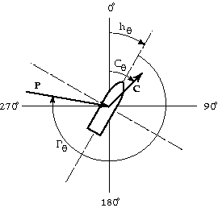
Calculation Details
Calculate the apparent wind in math coordinates.
A’_{θ} = 270˚ – (h_{θ}+R_{θ}+P_{θ})
|A| = |P|
Adjust the course over ground to math coordinates.
C’_{θ} = 90˚ – C_{θ}

Slide 38
Calculation Details
Calculate the components of the true wind vector.
T_{u} = T’_{u} = |A| cos(A’ _{θ}) + |C| cos(C’ _{θ})
T_{v} = T’_{v} = |A| sin(A’ _{θ}) + |C| sin(C’ _{θ})
Calculate the true wind speed and direction from which the wind is blowing.
|T| = (T_{u}² + T_{v}²)^{0.5}
T _{θ} = 270˚ – arctan(T_{v}/T_{u})
NOTE: Arctan function must have a range of -180˚ to +180˚.

Slide 39
Pressure Exercise
Using the equation
Given
p_{z} = 1010 hPa
T = 290 K
g = 9.81 m s⁻²
R_{a} = 287.05 J kg⁻¹ K⁻¹
e = 2.718281
Calculate the surface pressure (p_{s}) for your vessel using your barometer height (z).
Calculate the pressure difference (p_{s} – p_{z}) and add it to the list on the whiteboard.
} Pressure and temperature at a given time
}
Constants
Notes:
Facilitator Notes:
If the techs do not know their exact barometer height above the water, have them use an estimate in meters.
If the techs have access to a scientific calculator with e^{x} function, they can use this in place of inserting the value for e.
Note that the surface pressure should be calculated using an air temperature (T) measured at the same time as the pressure (p_{z}) is measured.

