Slide 1
Why We Care About Marine Meteorology
Notes:
Facilitator Notes:

Slide 2
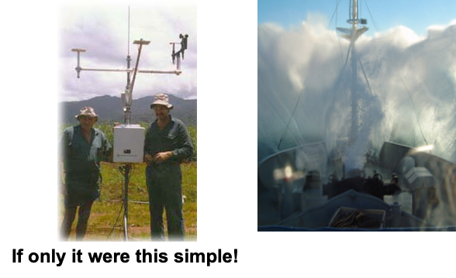
An Introduction to Marine Meteorology
Notes:
Facilitator Notes:
Marine meteorology is a general term to describe the study of weather conditions, events, etc over the oceans (and/or inland lakes/seas).

Slide 3
An Introduction to Marine Meteorology
Notes:
Facilitator Notes:

Slide 4
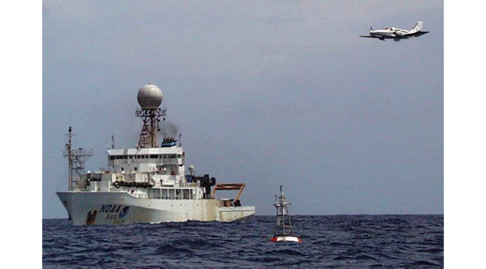
How Does Ocean Differ from Land?
Homogeneity
Moisture source
Surface friction
Diurnal cycles
Harshness
Notes:
Facilitator Notes:
Prompt: How does the marine environment differ from the environment over land?
Answer: Homogeneity, moisture source, surface friction, diurnal cycles, and harshness. Water is a climate moderator. No matter how cold the air gets, if there is open water there is a heat source.
Main Point: Marine environments are generally more moderate than land environments.
Figure: University of Flinders' Cessna 404 about to fly between PMEL's TAO buoy and NOAA's Ronald H. Brown just after completing an up-down profile to 3 km altitude near the ship. Buoy and ship are about 200 m apart. The image was captured from the ship's RHIB (small boat), deployed for the occasion. From Nauru99 experiment. Image source: http://www.oar.noaa.gov/spotlite/archive/spot_etl.html.

Slide 5
What to Measure
Notes:
Facilitator notes:
Prompt: What weather parameters are typically measured by your vessels?

Slide 6
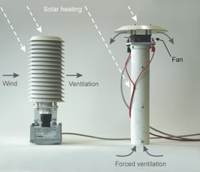
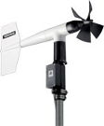
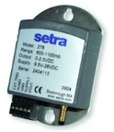
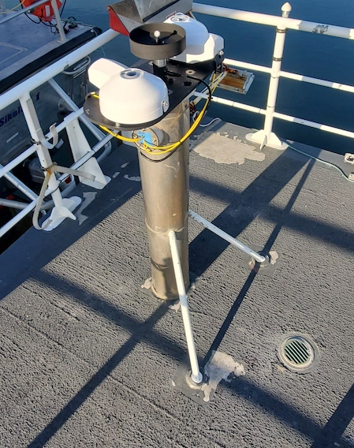
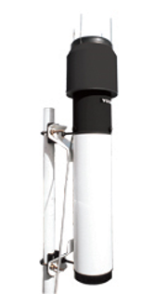
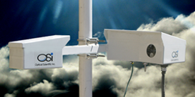
What to Measure
Meteorology
Wind direction and speed
Air temperature
Humidity
Pressure
Rainfall
Radiation
SW, LW, PAR
Notes:
The items listed here are of primary interest to the scientific community for the marine environment. These are the parameters we will focus on during this training session.
Humidity: typically measure relative humidity or wet-bulb temperature (rarely dewpoint temperature)
Radiation: typically measure downwelling shortwave (solar) and longwave (emitted) values; the photosynthetic portion of the solar spectrum is also very useful for biological studies.

Slide 7
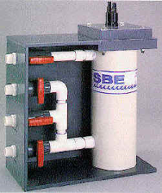
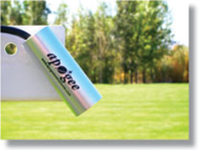
What to Measure
Oceanography
Sea temperature
Salinity
Navigation
Latitude and longitude
Course over ground
Speed over ground
Speed relative to water
Heading
Hull
TSG
IR
Notes:
Sea temperature is considered a marine weather variable.
Plays a key role in exchange of heat and moisture between the ocean and atmosphere.
Latitude and longitude: typically from a global positioning system
True heading of the vessel: typically from a gyrocompass
Course and speed over the ground: typically from a GPS
Speed relative to the water: typically from a Doppler speed log or Acoustic Doppler Current Profiler

Slide 8
Who Uses the Data?
Notes:
Facilitator notes:
Prompt: What are some uses of weather data you have encountered?
Answers: See the following slides.

Slide 9
Who Uses the Data?
Shipboard personnel
Vessel operations
Ocean deployments (buoys, CTDs, towed instruments, autonomous platforms)
Science during cruise
Notes:
Facilitator notes:
Answers: See the following slides.
Sometimes the data can be important near real-time. In other instances it can be useful many years later, especially when compiled with data taken over many years (STRATUS Synthesis data set Simon et al, 2010). Data taken in new and remote regions should not be given any more importance than studies repeated in the same region year after year.
de Szoeke, S. P., C. W. Fairall, D. E. Wolfe, L. Bariteau, and P. Zuidema, 2010 (August): Surface Flux Observations on the Southeastern Tropical Pacific Ocean and Attribution of SST Errors in Coupled Ocean-Atmosphere Models. J. Climate, 23(15), 4152-4174,
doi:10.1175/2010jcli3411.1.

Slide 10
Who Uses the Data?
Shipboard personnel
Vessel operations
Ocean deployments (buoys, CTDs, towed instruments, autonomous platforms)
Science during cruise
Secondary users (not on cruise)
Ocean and atmosphere modelers, including National Met Services
Satellite and other remote measurement communities
Air-sea interaction researchers
Product developers (climate atlases, gridded fields)
Instrument developers
Notes:
Facilitator notes:
Answers: See the following slides.
Sometimes the data can be important near real-time. In other instances it can be useful many years later, especially when compiled with data taken over many years (STRATUS Synthesis data set Simon et al, 2010). Data taken in new and remote regions should not be given any more importance than studies repeated in the same region year after year.
de Szoeke, S. P., C. W. Fairall, D. E. Wolfe, L. Bariteau, and P. Zuidema, 2010 (August): Surface Flux Observations on the Southeastern Tropical Pacific Ocean and Attribution of SST Errors in Coupled Ocean-Atmosphere Models. J. Climate, 23(15), 4152-4174,
doi:10.1175/2010jcli3411.1.

Slide 11
Satellite Calibration and Algorithm Development
Adapted from Smith, Bourassa, and Jackson, Sea Technology, June 2012
Notes:
Facilitator Notes:
RV underway datasets can be used to validate and correct bias in satellite retrievals of air temperature (T_{a}) and specific humidity (Q_{a}), particularly in regions where seasonal effects on profiles (e.g., cold-air outbreaks, inversions in stratocumulus regions) can impact satellite retrievals.
KNORR ship observations were compared to a dual sensor satellite T_{a} retrievals during 2007 and adjusted to the satellite T_{a} retrieval height of 10 m.
The map (a) indicates 1627 locations where ship and satellite observations are collocated.
Time series (b) identifies good agreement except for regional biases in March over the Gulf Stream region and in December near the western coast of Africa where satellite T_{a} predicts warmer temperatures.
Scatterplot (c) shows unbiased agreement at nearly all temperatures with overall bias near zero.
Scatterplot (d) show impact of applying a polynomial fit between collocated ship and satellite values to provide a correction that reduced air temperature RMS by 0.68˚C.

Slide 12
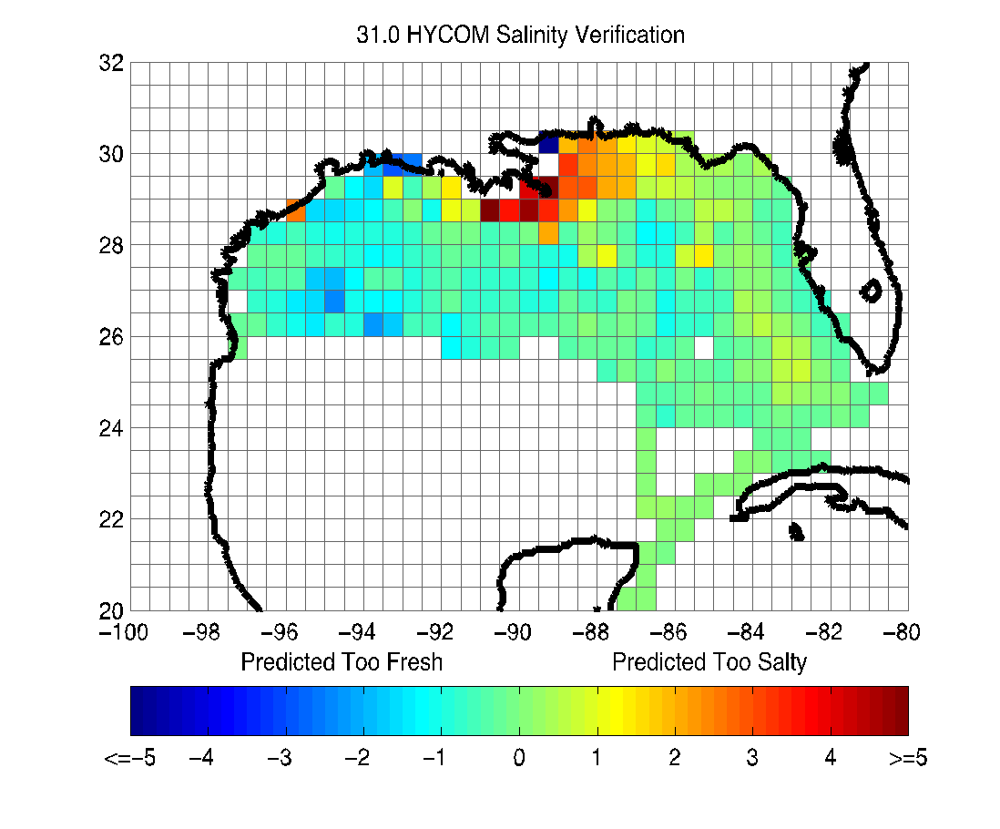
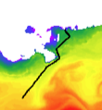
Ocean Model Evaluation
Sea Temperature and Salinity Time Series
Model vs. Ship Salinity:
Multi-ship Comparison
Notes:
Facilitator Notes:
Comparison of underway sea temperature (T_{sea}) and salinity from ship’s thermosalinograph vs. model (HYCOM) T_{sea} and salinity interpolated to actual vessel track.
In this case, the model is the Hybrid Coordinate Ocean Model (HYCOM)
Left: time series comparison over several weeks
Right: Multi-ship comparison combining salinity data from approximately 50 cruises between 2010 and 2012. In this case, individual ship vs. model salinity differences are combined in 0.5˚ latitude by longitude bins.
Main Point: Model underestimates freshwater input from rivers, resulting in an overestimation of salinity in HYCOM near the coast (as compared to research vessel measurements).

Slide 13
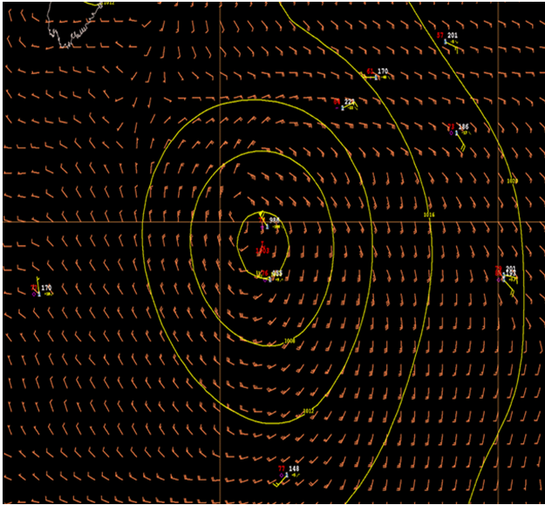
Real-Time Forecast Validation Data QC
Notes:
Facilitator Notes:
NWS uses ship observations to validate ocean weather forecasts.
Observations from RVs, particularly in remote ocean regions can assist forecasters to ensure model analyses are reasonable.
In this case, the ship observations showed that the low pressure center represented in the Global Forecast System was too far west and weaker than observations supported. These observations resulted in issuance of a hurricane force wind warning for the region.
Image from Smith et al 2019, Frontiers in Marine Science, https://www.frontiersin.org/articles/10.3389/fmars.2019.00434/full
GFS model 29 July 2015 0600 UTC 6-h forecast, valid 1200 UTC 29 July 2015, with available ship observations using standard synoptic station notation. Isobars are drawn with yellow lines, and the model wind field is indicated by wind barbs in orange. The low pressure center is located near 39 N, 58.5 W. Courtesy of National Oceanic and Atmospheric Administration, National Weather Service, Ocean Prediction Center.

Slide 14
How to Measure
Know what you want to measure . . . parameter(s).
Know the temporal and spatial scales.
Know the sensor characteristics.
Accuracy, precision, range, . . .
Know the data acquisition system.
Know the environment you will be working in.
Notes:
Facilitator Notes:
Before any measurement is made there are some basic questions that need to be asked.
Do ship techs get involved in this aspect of data collection and instrumentation? Who makes these decisions?
Revelle techs said it would make the most sense if the scientists bought the instruments that were put on ships to meet their needs.
Main Point: There are many steps that need to be followed to collect useful, high-quality data. In the ideal situation this is how you would proceed. In reality you may not have control over some of these decisions.

Slide 15
End Lesson 1
Notes:
Facilitator Note: The following slides are not part of the primary lesson but are included to provide supporting materials to address questions that may arise.

Slide 16
Time Scales
Notes:
Facilitator Notes:
These scales of motion are interrelated: energy transfers or cascades from the larger scale to the smaller scales, eventually dissipating as turbulence.
There are often several choices of sensor for each variable; the most suitable for a particular application depends on several factors, including the required accuracy and resolution, frequency response, and overall convenience of operation.

Slide 17
Sampling Rates
The Nyquist-Shannon sampling theorem in general states a signal can be reconstructed from its samples if the
sampling frequency is greater than twice the highest frequency of the signal (also known as the Nyquist frequency).
Oversampling is often preferred as it can
aid in anti-aliasing,
be used to increase resolution when using A/D convertors, and
help reduce uncorrelated noise when averaging multiple samples.
Notes:
Facilitator Notes:
Talk more about sampling rates when we get to some of the hands-on activities with instruments in Lesson 2.
Use the analogy of digital cameras (2D vs 1D). Look on laptop for MATLAB figures or use Wband example summary vs hourly.

Slide 18
Accuracy/Precision Targets
Manufacturer Accuracy
+/- 5º
+/- .3 m/s
+/- .3 hPa (Analog) +/- .1 hPa (Digital)
+/- .17ºC (Analog) +/- .12ºC (Digital)
+/- 2% (0-90%) +/- 3% (90-100%)
Notes:
Facilitator Notes:
The above accuracy estimates are based on the goal of determining the net surface heat flux to within ±10 Wm⁻² on the monthly to seasonal time scales appropriate for climate studies. The reader should recognize that they are nominal values that apply to typical marine weather conditions from the tropics to the midlatitudes. They cannot be expected to apply in unusual or extreme conditions. In the Arctic, for example, if the air temperature is -40ºC, it makes no sense to measure relative humidity to 2%.
The target net heat flux accuracy of ±10 Wm⁻² implies certain accuracies for the measured variables, as shown in the Table. The TOGA-COARE process study demonstrated that, even for the research-quality instruments installed on survey vessels, these accuracies are achievable only with very careful attention to instrument location and performance, calibration and post-cruise scrutiny (details and references can be found in WCRP 2000).
Accuracy of measurements depends on choice of sensor, its proper location on the vessel, and sensor maintenance practices.
Calculated bulk turbulent heat fluxes can incur errors from uncertainties in the measurements of temperature and wind speed in extreme conditions. Consider the ±10 Wm⁻² goal arbitrarily apportioned equally between radiative and turbulent fluxes. An accuracy of 5 Wm⁻² in the turbulent fluxes is less likely to be met when wind speeds exceed 15 ms⁻¹ and highly unlikely above 20 ms⁻¹. This level of accuracy is also difficult to achieve in conditions in which the 10‑m air–sea temperature difference exceeds ±3ºC. What happens in a 50‑kt gale in the Labrador Sea in January is anybody’s guess. However, very strong wind and/or extremely large sea–air temperature or humidity differences are sufficiently rare.

Slide 19
Accuracy/Precision
Notes:
Facilitator Notes:
The left graph is a depiction of how accuracy and precision can be quantified given a calibration reference value for accuracy and the number of samples for precision. The right graph shows two target analogies of how accuracy and precision interact.
Prompt: Which target is represented by the graph on the left?
Answer: Bottom target
In the case of atmospheric measurements, accuracy is how close a measurement is to a calibrated standard. Usually instruments are calibrated on a regular schedule as recommended by the manufacturer. Precision is how well an instrument is able to make the same measurement.

Slide 20
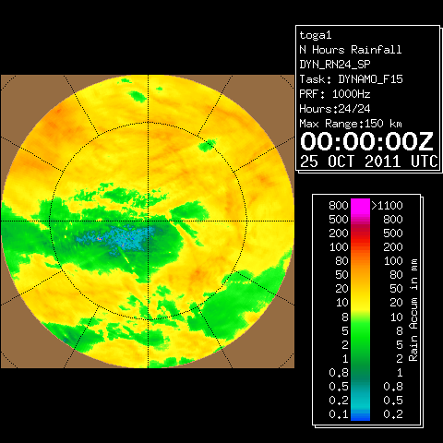
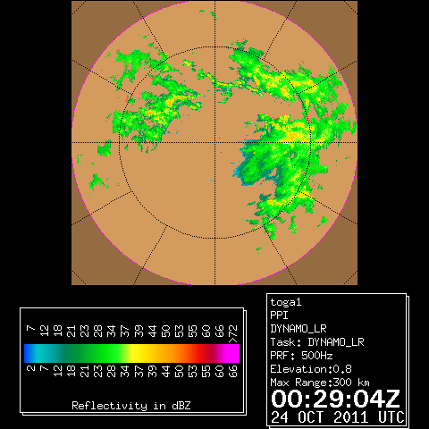
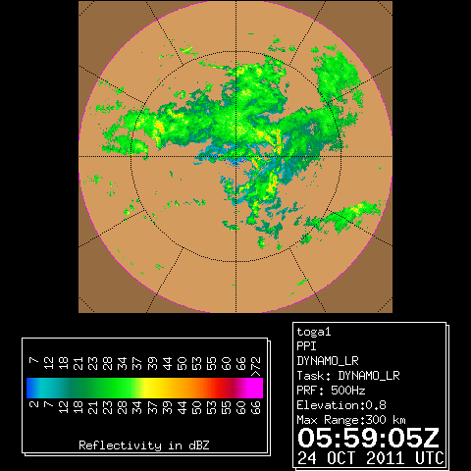
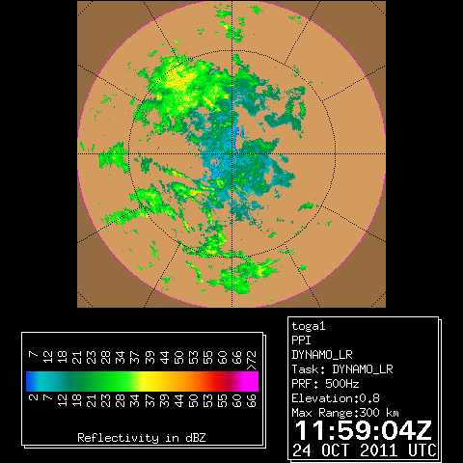
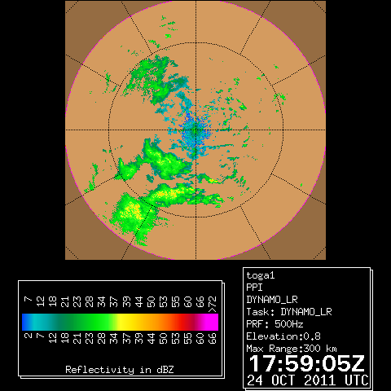
Precipitation/Clouds
24 hr Accumulated Rain
Radar Reflectivity
Notes:
Facilitator Notes:
Emphasize that rainfall can be very patchy in the tropics (when convective rainfall is involved).
Point vessel measurements are a challenge (more in Lesson 2).
Precipitation contributes to the energy exchange at the ocean surface. Find a DYNAMO example of rain and what it does to the air and sea temp off laptop.

Slide 21
Satellite
Water Vapor 24 Oct 06Z
Notes:
Facilitator Notes:
Satellite water vapor image showing the variability across the Indian Ocean.
Red circle represents the 300 km radius with Revelle at the center.

Slide 22
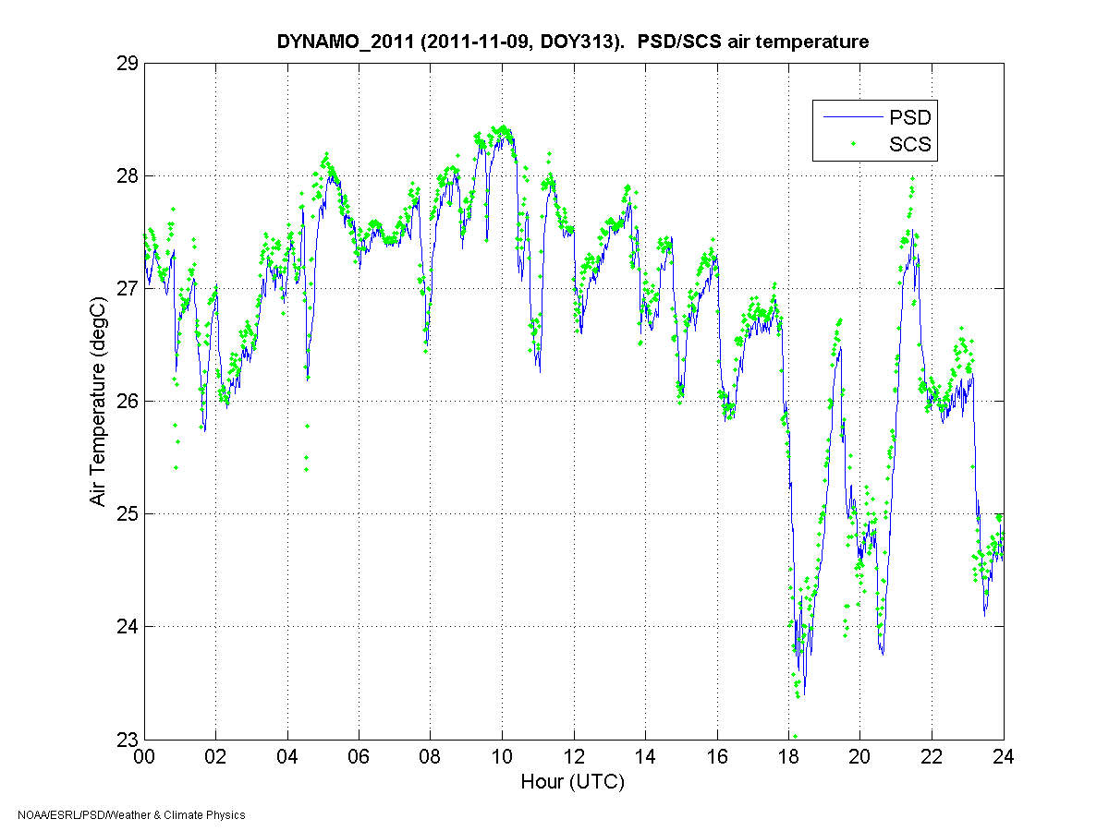
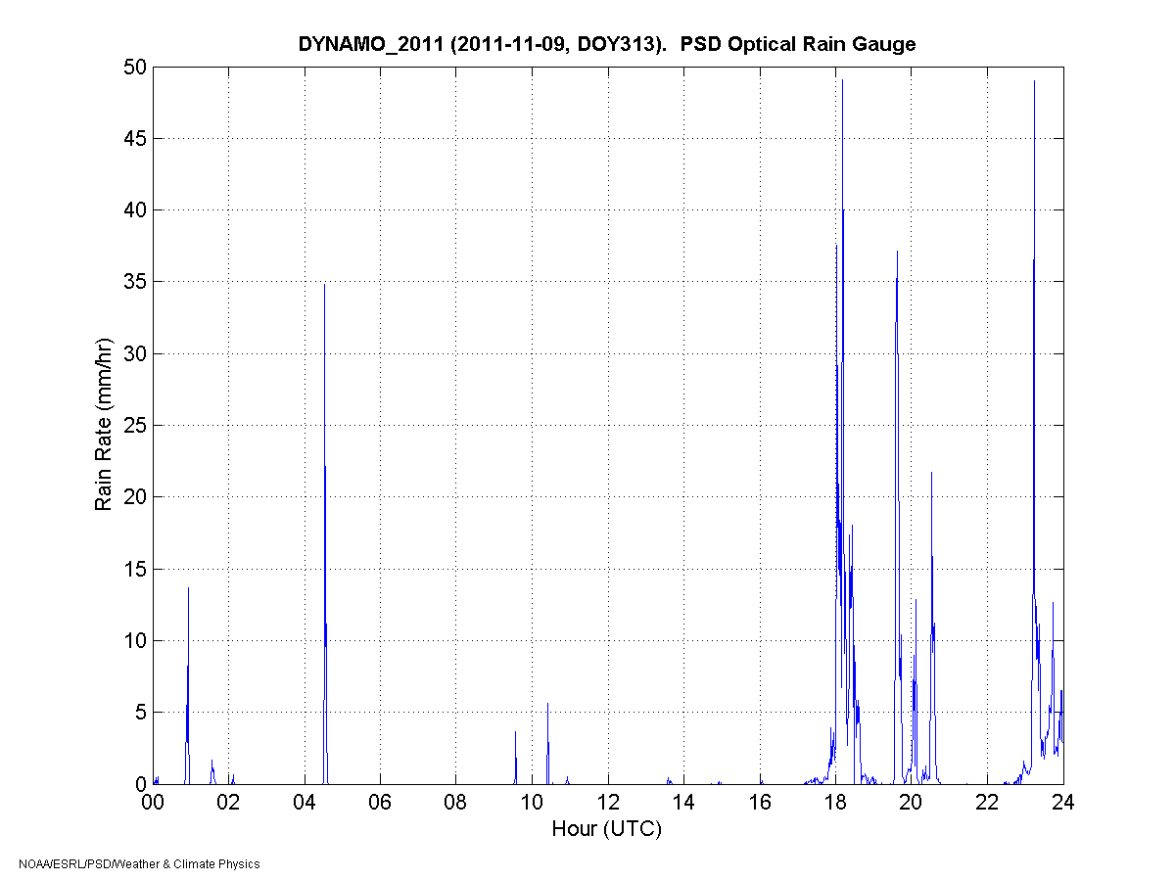
Temperature
Air
Rain Rate
Notes:
Facilitator Notes:
Graph shows time series of air temperature from 2 sensors on top and rain rate on bottom.
Note largest drops in temp are correlated to rain.

Slide 23
Sea Temperature
Local
Time
Notes:
Facilitator Notes:
Graph shows profiles of sea water temperature measured during the TOGA COARE program with a near-surface undulating towed sensor, known as Seasoar. The different symbols denote the (local) time of the profile. The strong temperature increase near the surface is caused by solar heating. Later in the afternoon, the surface mixing is eroding the warm layer.
Emphasize that most vessel intakes tend to be below the layer of diurnal warming, definitely below the cool skin layer (caused by surface flux).
Note that upper ocean temperature is better mixed during periods of moderate to strong winds, but will stratify under calmer wind conditions (common in the tropics).

Slide 24
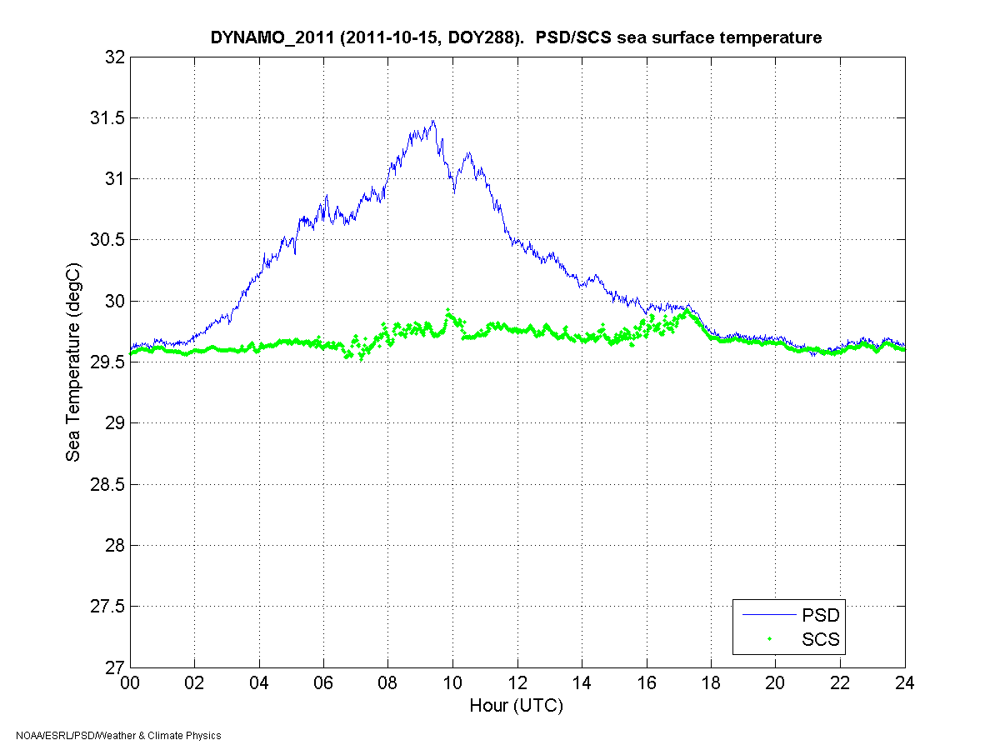
Sea Temperature
Notes:
Facilitator Notes:
Sea snake vs sea chest on a very clear day
Emphasize that most vessel intakes tend to be below the layer of diurnal warming, definitely below the cool skin layer (caused by surface flux).
Note that upper ocean temperature is better mixed during periods of moderate to strong winds, but will stratify under calmer wind conditions (common in tropics).

Slide 25
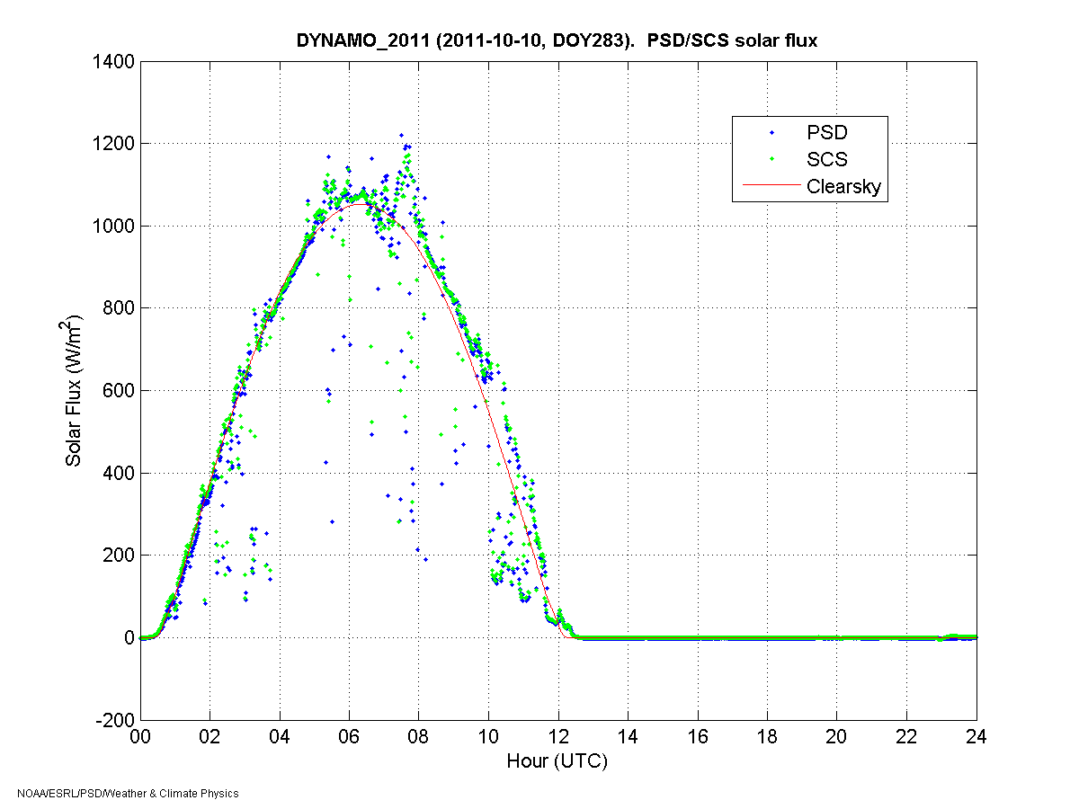
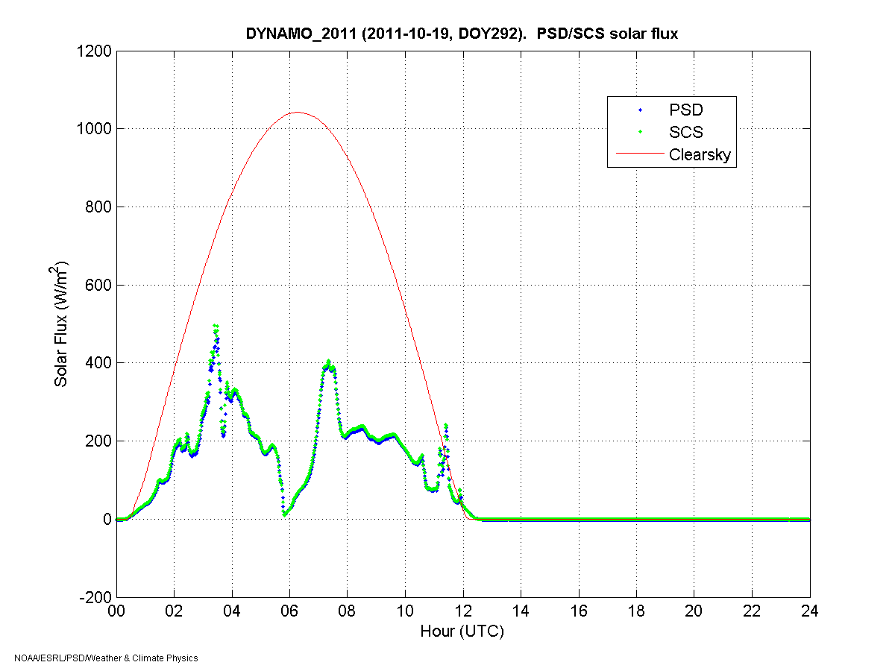
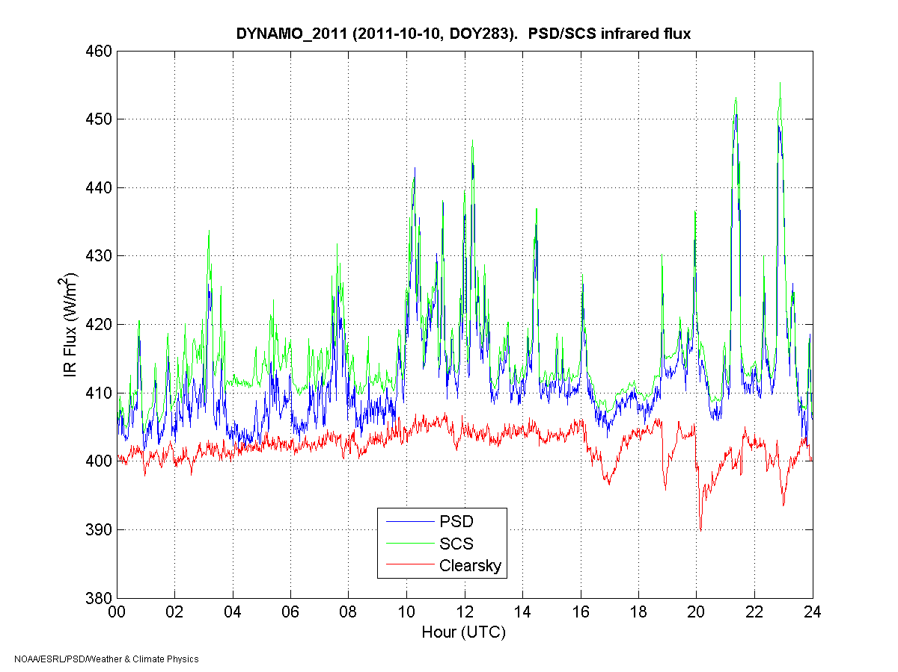
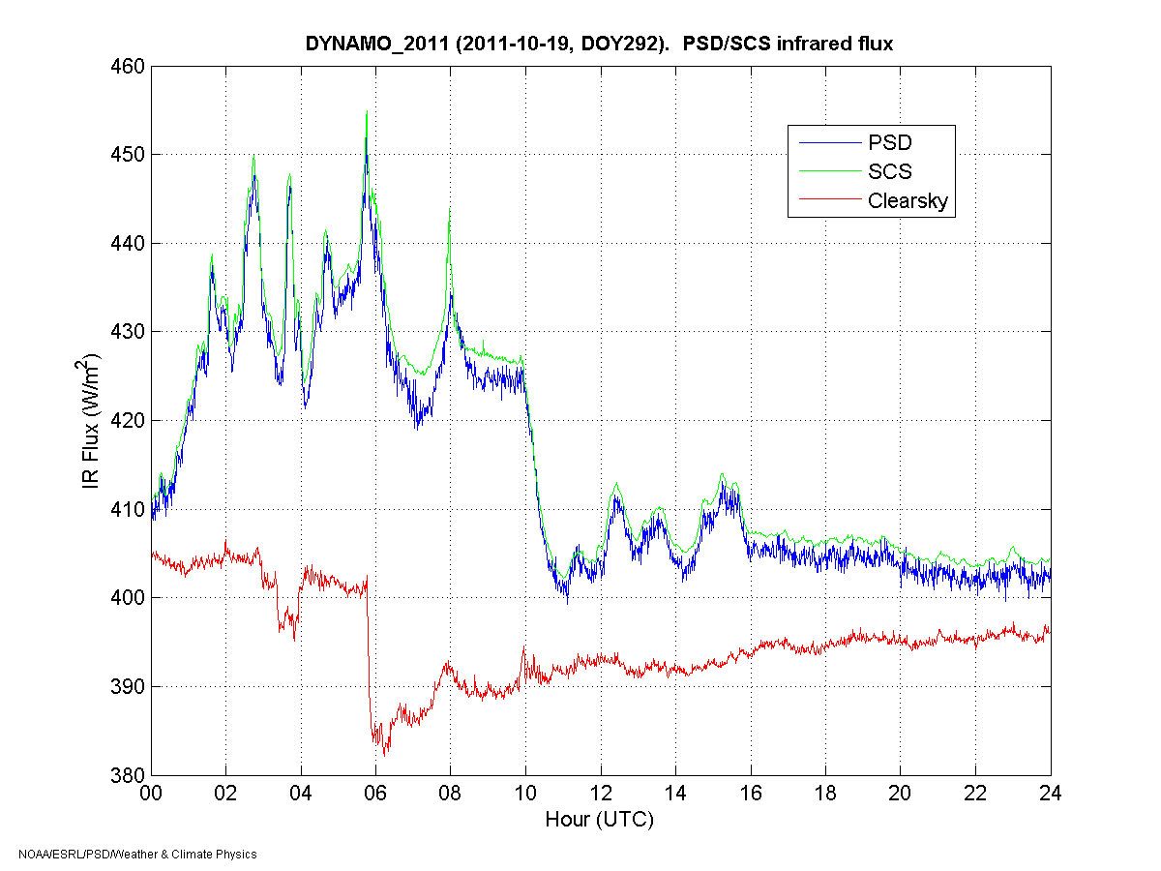
Radiation
SW
LW
Notes:
Facilitator Notes:
Tropical longwave (LW) radiation variability is low, since most radiation measured is emitted from the very humid atmosphere (cloud variations have little influence).
At higher latitudes, LW radiation is lower overall in value, but exhibits increased variability with changes in cloud cover.
In humid climates the atmosphere doesn’t cool off on clear nights as much as it does in dry areas. Therefore the diurnal temperature cycle is much smaller over water.

