Slide 1
Instrument Location Examples
Thanks to operators for providing images!
Notes:
Notes: We will not directly mention ship names in these examples. We are in no way trying to be critical of operators, just using existing photos as examples of how to improve sensor exposure.
‹#›

Slide 2
Notes:
Facilitator Notes:
Point out temperature and humidity sensor location.
Note: The following prompts apply to all the slides.
Prompt: Is this a good or poor sensor exposure? Why?
Prompt: How could the data from this sensor be improved?
Answers: The temperature/RH sensor (top, center of picture) is located directly above an air conditioner.
The heat output of the AC likely impacts sensor readings, especially at low ship speeds
Solution – move away from AC, as far forward as possible on vessel.
‹#›

Slide 3
Notes:
Facilitator Notes:
Point out that the sensors include the temperature, humidity, and pressure port.
Sensors poorly exposed – Ship heating will be a problem and sensors are blocked to airflow from > 2/3 of possible wind directions.
Solution: Move sensors up to rail on open deck above current location. Better exposure to more wind directions.
‹#›

Slide 4
Notes:
Solution: Move sensors up to rail on open deck above current location. Better exposure to more wind directions.
‹#›

Slide 5
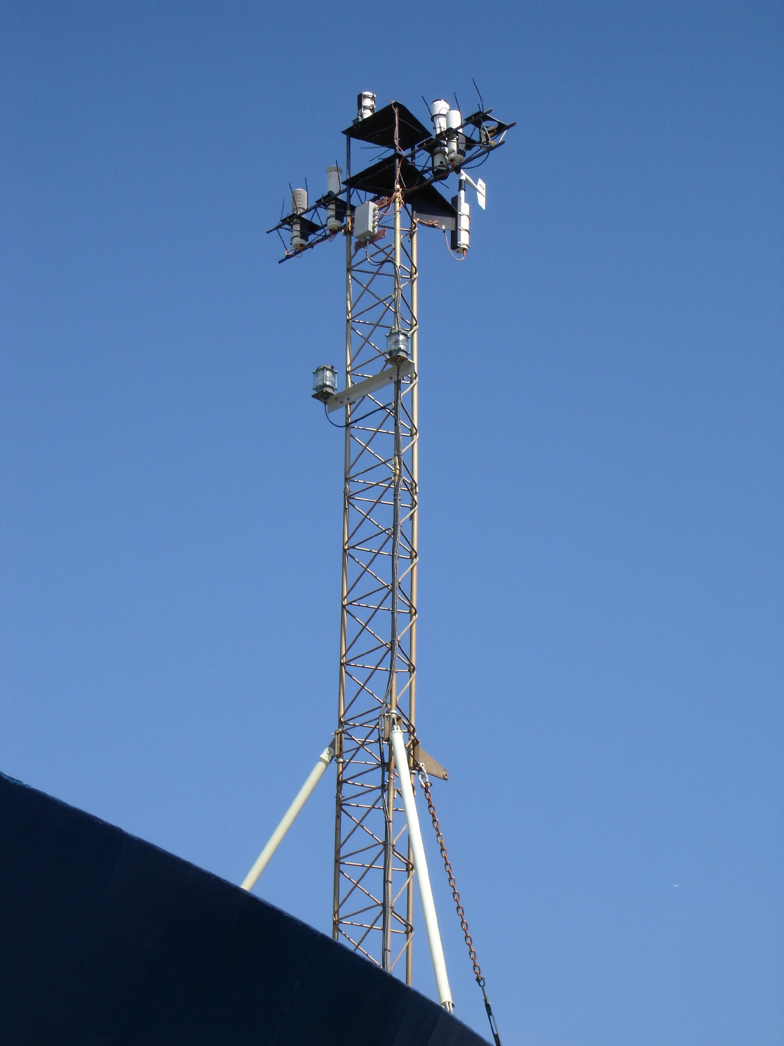
Notes:
Facilitator Notes:
Example of well-exposed Met sensor system on a bow mast.
Limitations: May not be able to service at sea in rough conditions, can still be affected by vessel heat and exhaust when winds are from the stern (rare condition).
‹#›

Slide 6
Notes:
Focus on T/RH sensors.
Sensors had a history of erratic recording (often higher than expected temps)
Suspect rapid upward airflow on flat facing front of vessel impacting sensors along with proximity to black masts.
Recommendation: move to port and starboard bridge wing rails.
‹#›

Slide 7
Notes:
Facilitator Notes:
Focus attention on anemometers.
Good exposure for port/starboard installation of anemometers. They are high enough to likely be above severe flow acceleration over wheelhouse.
Operating conditions of this vessel do not allow wind sensors to be placed on bow.
‹#›

Slide 8
Notes:
Facilitator Notes:
Knowing vessel’s operating environment is essential. Icing of sensors common at some latitudes.
Solution – Use sensor heaters when possible. When sensor is noted to be frozen, make note of date/times in an electronic log to allow downstream users to be aware of condition.
‹#›

Slide 9
Questions?

Slide 10
Notes:
Prompt: On this new vessel, what would be the best location for
Anemometer
Thermometer/hygrometer
Solar radiation sensors
‹#›

Slide 11
Notes:
Prompt: On this new vessel, what would be the best location for
Anemometer
Thermometer/hygrometer
Solar radiation sensors
Note: Lots of options for radiometers. High on mainmast may expose them more to soot. Foremast and atop the bridge allow easier access, but top of bridge may be prone to shadows at low sun angles (knowing operating environment is key).
‹#›

Slide 12
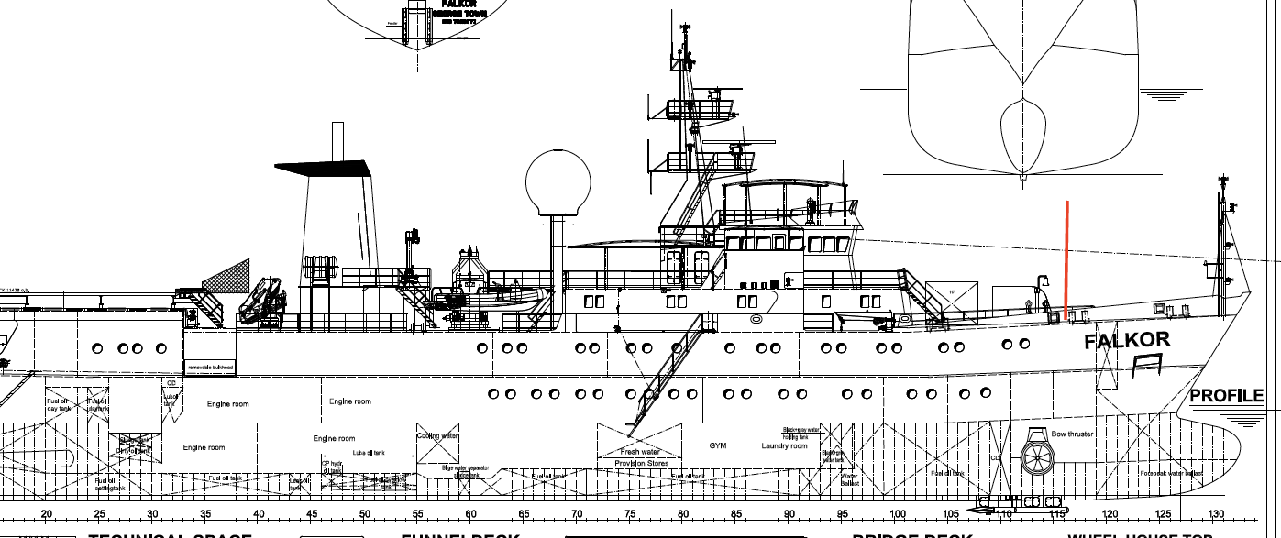
Invitation to Examine Your Vessel
We invite each operator to examine the location of the Met and sea water measurement systems on their vessel.
Please consider the exposure of each instrument discussed in this short course. Is it in the best possible location?
Please contact either of the facilitators or send a message to samos@coaps.fsu.edu to get recommendations for your vessel.
Digital imagery and schematics are essential to make these determinations for someone not on the vessel.
Notes:
Facilitator Notes:
Imagery like that shown in this presentation, along with vessel diagrams (schematics), are necessary to determine good sensor exposure. Ship visits are another option.
‹#›

Slide 13
Wrap-Up
Thank you for participating!
Please take a moment to provide feedback on the course at
http://www.surveymonkey.com/s/SH3RBQR
Course content and presentations will be available at
http://samos.coaps.fsu.edu/html/mt_shortcourses/http://samos.coaps.fsu.edu/html/mt_shortcourses/shortcourse_Inmartech2014.http://samos.coaps.fsu.edu/html/mt_shortcourses/shortcourse_Inmartech2014.php
Questions can be sent to
Shawn Smith: smith@coaps.fsu.edu
Daniel Wolfe: Daniel.Wolfe@noaa.gov
Jeremy Rolph: rolph@coaps.fsu.edu
Notes:
‹#›

