Slide 1
Sensor Siting and Exposure
Presented by Marc Castells

Slide 2
Introduction
Location of the sensors is the most critical aspect for accurate measurement of meteorological variables.
The difficulties of making these measurements aboard a ship include:
alteration of airflow by the vessel structure prior to air reaching the sensor (known as flow distortion);
exposure of the sensor to sea spray, salt contamination, and vessel exhaust;
vessel motion influencing collected data; and
maintaining hard to reach instruments while underway.

Slide 3
Instrument Location
Sensor Siting Locations
Air temperature
Humidity
Wind speed/direction
Radiation
Rainfall
Notes:
R/V Ronald H. Brown (NOAA)
R/V Southern Surveyor (CSIRO)
Locations suggested for different types of meteorological sensors include (A) foremast, (B) foredeck lattice mast, (C) pole above the wheelhouse, (D, E) port and starboard locations for redundant sensors, (F) top of mainmast, (G) top of foredeck mast, and (H) top of doghouse or aft crane shack.
Temperature
Humidity
Wind speed and direction
Radiation
Rainfall

Slide 4
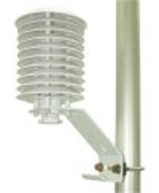
Instrument Location
Air Temperature
Notes:
Locations suggested for different types of meteorological sensors include (A) foremast, (B) foredeck lattice mast, (C) pole above the wheelhouse, (D, E) port and starboard locations for redundant sensors, (F) top of mainmast, (G) top of foredeck mast, and (H) top of doghouse or aft crane shack.
Temperature
Question: Why is the main mast usually not an ideal location for a temperature sensor?
Answer: Air can flow over large areas of the often warm deck before reaching the sensor.

Slide 5
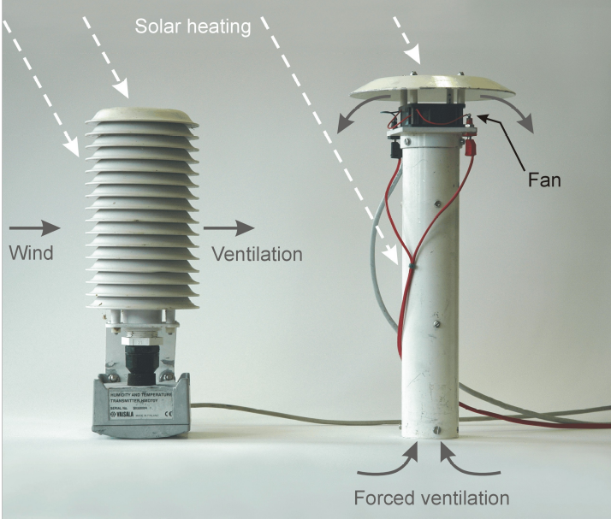
Air Temperature Sensor
Mounted as far forward as possible to avoid heat contamination from the ship.
Having duplicate sensors to port and starboard provides better data recovery.
Sensor should be shielded and ventilated.
Must avoid sea spray being drawn into the air inlet.
Notes:
R/V Ronald H. Brown (NOAA)
R/V Southern Surveyor (CSIRO)
Locations suggested for different types of meteorological sensors include (A) foremast, (B) foredeck lattice mast, (C) pole above the wheelhouse, (D, E) port and starboard locations for redundant sensors, (F) top of mainmast, (G) top of foredeck mast, and (H) top of doghouse or aft crane shack.
Temperature
Question: Why is the main mast usually not an ideal location for a temperature sensor?
Answer: Air can flow over large areas of the often warm deck before reaching the sensor.
The temperature sensor should be as far forward as possible to avoid heat contamination from the ship. Avoiding heat contamination is impossible when the wind is from astern, so having duplicate sensors to port and starboard is one solution to provide better data recovery. The temperature sensor should be shielded and ventilated, but care must be taken to ensure that there is no possibility of sea spray being drawn into the air inlet. Although the mainmast may have a well-exposed site for wind instruments and be clear of sea spray, it is usually a poor location for temperature sensors that can then “see” large areas of the (often warm) deck.

Slide 6
Instrument Location
Humidity
Notes:
Locations suggested for different types of meteorological sensors include (A) foremast, (B) foredeck lattice mast, (C) pole above the wheelhouse, (D, E) port and starboard locations for redundant sensors, (F) top of mainmast, (G) top of foredeck mast, and (H) top of doghouse or aft crane shack.
Question: How much does the wind and temperature distortion caused by the ship affect the humidity measurements?
Answer: Not much, but it is important that the temperature of the air surrounding the humidity sensor is recorded, and since the two measurements are commonly made by the same package, the more stringent requirements of the temperature sensor ensure that the humidity sensor is also well exposed. The location must, however, permit access to the humidity element for periodic maintenance. If a psychrometer is being used, it will also be necessary to top off the water reservoir with distilled water from time to time.

Slide 7
Humidity Sensor
Not affected much by wind and temperature distortion of the ship.
However, air temperature surrounding humidity sensor must be recorded, and the two measurements are usually made in the same package.
Therefore, the more stringent exposure requirements of the temperature sensor ensure that the humidity sensor is also well exposed.
Notes:
Locations suggested for different types of meteorological sensors include (A) foremast, (B) foredeck lattice mast, (C) pole above the wheelhouse, (D, E) port and starboard locations for redundant sensors, (F) top of mainmast, (G) top of foredeck mast, and (H) top of doghouse or aft crane shack.

Slide 8
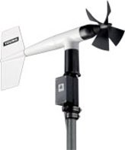
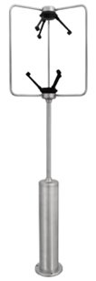
Instrument Location
Wind speed/direction
Notes:
Locations suggested for different types of meteorological sensors include (A) foremast, (B) foredeck lattice mast, (C) pole above the wheelhouse, (D, E) port and starboard locations for redundant sensors, (F) top of mainmast, (G) top of foredeck mast, and (H) top of doghouse or aft crane shack.
Wind speed and direction
The most important requirement of the wind sensors is that they should have no obstruction upwind. A single speed/direction set can be mounted on a forward-facing arm from a foremast or high on the mainmast. With only one set of instruments, there will always be a sector astern over which the relative wind will be in error. If two wind sets are available, it is good practice to mount one on each side of the ship and give preference to whichever has the best exposure to the relative wind.

Slide 9
Wind Speed and Direction Sensor
Should have no obstruction upwind.
A single speed/direction sensor can be mounted on a forward-facing arm from a foremast or high on the mainmast.
With only one set of instruments, there will always be a sector astern over which the relative wind will be in error.
If two wind sets are available, it is good practice to mount one on each side of the ship and give preference to whichever has the best exposure to the relative wind.
Notes:
Locations suggested for different types of meteorological sensors include (A) foremast, (B) foredeck lattice mast, (C) pole above the wheelhouse, (D, E) port and starboard locations for redundant sensors, (F) top of mainmast, (G) top of foredeck mast, and (H) top of doghouse or aft crane shack.
Wind speed and direction
The most important requirement of the wind sensors is that they should have no obstruction upwind. A single speed/direction set can be mounted on a forward-facing arm from a foremast or high on the mainmast. With only one set of instruments, there will always be a sector astern over which the relative wind will be in error. If two wind sets are available, it is good practice to mount one on each side of the ship and give preference to whichever has the best exposure to the relative wind.

Slide 10
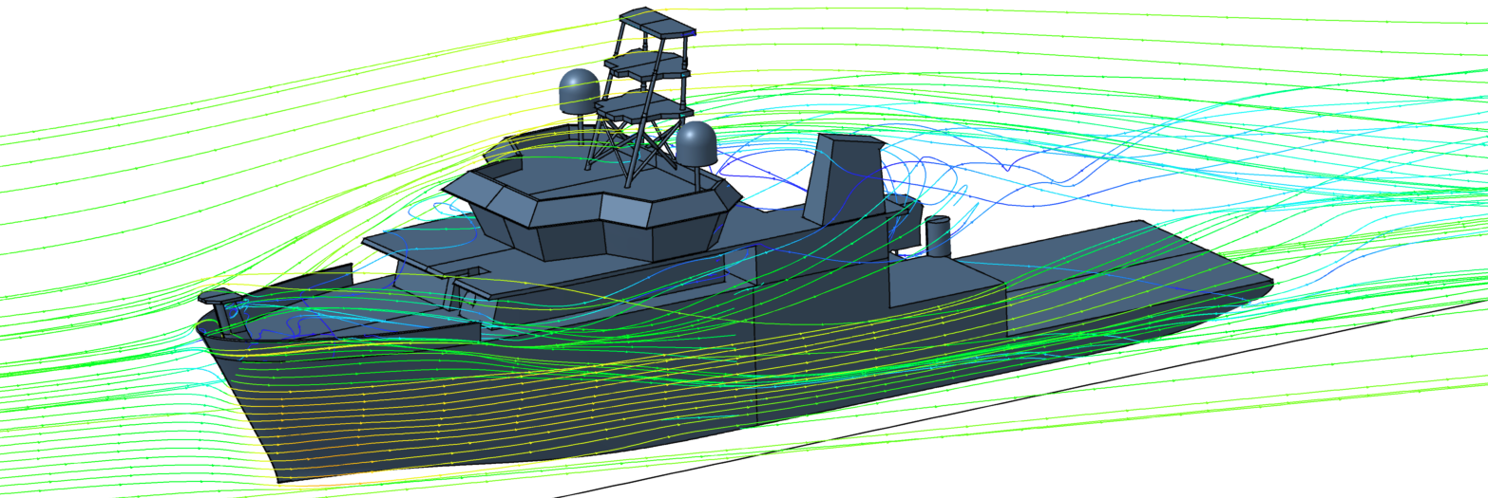
Flow Distortion
Notes:
Regional Class Research Vessel Design
Mast Airflow Computational Fluid Dynamics (CFD) Study performed for Oregon State University
July 6, 2020
Top: 12 kts vessel speed, 20 kts headwind
Bottom: 12 kts vessel speed, 20 kts at 30 degrees off starboard bow
Results of the CFD study indicate that meteorological instrumentation installed atop the current forward and main mast design will encounter clean airflow. Airflow likely to pick up mist or salt particulates from sea water is almost entirely diverted down and along the vessel’s sides as a result of the bow shape.

Slide 11
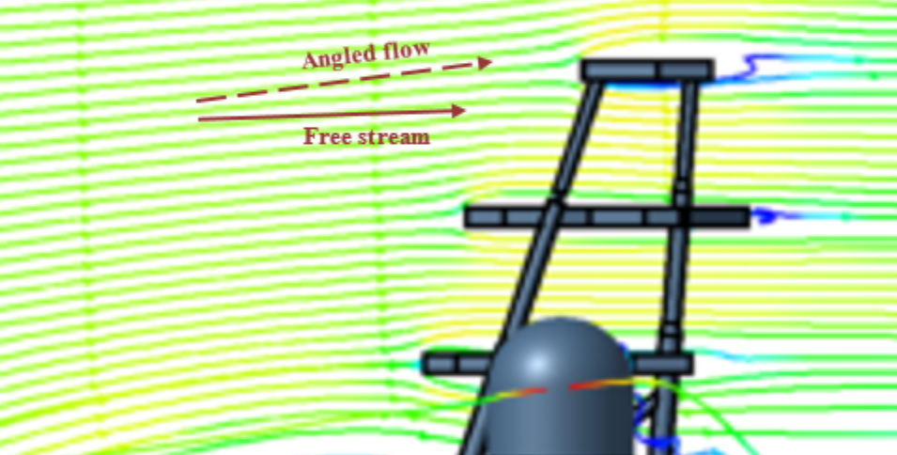
Forwemast and Mainmast
Notes:
Regional Class Research Vessel Design
Mast Airflow Computational Fluid Dynamics (CFD) Study performed for Oregon State University
July 6, 2020
Results of the CFD study indicate that meteorological instrumentation installed atop the current forward and main mast design will encounter clean airflow. Airflow likely to pick up mist or salt particulates from sea water is almost entirely diverted down and along the vessel’s sides as a result of the bow shape.

Slide 12
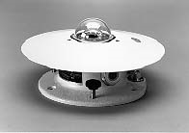
Instrument Location
Radiation
Notes:
Locations suggested for different types of meteorological sensors include (A) foremast, (B) foredeck lattice mast, (C) pole above the wheelhouse, (D, E) port and starboard locations for redundant sensors, (F) top of mainmast, (G) top of foredeck mast, and (H) top of doghouse or aft crane shack.

Slide 13
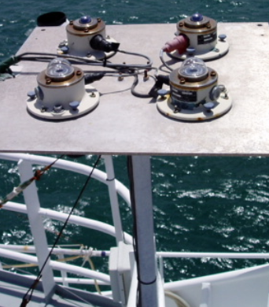
Radiation Sensor
Upward-facing radiometers need an all-round, horizon-to-horizon view with minimal obstruction by parts of the ship, which will cast shadows on the pyranometer and be a source of thermal radiation for the pyrgeometer.
Possible locations are the top of the mainmast or foremast, providing they are accessible at sea under moderate weather conditions so that the domes can by cleaned periodically and the desiccant replaced.

Slide 14
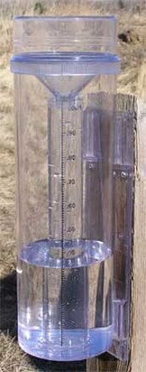
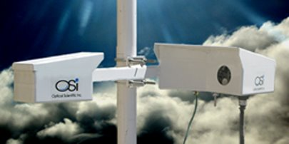
Instrument Location
Rainfall
Notes:
Locations suggested for different types of meteorological sensors include (A) foremast, (B) foredeck lattice mast, (C) pole above the wheelhouse, (D, E) port and starboard locations for redundant sensors, (F) top of mainmast, (G) top of foredeck mast, and (H) top of doghouse or aft crane shack.
Question: Why would C be a bad location for this sensor?
Answer: Strong updrafts (next slide)

Slide 15
Rainfall
A
C
Notes:
Avoid strong updrafts

Slide 16
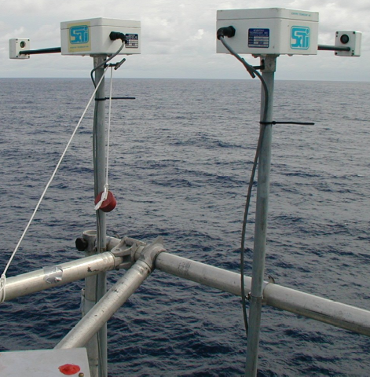
Rainfall Sensor
Accurate measurements of rainfall on ships has a strong dependence on location of the instruments, with the foremast being the best location.
Funnel gauges should not be mounted in a location of strong updrafts, such as on a rail just above the side of the ship or above the wheelhouse, where they will lose catch.
Rain gauges located on the aft part of the ship may overestimate by catching water that has accumulated on the superstructure.

Slide 17
Takeaways
Sensor location and exposure will be a compromise between the scientifically “best” location for the sensor and the operational realities on board a vessel.
Ideally, sensors should be exposed to the air before it flows over the bulk of the vessel’s decks and super structure, i.e. forward on the ship, ahead of the engine and air-conditioner exhausts, preferably high on a forward mast, high enough to be above spray when the ship pitches in heavy seas.
Deploying redundant sensors can allow the selection of data from the sensor that is best exposed to the vessel-relative wind flow.

