Slide 1
Sensor Metadata and QC

Slide 2
Making Data Meaningful
Data
Metadata
Notes:
Facilitator’s notes:
Sensor data is just numbers. Metadata is all the supplementary information that gives data “weight,” or context.
Prompt:
There are many different types and avenues of metadata. As marine technicians collecting weather and ocean surface observations, what do you think are the key components for you to document metadata-wise?
Answers: (next slide)

Slide 3
Metadata
The basics
Ship name
Time convention (preferably GMT [UTC])
Parameters measured
Recorded units of observations (preferably SI)
Data sampling rates
Averaging or calculation methods (e.g., true wind vs. ocean-relative winds)
Sensor calibration & history
Make/Manufacturer
Model
Serial number
The date and source of each calibration (indicates stability of sensor)
Dates of sensor deployment (and recovery)
Incidents during deployment period (maintenance, repairs, mishaps--e.g., swamped by wave over bow)
Notes:
Additional note, most data acquisition software may have built-in offsets of which the technician should be aware and which may need to be reported as metadata. An example would be the zero offset for aligning a wind sensor to the vessel.

Slide 4
Instrument Location Metadata
Height/depth from the waterline and/or height above some ship reference (e.g., 15.3 m above foredeck)
Position w.r.t. ship’s centerline (e.g., 2.5 m to port or stbd)
Distance from bow
Depth of sea water intake
Also, approximate pipe run length to sensor
Coordinate system of vessel - https://www.rvdata.us/community/ship-operators/sensor
Description and location of main support (e.g., foremast, forward rail above wheelhouse)
Any significant object that may affect the exposure of the instrument (e.g., Inmarsat dome on rail 2 m to port; after installation large instrument box mounted 1 m forward)
Notes:
Facilitator’s notes:
At minimum, document the sensor’s height above the mean water line (or the plimsol line) – most important location element for science users.
For sea temperature and salinity, it is essential to note the depth of the intake port for the sea water even if the TSG is far removed from the port. Users want to know the approximate ocean depth where the water came from.
If a vessel has a known location for an origin of an x, y, z coordinate system (usually from a survey), instruments can be measured from that origin, BUT it’s important to note that the difference in z between the origin and the plimsol must be known and recorded.

Slide 5
Digital Imagery Metadata
Notes:
Facilitator Notes:
Some general rules of thumb to consider when composing images:
Best to incorporate both a close-up of the instrument and an overview shot of the area. Composite graphics with labels are really helpful.
close-ups show instrument and immediate surroundings clearly
overviews shoot for ~5 m clearance
Include anything that could “shadow” the instrument (And especially with your light sensors, SW/LW/PAR, where literal cast shadows matter, this could mean including structures well outside of a 5 m radius, depending on how low on the deck the radiometers are in relation to the tallest structures, like the pilothouse or the stacks)
Keep an eye toward demonstrating heights/distances, i.e., instrument height (try to include deck), clearance between instrument and ship’s equipment it might be mounted above (e.g. storage shed)
Good port and stbd profile shots will round it all out. These shots are ideally taken from shore/dock when the ship is in fully unobstructed view. Or sometimes these days drone shots could be an option, you would just want the shot to be taken level with the ship.
All useful to keep in mind when working with schematics, too.

Slide 6
Digital Imagery Metadata
2013
2014
Notes:
Facilitator’s Notes:
Note the composite images and the clear labeling of sensors. Also important to update imagery whenever sensors added or moved.

Slide 7
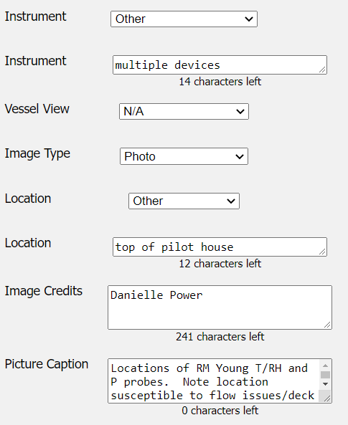
Metadata about Metadata!
Notes:
Facilitator’s Notes:
(SAMOS image upload web tool)
A good picture really is worth a thousand words!

Slide 8
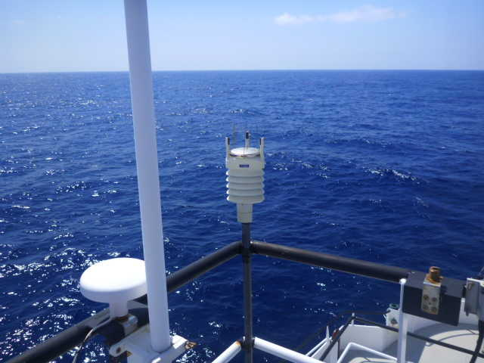
Managing Data Quality
Notes:
Prompt: QC, or quality control, takes place after the data has been collected and assembled. Vs. quality assurance, or QA, which is the responsibility of the data collector. As technicians, what are some steps you can take to ensure the quality of the meteorological observations on your own vessels?
Answers: (next slide)

Slide 9
Five Steps for Quality Assurance
Good sensor exposure
Sensor calibration
Program for cleaning and maintenance
Routine checks of sensor output
Documentation (a.k.a. metadata)
Notes:
Facilitator Notes:
Sensor Exposure – covered in the first session.
The course content for these modules covers calibration, maintenance, and data monitoring in detail.
Other key routines would be to always log the raw data from your sensors, and make sure you’ve read the sensor manuals
Prompt: As marine technicians, what are some ways you check or monitor the sensor output on your own vessels?
Answers: (next slide)

Slide 10
Spot Checks of Data
Monitor data
Use graphical displays on the vessel (daily if possible).
Conduct periodic checks with handheld instruments.
Compare to nearby station
Make visual estimates to verify winds. http://en.wikipedia.org/wiki/Beaufort_scale.
Participate in a shoreside monitoring program.
Notes:
Facilitator Notes:
Noted Australian scientist Frank Bradley using a ventilated psychrometer to measure air temperature and humidity. When doing these handheld comparisons, if possible, you want to take measurements as near as possible to the location of the automated sensor.
Comparison to nearby station (buoy or coastal station) – best for pressure, air temperature, and humidity (sometimes wind). Need to realize that land stations can be affected by local conditions, so a location very near the ship is best.

Slide 11
Quality Control
Responsibility of data users and data center
Common quality control includes the following:
Verifying temporal sequence
Ensuring values are in a plausible range
Comparing values to a known marine climatology
Verifying physical relationships (e.g., dew point temperature not greater than air temperature)
Ensuring ship position is over water and distance between sequential locations is plausible (track checking)
Validating true wind (and other) calculated values
SAMOS provides shoreside monitoring and quality control.
Notes:
Facilitator’s notes:
physically plausible: for example, checking to see that relative humidity values aren’t negative. These are broad ranges, as opposed to comparing values to a known marine climatology.
These are all tests that SAMOS has automated.

Slide 12
QC Example
Not all problems can be identified with simple QC tests.
Visual inspection and use of metadata can identify problems.
Notes:
Facilitator Notes:
Visual inspection and use of metadata can identify problems that are difficult to determine with automated tests. This is where the accuracy and completeness of metadata becomes really important.
In the example, note that air temperature, dew point temperature, and humidity all show anomalous values when the ship-relative winds are from the vicinity of the vessel stern (around 170-200 degrees).
Ship names removed from examples. Not judging operators, just showing real-world examples.

Slide 13
QC Example
Notes:
Facilitator Notes:
In this case, a digital photo of the vessel along with the reported position of the air temperature sensor (on main mast forward of stack) allowed us to confirm that the suspect air temperatures are caused by stack exhaust passing the thermometers. METADATA really matters!
Prompt: Can you recommend a possible solution here?
Answer: Move the air temperature sensor farther forward, possibly to the bow mast.

Slide 14
Keeping Metadata Current
Notes:
Facilitator’s notes:
Filling out metadata for sensors not a “one and done” activity. Details need to be kept current. For example, after a sensor comes back from calibration. For the most part we rely on the tech community to notify us when anything changes. We recognize marine techs are very busy, typically with many more and higher priorities going on all the time.
Prompt: Basically we've been trying for a while to improve the timeliness of metadata updates reported to SAMOS. What would you propose?
Answer: suggestions? (some in-house methods/ideas on next slide)

Slide 15
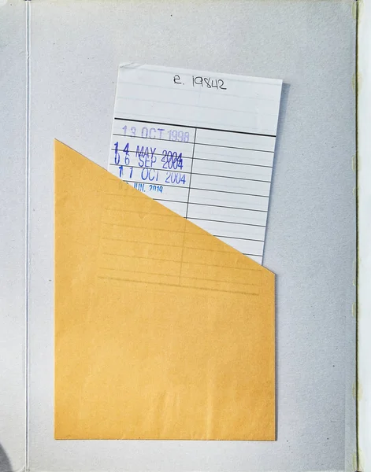
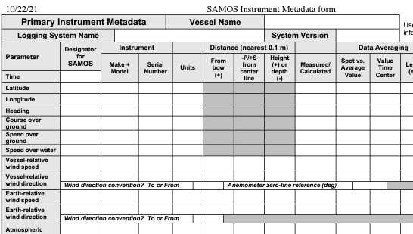
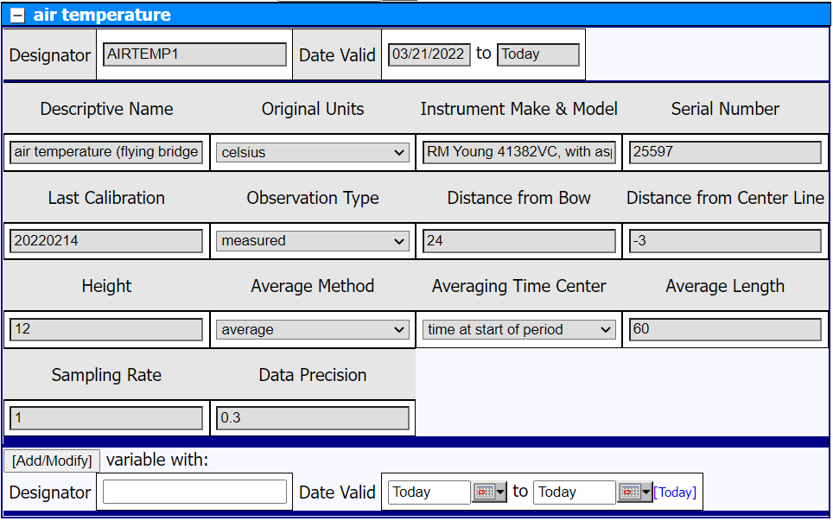
Keeping Metadata Current - Other Ideas?
x 3 or 4 a year
URL
query
Notes:
Facilitator’s Notes:
(bottom right) blank SAMOS instrument metadata form, (top left) enhanced spreadsheet of current metadata values, (bottom left) metadata update web interface. Other ideas: check in with vessel 3 or 4 set times per year? some kind of a “checkout” system for current info for a single variable (maybe a web service: URL query returns a JSON of the info)?
Other ideas???

Slide 16
Wrap-Up
Notes:
Facilitator’s notes:
While these days meteorological data collection at sea occurs primarily via automated sensing systems, providing quality data to the community still requires end-to-end human effort. “QA,” the monitoring and maintaining of sensors to promote quality measurements is the responsibility of the technician. Data centers and data users are in charge of assessing collected data and making decisions about data fitness based on objective means (like automated tests) and subjective/manual interpretations (such as visual data flagging). A final note that in the realm of QC, current metadata is vital for both the automated and manual processes, so it’s important to keep metadata up-to-date for your sensors.
Prompt: Any questions?

Slide 17
Common Installation Problems
Anemometer orientation
Pressure port (dynamic shield)

Slide 18
Suggested Calibration Intervals
Mechanical Anemometer – Yearly (more often, if possible)
Sonic Anemometer – 3 to 5 years (generally replace)
Thermometer/Hygrometer – 1-2 years (if routinely cleaned, also generally replaced)
Radiometers – 3 to 4 years (if cleaned and inspected)
Barometer – 3 to 5 years (pretty robust sensors)
Siphon rain gauge – Yearly
Optical rain gauge – unknown
TSG – Yearly (more often depending on operating conditions)
Notes:
NOTE: One concern with “all-in-one” met packages is that sensors likely have varying life expectancy.
Calibration
Minimum – Follow manufacturer instructions
Realistic – Yearly
Ideal – Before and after each cruise
Record calibration history and make available to users.

Slide 19
Maintenance
Critical to data accuracy
Cleaning radiometer domes, removing salt buildup
Replacing filters, desiccant, etc.
Notes:
Facilitator Notes:
Bird guano is a big problem on radiometers and rain gauges.
Salt build-up will reduce the quality of relative humidity measurements.

Slide 20
QC Example
Notes:
Facilitator Notes:
When the values flagged as suspect by a trained data analyst are plotted versus the ship-relative wind, a clear pattern emerges. The largest percentage of flagged air temperature occurs when the wind is from the stern of the vessel and are typically E, K, or S flags.
Prompt: What may cause air temperature to be influenced by ship-relative wind direction?
Answer: The exhaust plume from the ship passes over the temperature sensor.
Note: Dots represent flagged air temperatures (colors are different tests, but that is not important for this exercise).
Bars are % of air temperature data flagged in each 1-degree ship-relative wind bin.

Slide 21
SAMOS examples: Lat/Lon Spikes
Notes:
Here we see either GPS on the fritz, or we have some electrical interference. Clearly the vessel could not have traversed several degrees of lat and or lon and return to a reasonably expected location.

Slide 22
SAMOS examples: Acceleration Spikes
Heading
SOG
True Wind
Direction
True Wind
Speed
Notes:
In this example, we see acceleration spikes in the true wind direction and speed resulting from the vessel turning and speeding up as evident in the heading, platform speed, and true wind data.

Slide 23
SAMOS examples: Air Flow Obstruction
Port Relative
Wind Direction
Stbd. Relative
Wind Direction
Port True
Wind Speed
Stbd. True
Wind Speed
Notes:
Here we see (vaguely) that the platform relative wind direction has changed (likely due to vessel maneuvers) and the true wind speed from the starboard anemometer decreases and there are 2 acceleration (deceleration) spikes in the port anemometer. We also see the largest decreases in SPD2 when the relative winds are from around 220/270, or port aft of the vessel. This wind must traverse the entire science deck of the vessel, the wheel house, stadck, etc and has thus been obstructed and velocity reduced.

Slide 24
SAMOS examples: No Pressure Port
Notes:
Here we see anomalous variation in the pressure due to changing platform relative wind directions. You can see pressure reduction when winds blow from about 270-350 degrees. These dynamic pressure changes can be reduced by using a Gill-type pressure port.

Slide 25
SAMOS examples: T/RH Steps
Ship-Relative
Wind Direction
Ship-Relative
Wind Speed
Air
Temperature
Relative
Humidity
Notes:
This example is of a maneuvering vessel resulting in high frequency variation of the relative winds’ direction and speed. Here, we see increased temperatures at lower wind speeds as the winds rotate from 90-270, passing over the stern of the vessel, resulting in increased temperatures and reduced RH.

Slide 26
SAMOS examples: T_{sea} Intake Problem
Notes:
Use of flow meter in pipe may support additional QC tests for pumps being off. In this example, we see dry air being taken in by the vessel bobbing in seas or with a leak in a line.

Slide 27
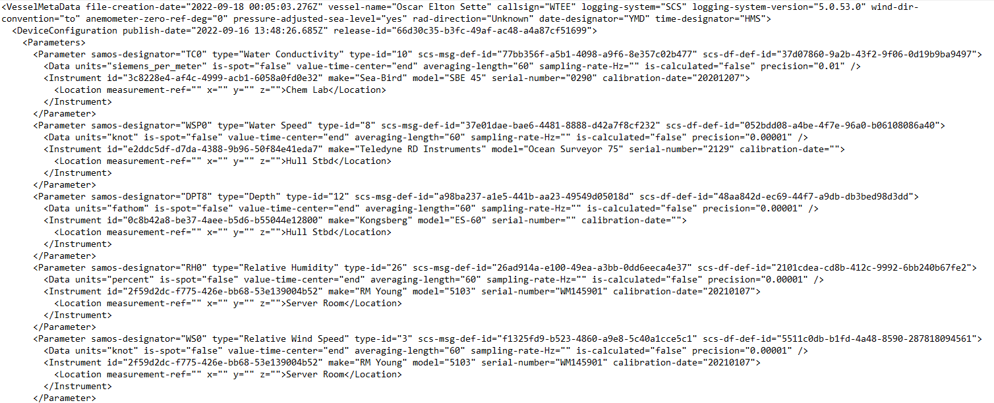
Metadata XML Example
Notes:
SCS v5 and Coriolix (RCRV’s) generate instrument metadata in XML format that goes out automatically every time a SAMOS data file is sent. This makes it easier on techs, you only need to enter the metadata in one place (in your data acquisition/assembly server) and it can get sent out to multiple data submission programs. (Still need to ensure it’s kept up-to-date, though.)

