Slide 1
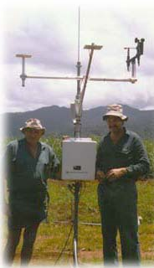
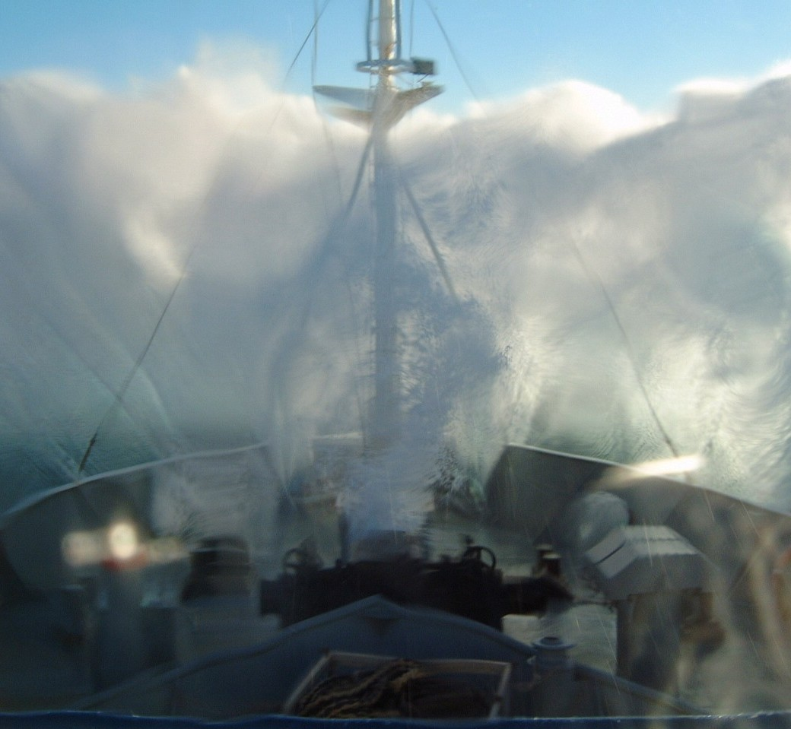
Lesson 2:
Common Sensors and Measurements Systems
If only it were this simple!
Notes:
Main Point:
We will be discussing how the various measurements are made and showing examples of the types of sensors currently in use.
Mention of a specific manufacturer or design is not an endorsement.
Feel free to ask questions at anytime.

Slide 2
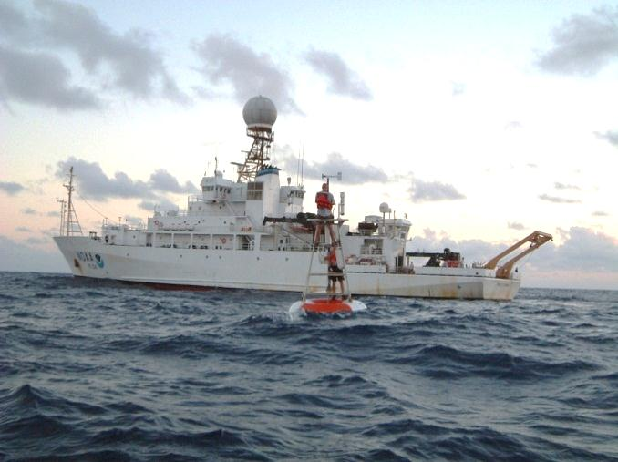
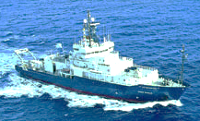
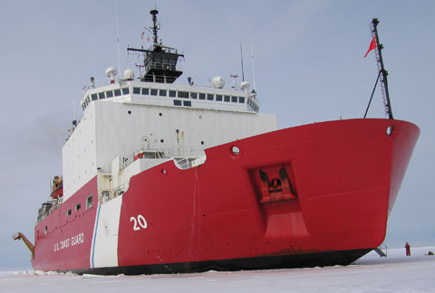
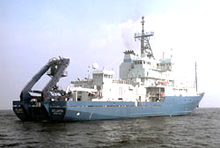
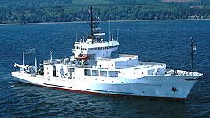
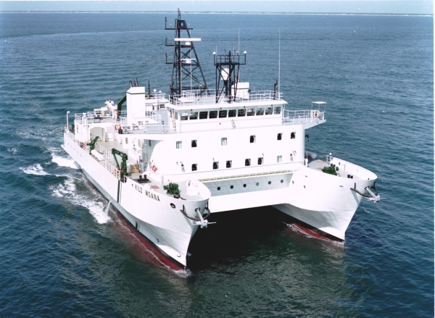
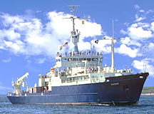
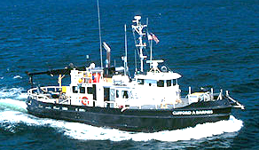
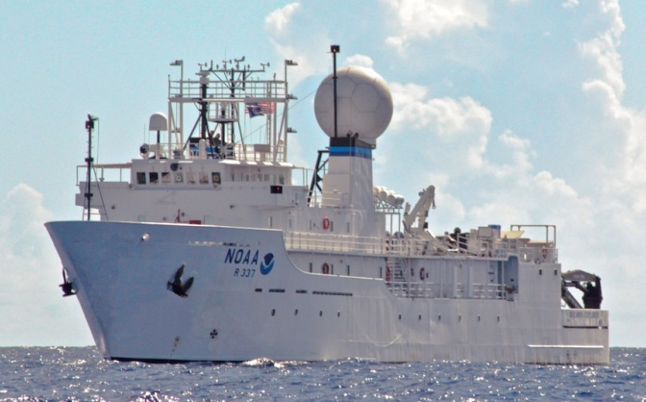
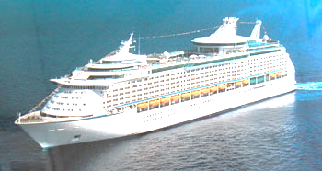
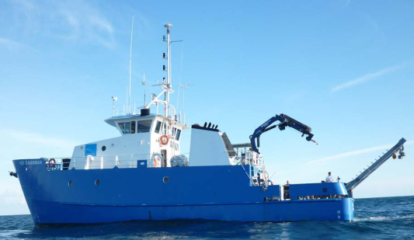
Brown
Revelle
Healy
Atlantis
Thompson
Kilo Moana
Knorr
Clifford A Barnes
Okeanos Explorer
Explorer of the Seas
Savannah
Notes:
Just as there are many different shapes and sizes of ships, there are many different types and styles of meteorological sensors you can mount on these ships to take measurements.
Direct vs Indirect measurements……
Most measurements require a conversion from some engineering units (volts, resistance, capacitance) to SI units. This is direct.
But there are times where you measure another parameter and it takes some empirical relationship to get say rain rate as you will see later.

Slide 3
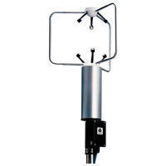
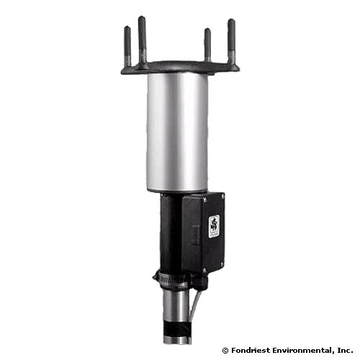
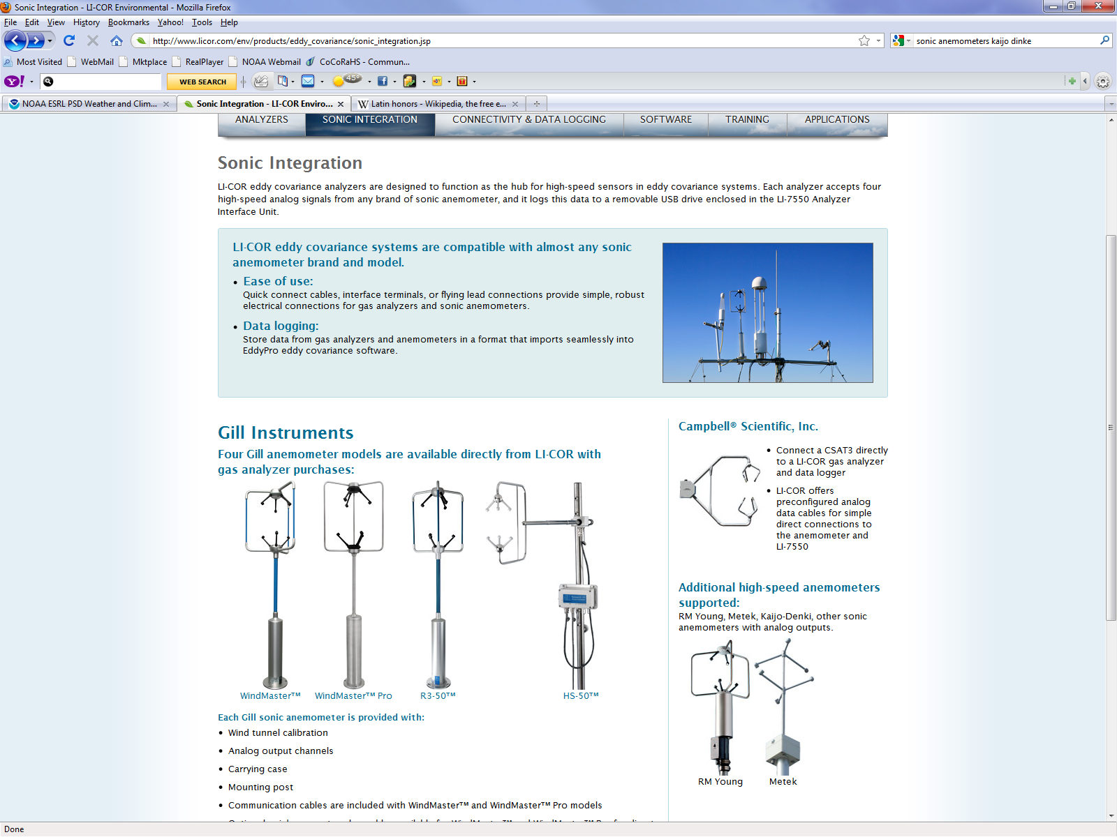
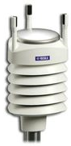
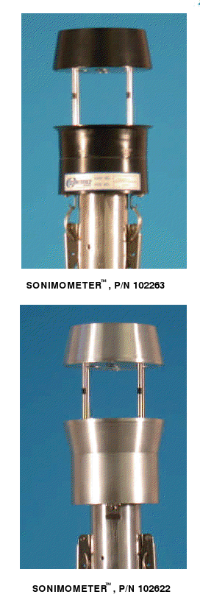
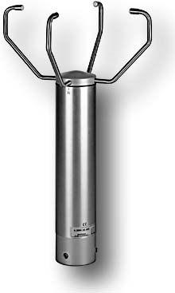
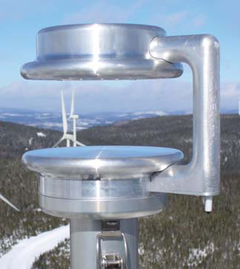



Sonic Anemometers
Notes:
Only a few of the different types of sonic anemometers

Slide 4
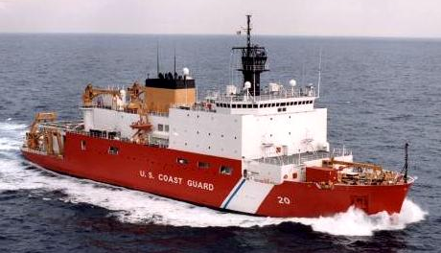
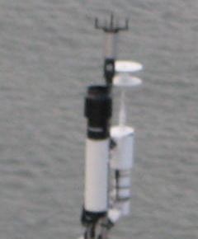
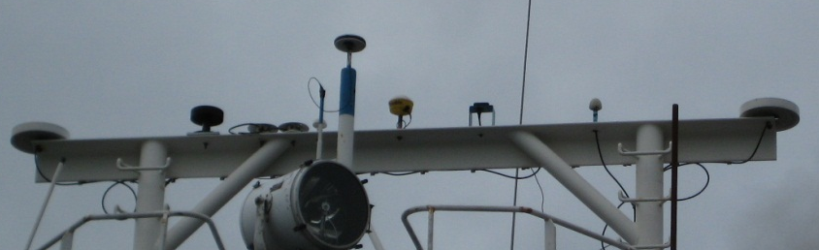
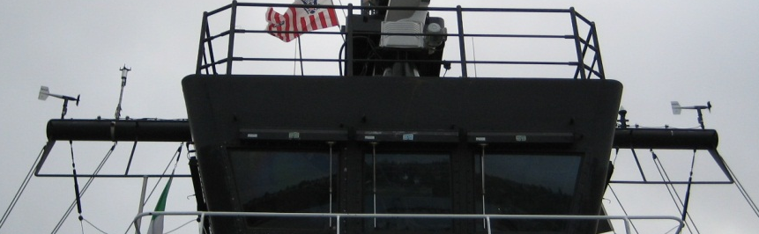
HEALY 2008
Main Mast
Forward Mast
PSP and PIR radiometers
Ultra Sonic & Prop-Vane (stbd)
Prop-Vane (port)
Ultra Sonic, T/RH/P
Notes:
Healy has 2 different types of wind sensors and some are used and maintained by the science side and others by the ship (navigation/bridge)

Slide 5
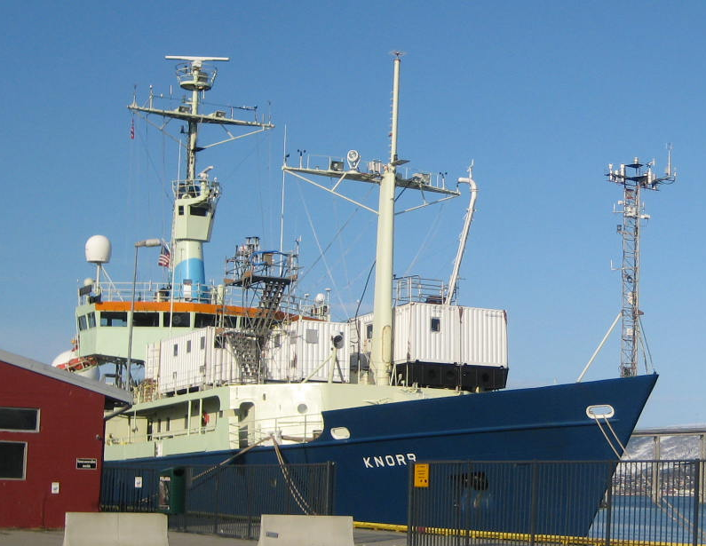
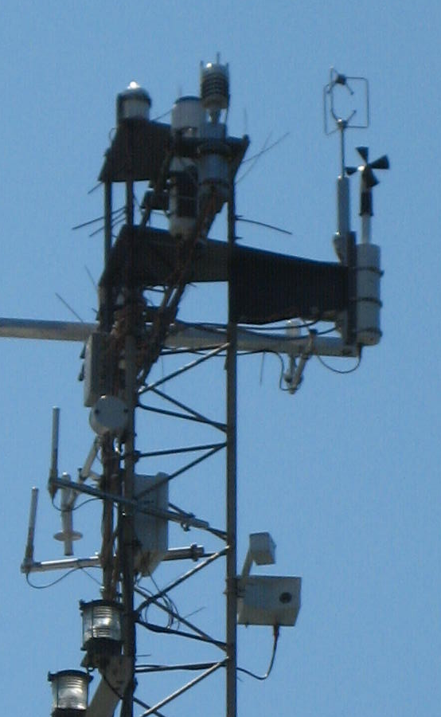
WXT, Prop-Vane,
IMET
ICEALOT 2008
Notes:
2-sonics and 1 prop-vane The prop-wane and WXT sonic belonged to the ship.

Slide 6
Wind Speed and Direction
Air temperature and humidity
Atmospheric pressure
Incoming short- and long-wave radiation
Rainfall
Sea surface temperature
Ship’s heading
Ship’s course over ground (COG)
Ship’s speed over ground (SOG)
Time (UTC)
Notes:
Again just a reminder of the measurements we are focusing on.

Slide 7
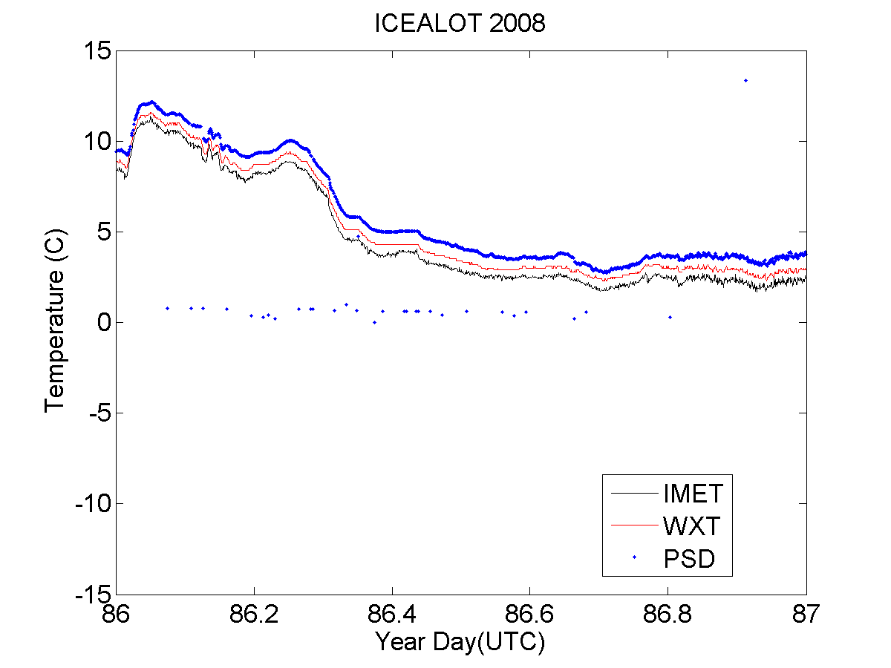
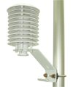
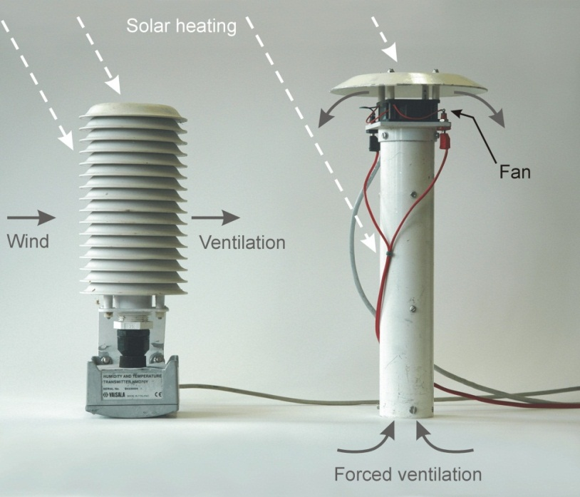
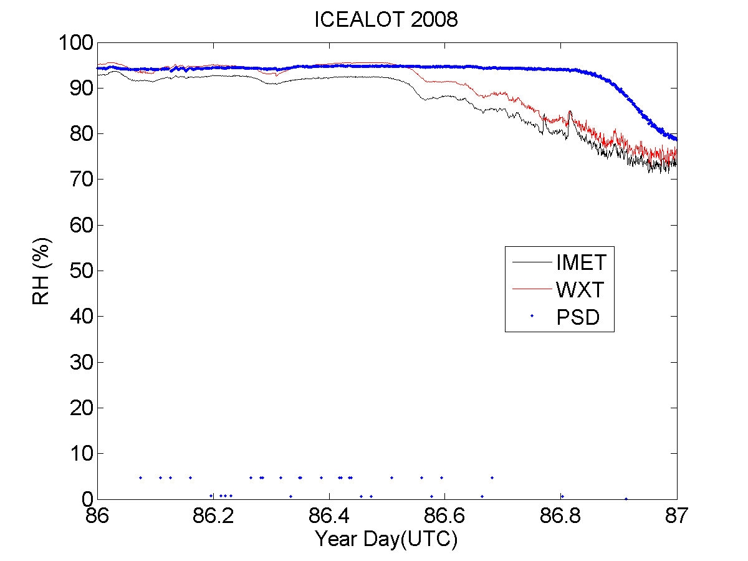
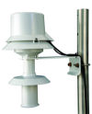
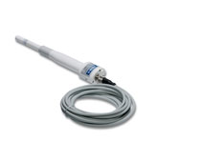
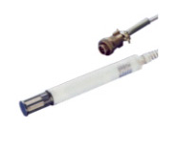
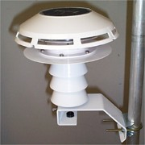
Air temperature and humidity
Notes:
Type of sensors:
Temp....Thermistors (RTD), thermocouples del(R) = k* del(T)
RH.... Capacitance or resistance
The most usual causes of error in air temperature measurement are sources of anomalous heating; the sun and the ship.
Ventilation: Natural (wind), van
The ship itself is a massive source of heat, and almost any location aft of the bow will measure air that has passed over some area of warm steel
Thus, relative wind direction is a critical part of the data record.
Most systems combine air temperature and humidity sensors in the same package, so they are subject to the same conditions of ventilation and screening from solar heating.
Indirect measurement (next slide)

Slide 8
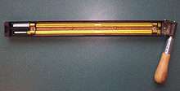
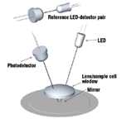
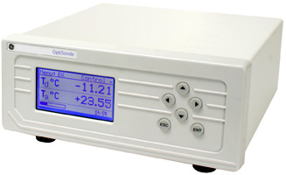
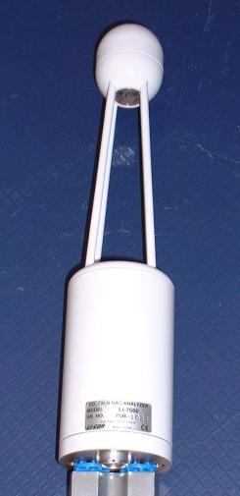
Humidity indirect measurement
Psychrometer
(Wet/Dry Bulb)
Chilled Mirror
(Dew point)
LICOR 7500 gas analyzer
(Water vapor)
Notes:
Here are a ways to indirectly measure RH.
All require formulas or tables to compute RH.
Psychrometer is often used as a reference when careful measurements are taken (well ventilated and at night)
Cool mirror is often used for very low humidity's and is very accurate.
Gas Analyzer uses changes in IR intensity across a given path

Slide 9
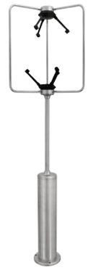
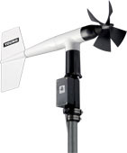
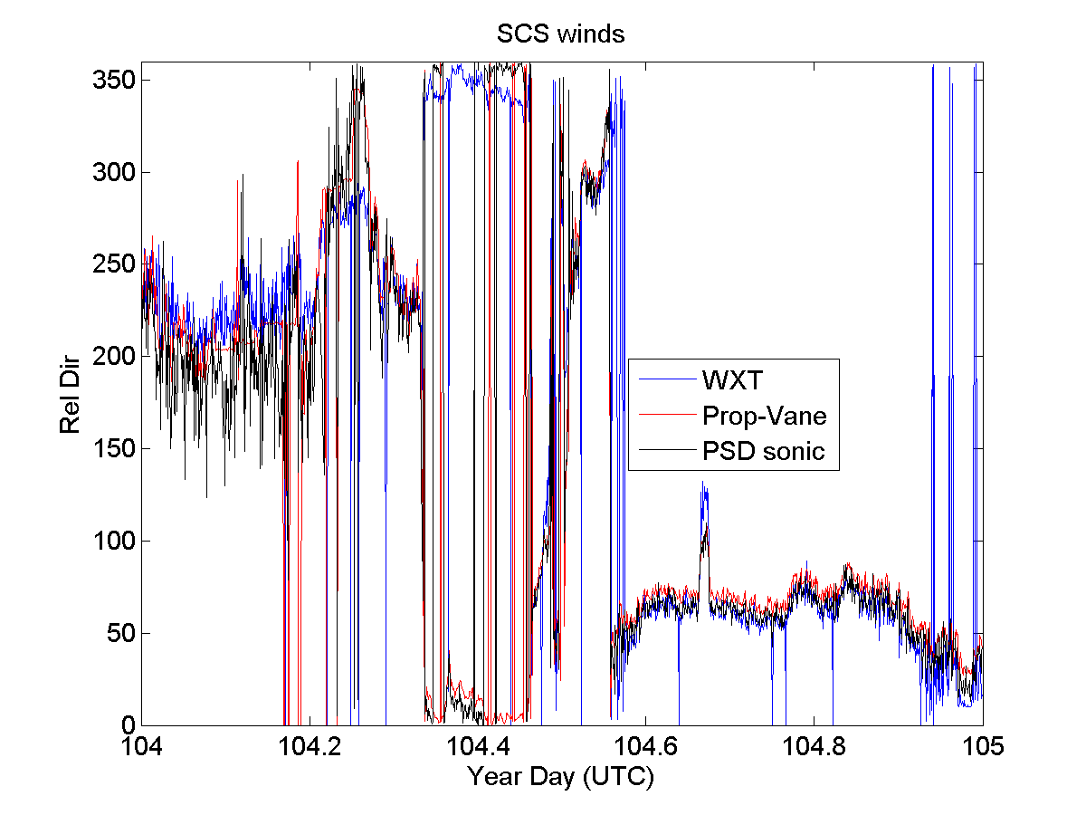
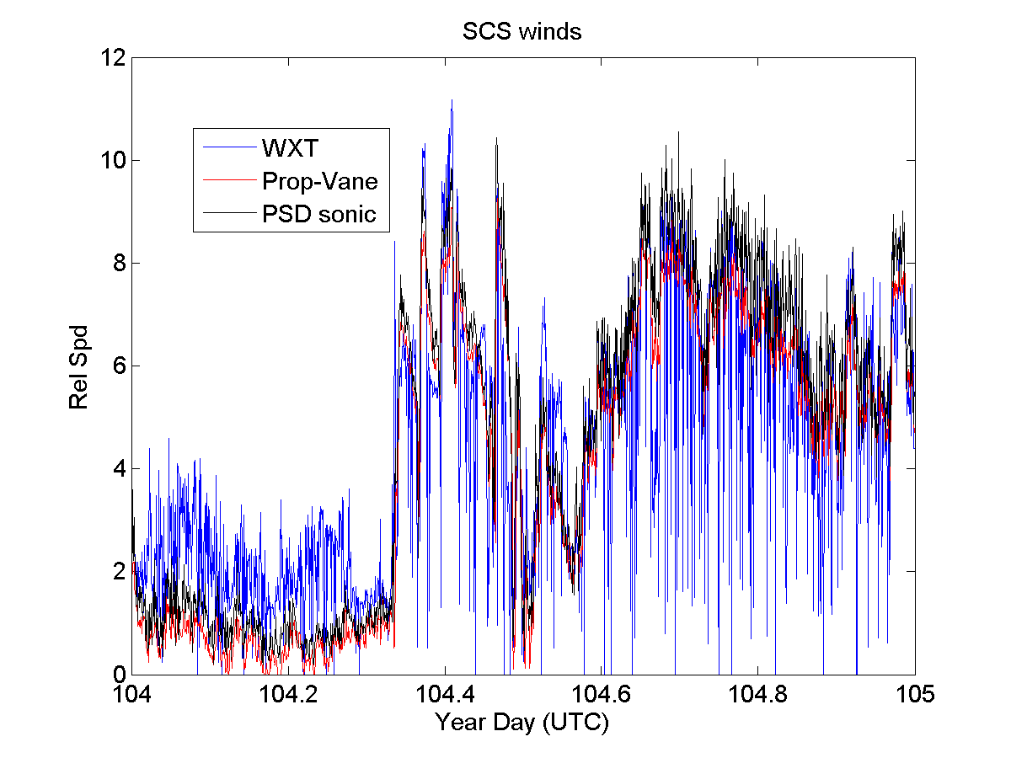
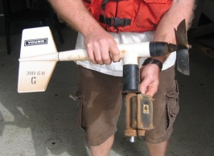
Wind Speed and Direction
Cup/Vane
Notes:
Bulk fluxes are directly proportional to the wind speed.
Wind speed and direction are taken together, partly because they are often both obtained from a single instrument, but also because they are measured relative to the ship and must be combined with the ship’s heading, course, and speed to arrive at the true wind vector…which Shawn will be covering later.
The demands on accuracy of the ship’s velocity are therefore equivalent to those of the anemometer measurement, a fact not always appreciated.
It is thus necessary to record the ship’s navigational data stream together with the meteorological data, and to document whatever information is available on the accuracy of the various components.
The appropriate wind speed to use in bulk flux algorithms is that relative to the ocean surface; i.e., taking account of the surface current.
This introduces another source of uncertainty, because the water velocity at the interface itself is very seldom measured. There are two ways in which conversion from relative to true wind can take some account of the surface velocity: by combining the ship motion in Earth coordinates (e.g., from GPS) with currents from the ship’s ADCP, or by using the Döppler-log/gyro which measures the ship’s motion through the water. Data reports should indicate which method has been used; both incur additional sources of instrumental error, and furthermore the measured currents are at considerable depth (of order 10 m). Fortunately, in many cases current is a small fraction of the wind speed, so its contribution to the error is also small, but in light winds it can be significant.

Slide 10
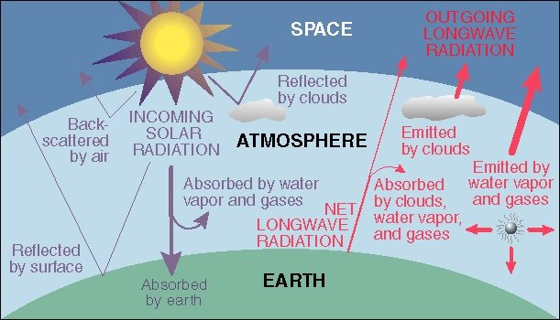
Incoming short-wave and long-wave radiation
Direct/Diffuse
Direct/Diffuse
Notes:
How many of you consider radiation measurements standard, like T/RH and winds?
Besides direct application the net radiative fluxes (R_{s↓}- R_{s↑}) and (R_{l↓}‑ R_{l↑}) are also used in bulk algorithms for models of the oceanic mixed layer temperature profile and to estimate SST. For these reasons they are increasingly being measured routinely aboard ships and moorings.
On a clear day at low and middle latitudes, R_{s↓} is the dominant component of surface heating, peaking in the vicinity of 1000 Wm⁻². Thus, any deterioration in performance of the measuring instrument can lead to significant error in determining the net flux, and the thermal and density structure of the ocean mixed layer. Studies of cloud-radiation interaction, currently in their infancy, will need to distinguish between the direct and diffuse components of R_{s↓}.
Over tropical oceans R_{l↓} is determined largely by very high humidity in the boundary layer, with little diurnal variability or effect from clouds (typically R_{l↓} ~350-400 Wm⁻²); at higher latitudes and under clear skies, R_{l↓} is significantly lower. The warm water of the tropics can emit 450 Wm⁻² of thermal energy, cooler waters of higher latitudes correspondingly less. (R_{l↓}- R_{l↑}) is therefore the difference of two fairly large quantities, and typically of order 50 Wm⁻².

Slide 11
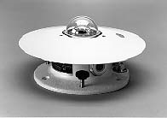
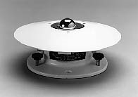
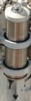
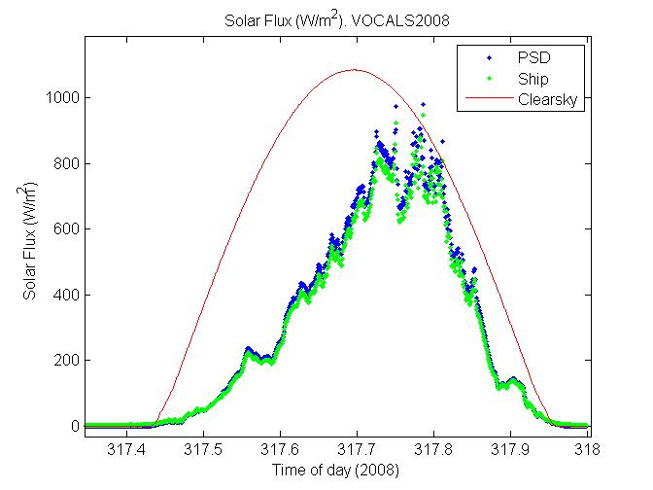
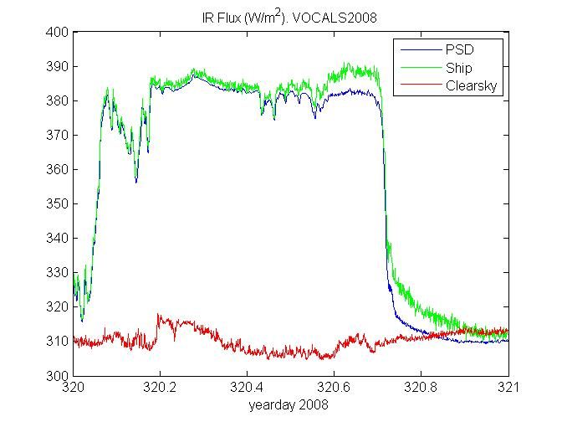
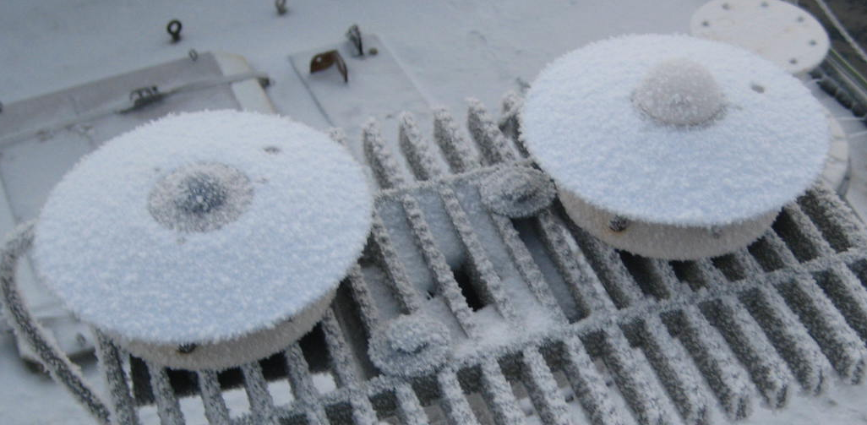

Incoming short-wave and long-wave radiation
SW
LW
Notes:
Pyranometer…..broadband solar irradiance on a planar surface 300 to 2,800 nm Direct and Diffuse
radiation varies with the cosine of the angle of incidence (Stabilized platform?)
Pyrgeometer….. atmospheric infra-red radiation spectrum that extends approximately from 4.5 µm to 100 µm.
Stabilized platform designed to keep radiometers level, but if not working properly can introduce it’s own errors.
Besides bulk calculations use the net radiative fluxes (R_{s↓}- R_{s↑}) and (R_{l↓}‑ R_{l↑}) as do models of the oceanic mixed layer temperature profile and to estimate SST. For these reasons they are increasingly being measured routinely aboard ships and moorings.

Slide 12



Direct Diffuse
Pyroheliometer
Rotating Shadowband
PHOTOSYNTHETICALLY ACTIVE RADIATION (PAR)
Notes:
Pyroheliometer measures direct incoming SW radiation and requires tracking the sun
Rotating Shadowbanding….. Measures diffuse (reflected) SW radiation. Normally is tracking the sun, but “Rotating band” allows for a pitching and rolling ship
PHOTOSYNTHETICALLY ACTIVE RADIATION (PAR) measurements cover the spectra band that photosynthetic organisms are sensitive to and used to calculate the euphotic depth in the ocean.

Slide 13



Rainfall
(direct)
Siphon
Hasse et al., 1998
Notes:
Direct measure accumulation
Rainfall, particularly during convective storms, is perhaps the “patchiest” of all meteorological variables. Single point measurements from ships and buoys are generally less relevant for climate models than area-averaged values or spatial characteristics. Nevertheless, accurate point measurements over the ocean are invaluable for validating satellites and radar which do obtain spatial rainfall patterns, but must be calibrated against ground truth. Currently such validation is mostly obtained from rain-gauges located on islands and atolls, which have been found to distort the rainfall field.
The main problem is error due to wind flow distortion that can lead to under-estimation depending on the location of the gauge.
The problem has been studied, using an array of gauges distributed around the ship, and correction schemes devised which can improve the accuracy of rain measurement, to within 10-15%, as shown in Figure 2.3. Operationally, it is important to ensure the rain gage is well exposed and near the location where relative wind speed and direction are recorded. A well-positioned gauge adjacent to a wind instrument is better than several gauges scattered around the ship. The range of rainrates observed, from drizzle registering less than 1 mmhr⁻¹ to tropical storms producing 200 mmh⁻¹ (often accompanied by strong winds) also presents challenges for rain-gauge design (see section 3.8).
The net air-sea heat flux, includes a component of sensible heat from rainfall. Warm rain in Hawaii and the cold drops felt from mid-west storms even in the middle of summer.
Over extended periods, the contribution is small, but during heavy storms it can be several hundred Wm⁻²

Slide 14


Rainfall
(Indirect)
Disdrometer
Optical
Rain rate
Rain accumulation
Notes:
InDirect
Disdrometer is an instrument used to measure the drop size distribution and velocity of falling hydrometeors. Some disdrometers can distinguish between rain, graupel, and hail.
Optical sensors: Falling rain causes beam intensity variations in the infrared light as the rain passes through the beam. These irregularities, known as scintillation, have characteristic patterns, which are detected by the sensor and converted to rain rate.
WXT uses intensity of impact to compute volume and then rain rate.

Slide 15
Rainfall measuring instruments used aboard ships and moorings
Siphon rain-gauge
+ Volumetric – direct calibration
- Distorts wind flow
- Funnel can clog with debris or guano
- Misses catch when siphoning
- Evaporation loss at low rain-rates
- Affected by ship motion
Optical rain-gauge (ORG)
+ Open path, less wind distortion
+ Sensitive to low rain-rates
- Requires calibration
- Uncertain directional response
Notes:
Pros and Cons

Slide 16






Atmospheric pressure
Quad-Disk Pressure Port
minimizes dynamic pressure errors due to wind
Static Pressure Head
Notes:
Pressure is one of the state variables which define the thermodynamic properties of the atmosphere.
In boundary layer and climate studies, pressure most commonly appears in the calculation of dry and moist air density (needed for air-sea flux calculation), and in humidity conversions; it also appears in the psychrometer equation.
Most weather stations house their barometric pressure sensor within the weather station display console. Therefore, placement of the weather station console receiver is an important consideration since the physical environment of the console will influence air pressure measurement readings. If possible, install the console at an indoor location where the temperature is as constant as practical, i.e. not affected by home heating, drafts, or the sun. Because the pressure is the weight of the atmosphere above the sensor, the pressure port is the true height of the pressure sensor.
Rule of thumb is that 1 mb = 10 m change in altitude
Bernouli Effect: Increased velocity = decreased pressure
Two objects hanging .. increasing flow between them they will
Come together

Slide 17






Sea surface temperature
Sea Chest
Hull
Notes:
Historically, sea surface temperature was understood to be the temperature measured from a ship by whatever means available, and reported as SST irrespective of the depth of measurement. We now know that temperature in the ocean surface layer can vary with depth by an amount that is significant in the context of accurate bulk flux determination. It is the temperature of the sea-air interface itself that physically determines the magnitude of the turbulent heat fluxes and also the outward flux of longwave radiation. At the same time, these fluxes produce a cooling at the interface, the so-called “cool skin” of order 1 mm thick and typically a few tenths of °C.
In moderate to strong winds the water below the skin will be well mixed, and its “bulk” temperature will vary little in the vertical. During the day, however, penetration and absorption of solar radiation can produce a diurnal warm layer below the cool skin. Under clear skies and with light winds, as found in tropical oceans, this layer may be a few °C higher than in the bulk below. “Sea surface temperature” may thus vary with depth, as shown in Figure 2.2, and for the purposes of flux calculation, the temperature value should always be accompanied by the depth at which it was measured (e.g., SST_{(d)} = 18.3º_{(4.5 m)}). As indicated in section 3.6, this depth can be ambiguous. The characteristics of the ocean surface mixed layer are discussed in Price et al. (1986), and the physics of the cool skin and diurnal warm layer is given in Fairall et al. (1996a).
Traditional bulk transfer coefficients have usually been determined using a bulk sea temperature. However, newer algorithms use transfer coefficients determined with respect to the interface value. The true interface temperature cannot be measured with present technology, but the measurement of an infrared radiometer (at a few μm depth) comes close; and is sometimes available from shipboard or satellite sensors. Also, models of both the cool skin and diurnal warm layer, which enable skin temperature to be estimated from a bulk measurement at known depth, are becoming more reliable.
The TOGA program specified an accuracy of ±0.3ºC for SST over a 2 x 2 degree region as a target for validation of space-borne radiometers (WCRP 1985). An error of 0.3ºC changes sensible and latent heat fluxes calculated with a bulk flux algorithm by 2 Wm⁻² and 10 Wm⁻² respectively, for typical climatic conditions in the tropics. The past decade has seen the development of several high-resolution infrared radiometers for shipboard deployment that achieve 0.1ºC accuracy.

Slide 18


Sea surface temperature
(IR)
Notes:
Renewed interested in remote IR and Microwave sensors
Indirect and Remote

Slide 19


Heading, SOG, COG
Notes:
Heading
The direction in which a vehicle is moving. For air and sea operations, this may differ from actual Course Over Ground (COG) due to winds, currents, etc.
Course Over Ground (COG)
Your direction of movement relative to a ground position.
Speed Over Ground (SOG)
The actual speed the ship is moving over the ground. This may differ from nautical speed due to such things as head winds or sea conditions.
Many scientists bring their own GPS units.

Slide 20

Heading vs Relative wind
HEALY 2008
Notes:
A simple rule of thumb is that you should see changes in the relative winds (speed and dir) correlated to changes the ship’s course or speed.
In general you should not see these types of changes if the True wind calculations are correct. One may see blocking or flow distortion of the instrument as the ship maneuvers. Real changes in the wind may coincide with ship maneuvers adding confusion if you are looking for problems.
Once a True wind calculations have been confirmed as good, there should not be any further need to worry unless you switch sensor types.

Slide 21

Ship Motion
Notes:
These are in addition to the heading, COG, and SOG.
Need to know exactly what is being measured.
Accelerations in the w (yaw), x (roll), y (pitch)
These are normally accelerometers
Pitch: angular motion about the ships transverse axis.
Roll: angular motion about the ships longitudinal axis.
Yaw: angular motion in the horizontal plane containing the projection of the longitudinal axis, about
the mean course.
Surge: fore and aft movement of the C.G. of the ship after subtracting mean speed.
Sway: transverse movement of the C.G. of the ship measured in the horizontal plane.
Heave: vertical movement of the C.G. of the ship.

Slide 22
TIME
Reference (UTC)
Synchronized (GPS)
between systems when necessary

Slide 23
Hosom, D. S., R. A. Weller, R. E. Payne and K. E. Prada. The IMET (improved meteorology) ship and buoy systems. Journal of Atmospheric and Oceanic Technology 12:527-540. June 1995
Colbo, K., and R. A. Weller. The accuracy of the IMET sensor package. Journal of Atmospheric and Oceanic Technology, 26:1867-1890. September 2009
Bradley, E. F. and Fairall, C. W.: A guide to making climate quality meteorological and flux measurements at sea. NOAA Technical Memorandum OAR PSD-311. Earth System Research Laboratory, Physical Sciences Division, Boulder, Colorado. October 2006.

Slide 24
Hands on with instruments and DAS
We have the following instruments available (in addition to a Campbell Scientific logger, PC, etc)
R.M. Young wind monitor
Gill 2-D windsonic
Vaisala T/RH (HMP45 and HMP50)
Vaisala WXT (all in one weather station)
Pressure sensor
20-30 mins

Slide 25
End
Lesson 2

