Slide 1
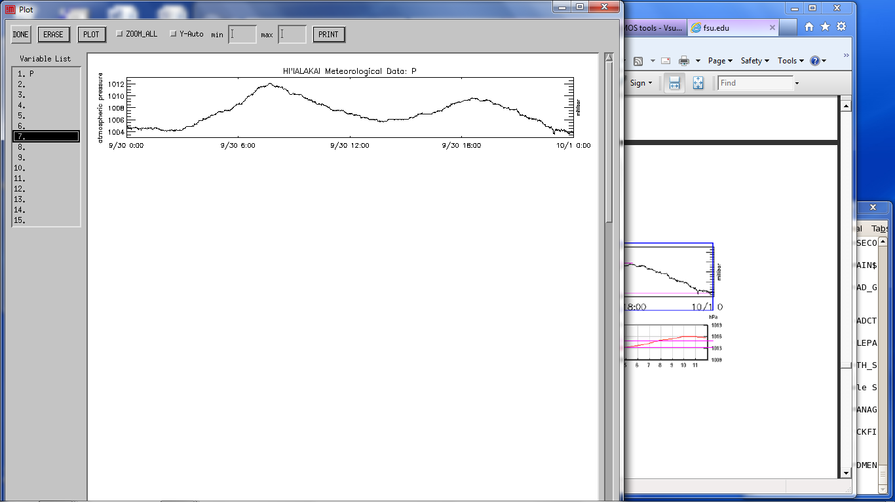
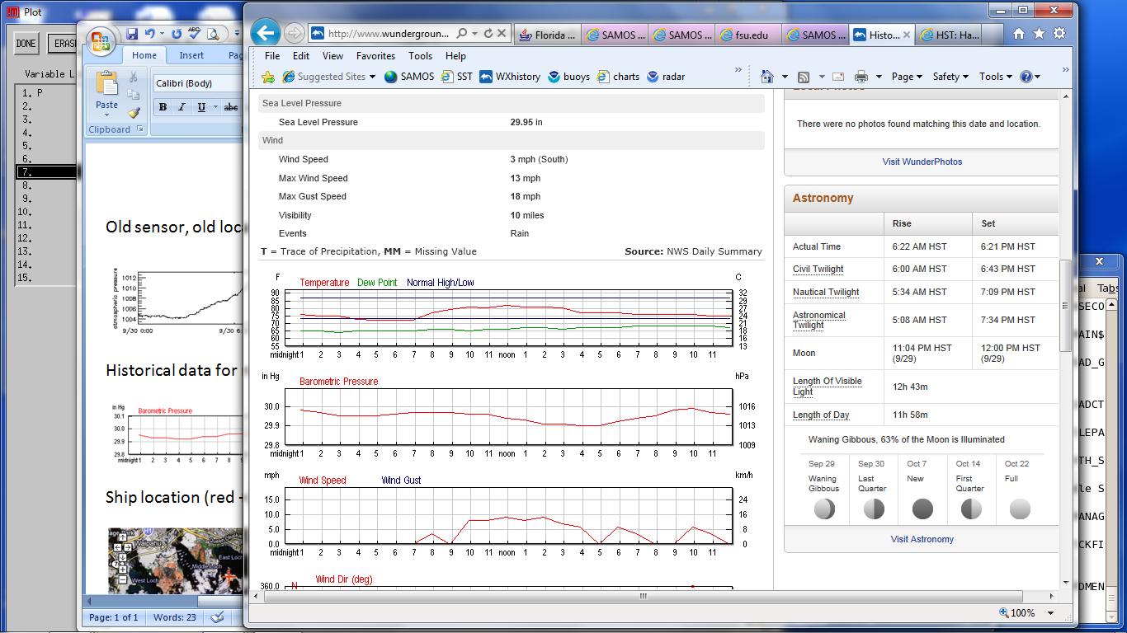
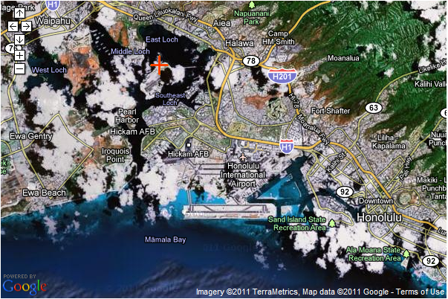
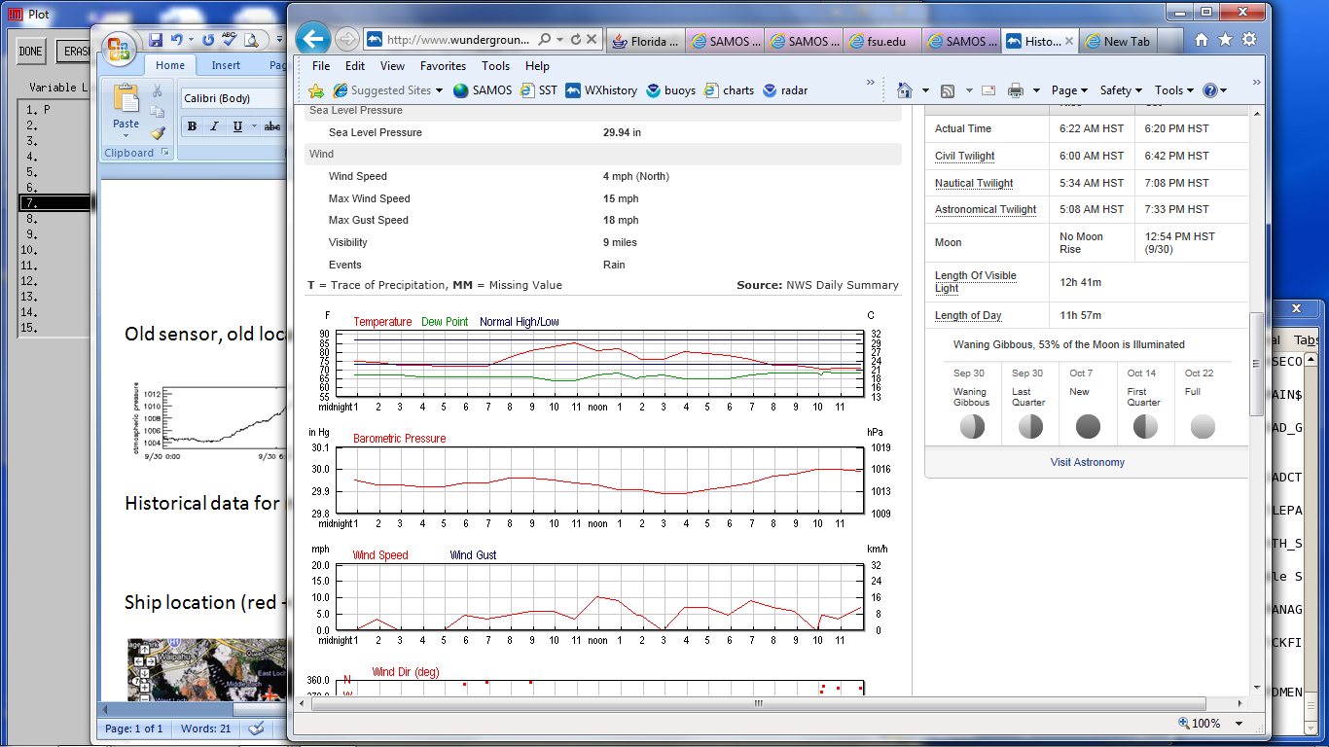
Vessel Pressure
Honolulu
Notes:
Facilitator Notes:
TOP: Old sensor, old location aft of satellite antenna mast near rear of superstructure (bad data; 9/30/2010)
MIDDLE LEFT: Historical data (top 9/29/10, bottom 9/30/10) for nearby Honolulu International Airport (UTC – 10)
MIDDLE RIGHT: Ship location (red +) relative to Honolulu International
Delta P ~ 7 mb (12 UTC, Vessel at 1007 mb, 2 am local Honolulu at 1014 mb)

Slide 2
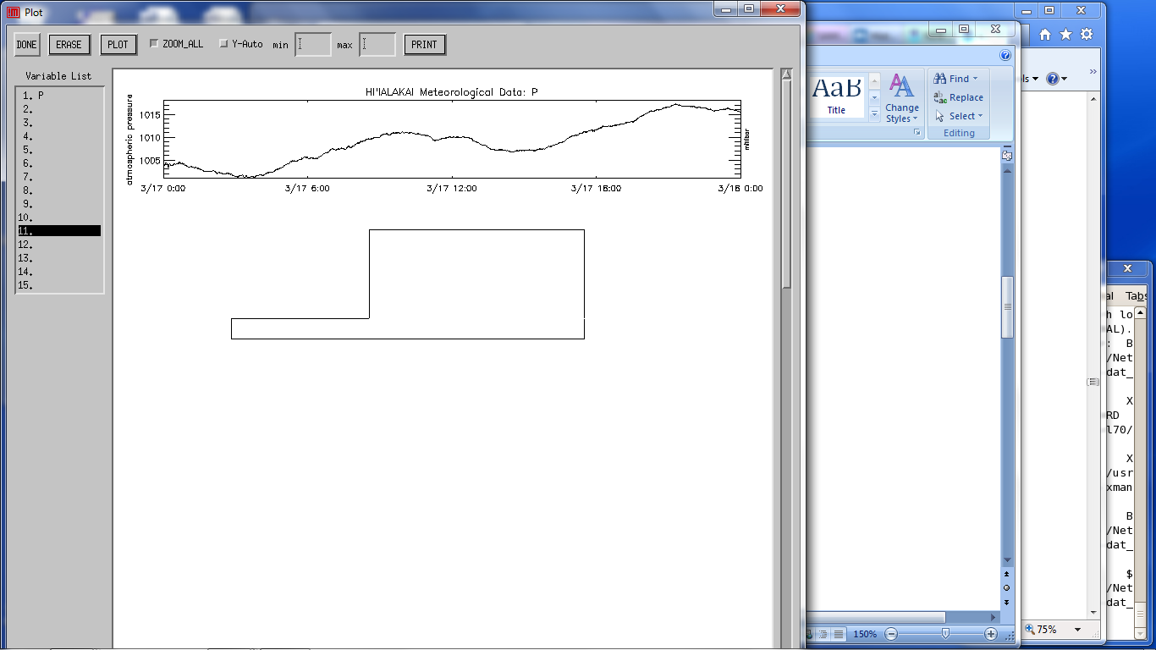
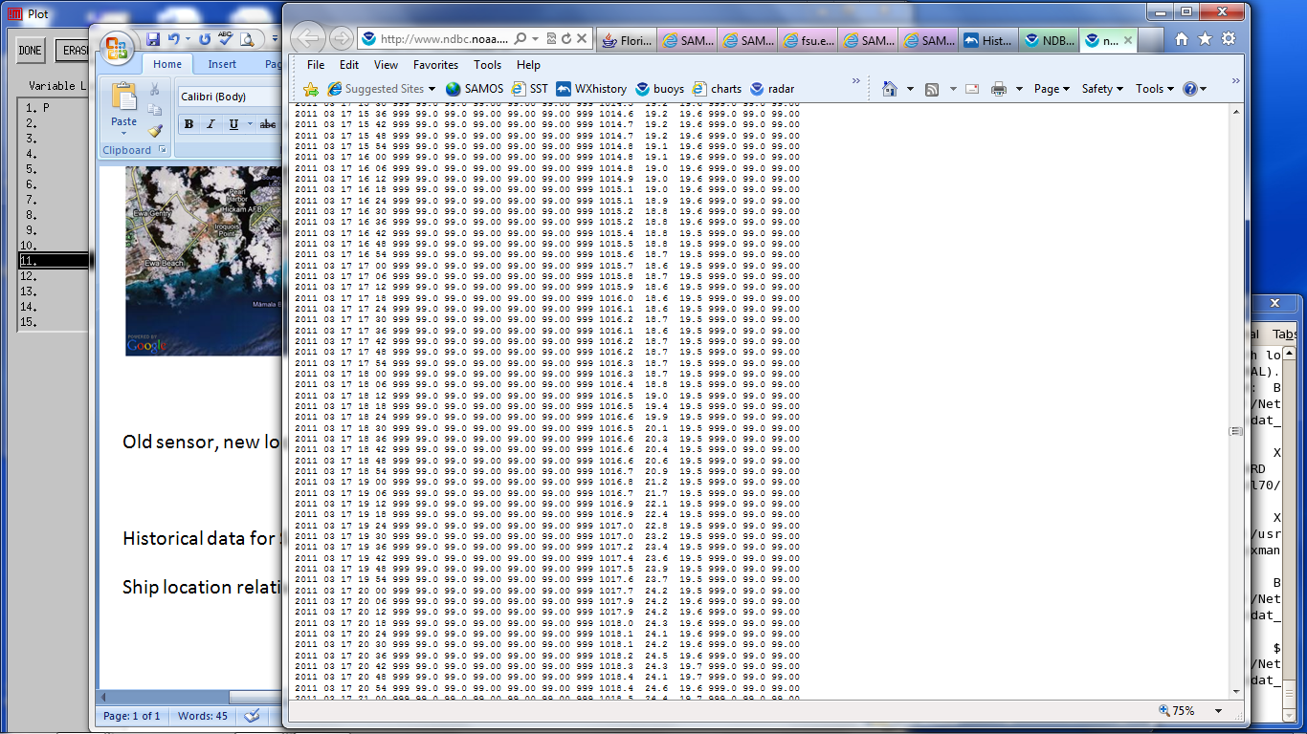
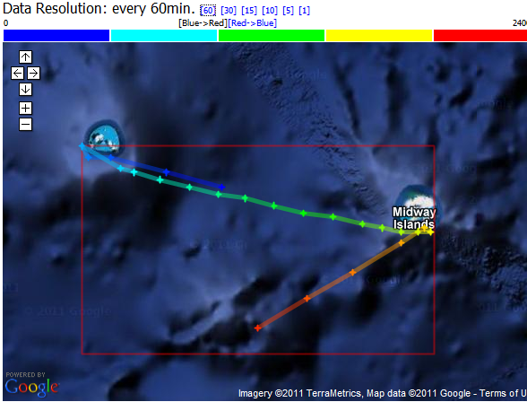
Vessel Pressure
Midway Island Mooring
Notes:
Facilitator Notes:
TOP: Old sensor, new location on Flying Bridge (much farther forward on superstructure; improved data; 3/17/2010)
MIDDLE: Historical data for Sand Island, Midway Islands (date/time columns 1-5, pressure column 13)
BOTTOM: Ship location relative to Sand Island
Delta P ~ 3 mb (Ship = 1013 mb, Island = 1016.8 at ~1900 UTC)

Slide 3
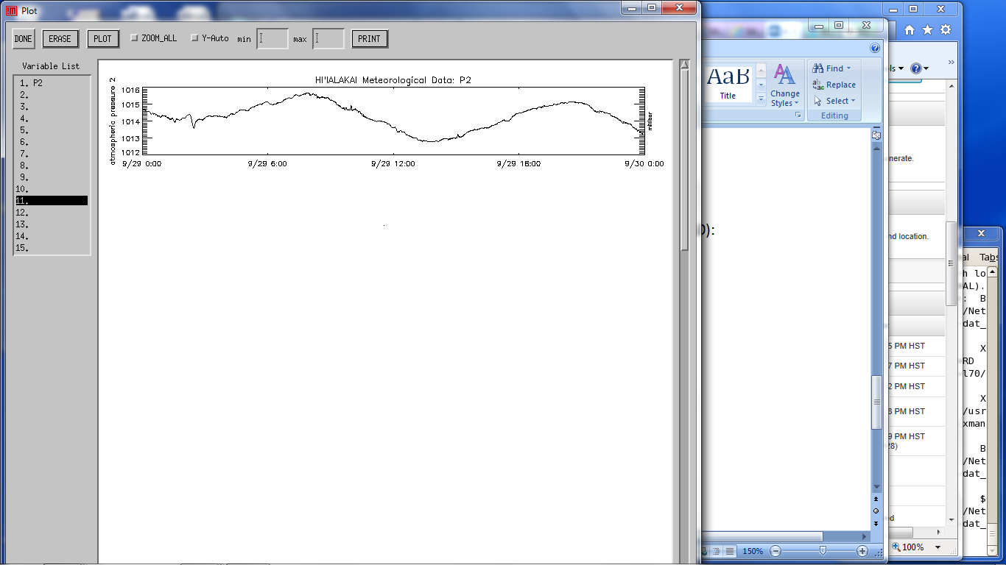
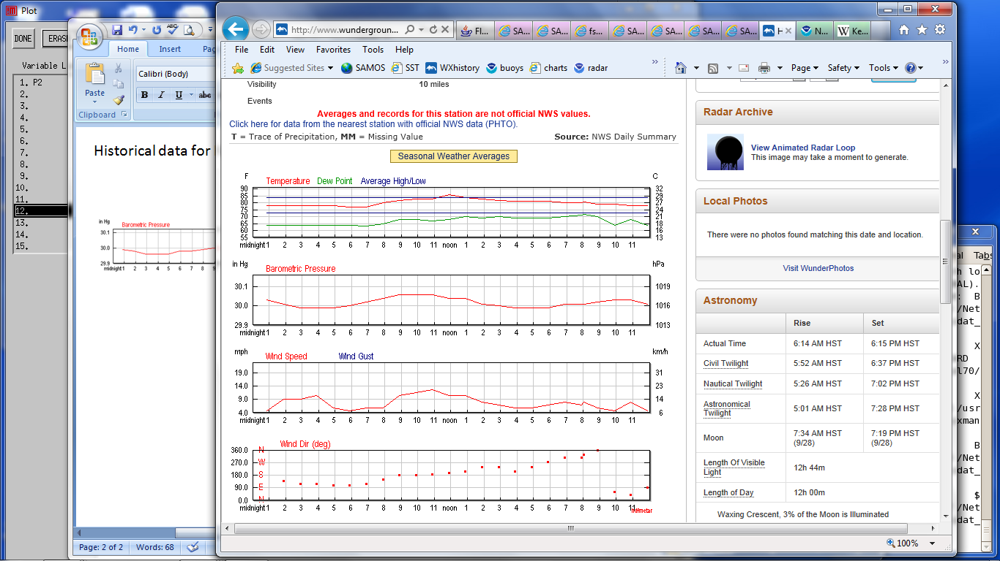
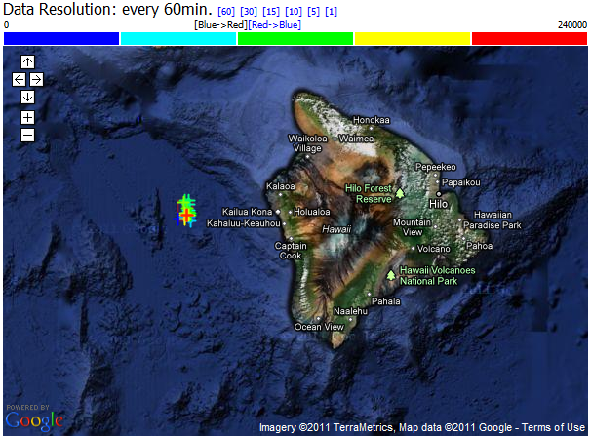
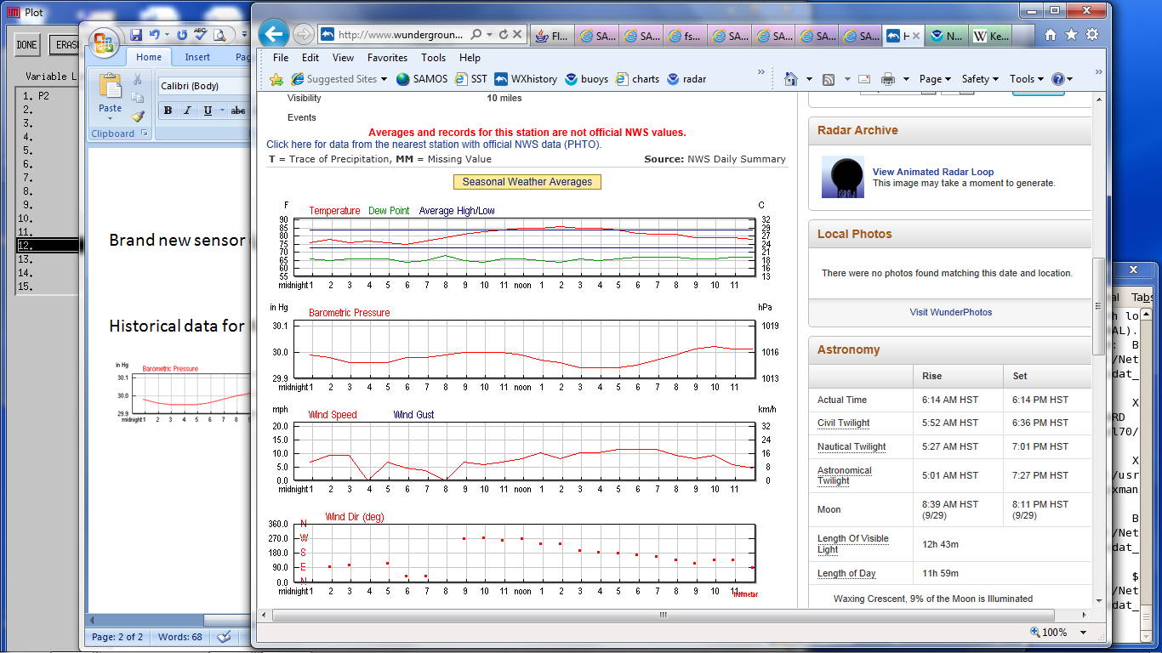
Vessel Pressure
Kona Airport
Notes:
Facilitator Notes:
Prompt: Given sensors that are working correctly at both locations, what might contribute to differences between pressure measurements made at ship and shore locations?
Answer: station height, conversion of pressure to sea level
TOP: Brand new secondary pressure sensor on bridge wing (good data; 9/29/2011)
MIDDLE: Historical data (top 9/28/11, bottom 9/29/11) for nearby Kona International Airport (UTC -10)
BOTTOM: Ship location relative to Kona International (westernmost point of the island, red star)
Delta P ~ 1 mb (12 UTC, Vessel at 1014 mb, 2 am local Kona at 1015 mb)

